Slide 1

9896.HK
MINISO
LIFE IS FOR FUN
April 17th, 2025
Group 3: Kai Ren, Gary Li, Rui Hu, Yang Lan, YiMing Jiang, WeiJie Zhang

Slide 2
CONTENTS & Framework
Was MINISO's IPO a Good or Bad deal ?
Company Analysis
Industry
Business
Finance
3
IPO Overview
Issue Shares
Issue Price
Raise Money
Valuation
Fundamental
Relative
2
4
MINISO Profile
Description
Development Path
Extension
Quantitative trading strategy
1
5

Slide 3
01
MINISO
PROFILE

Slide 4
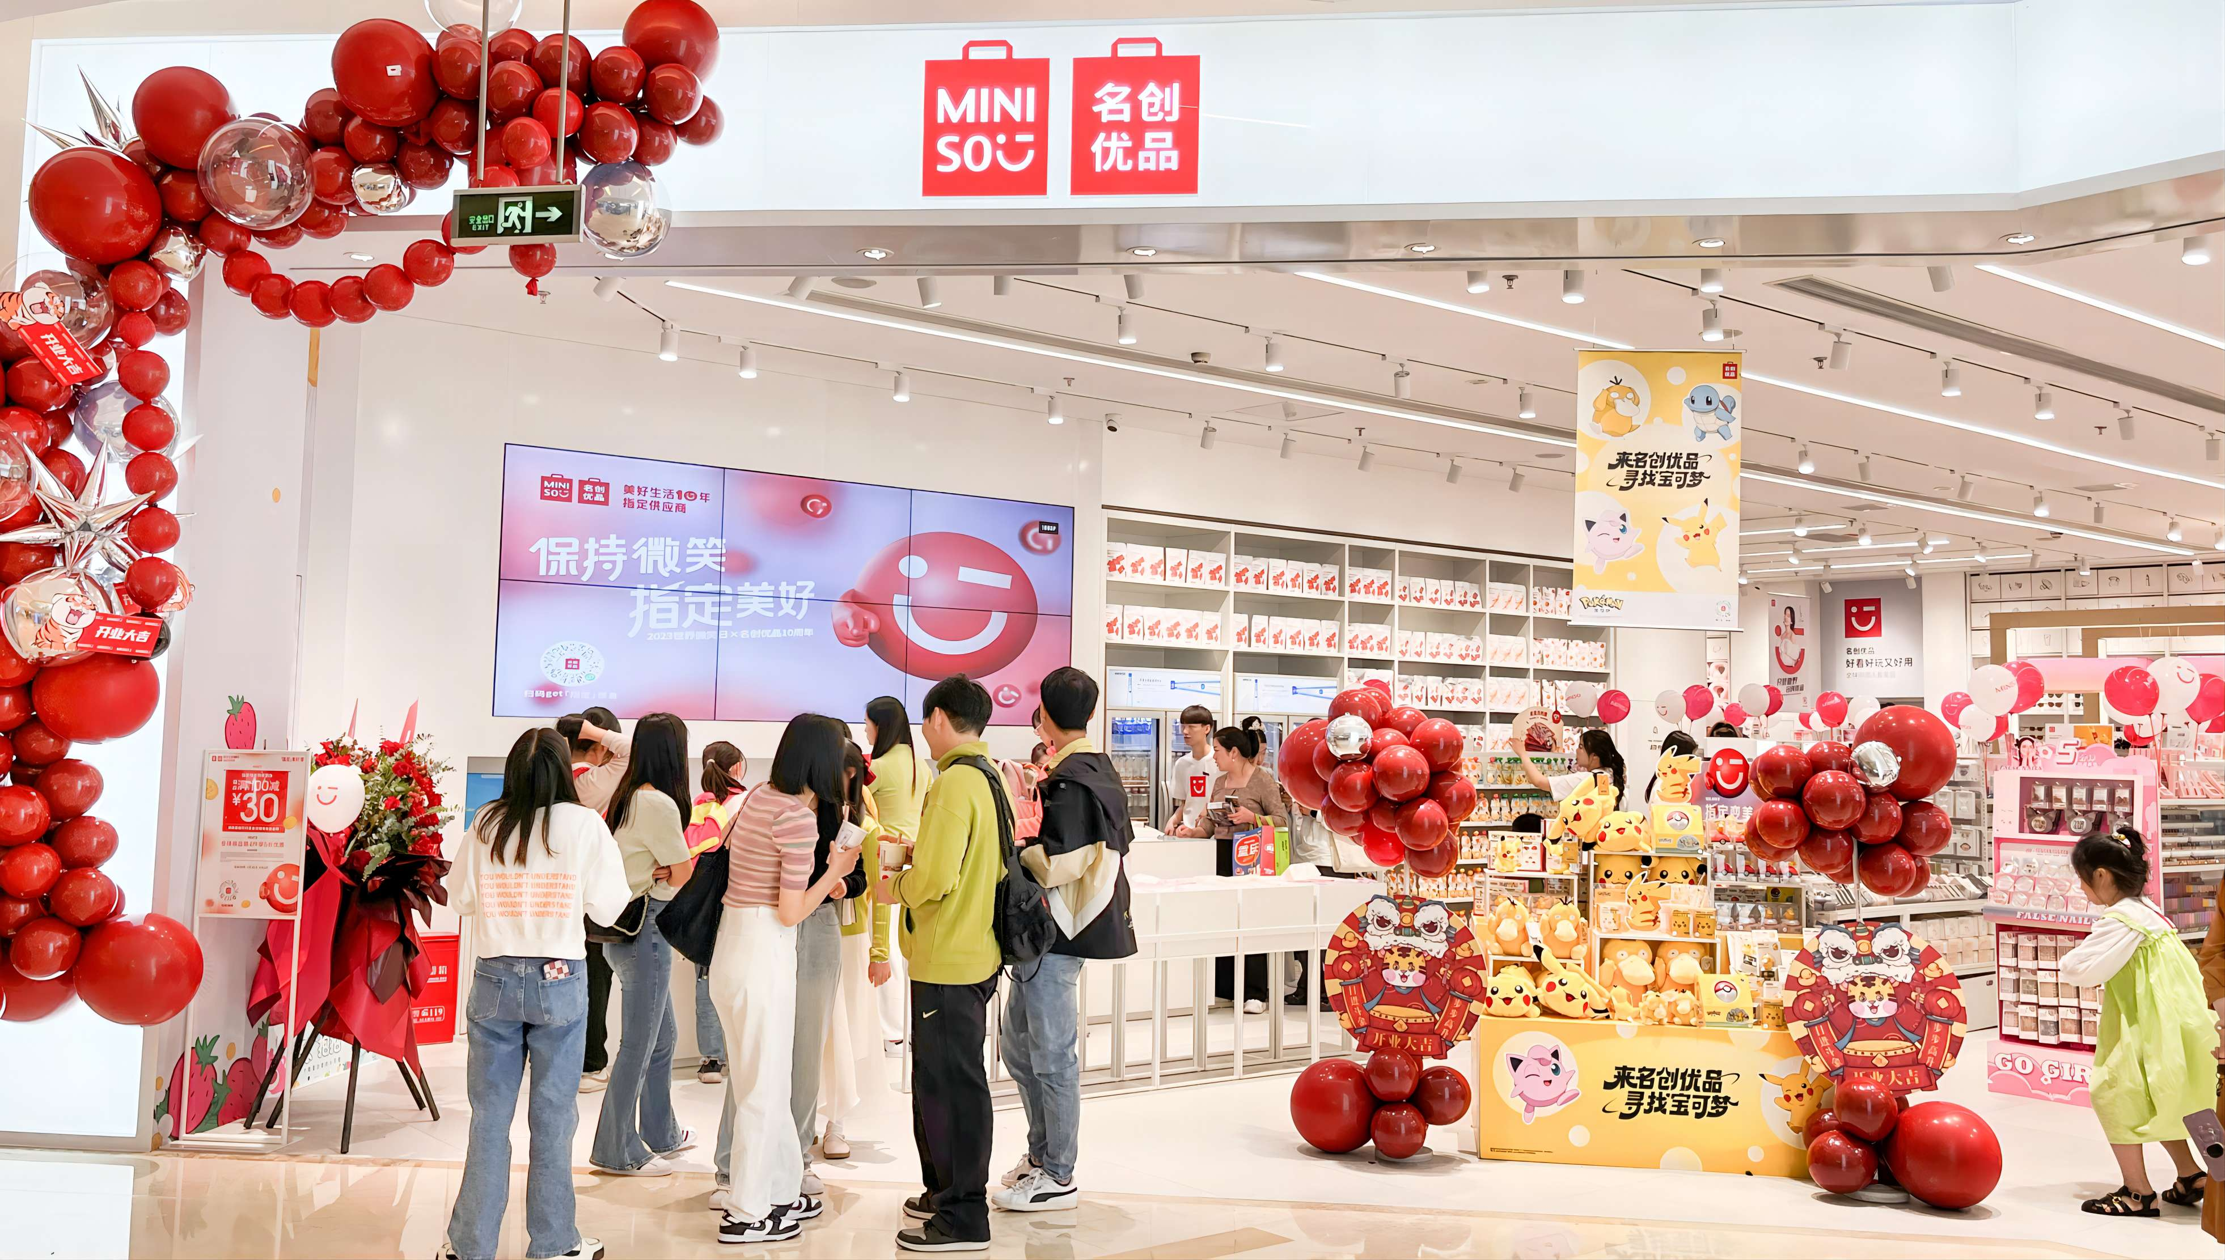
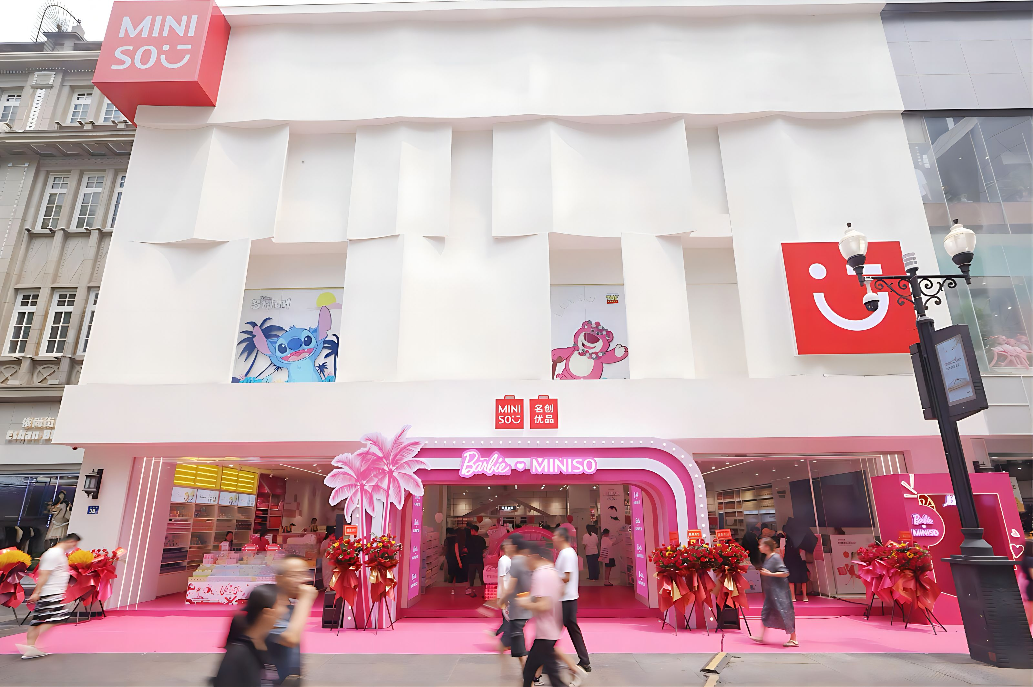
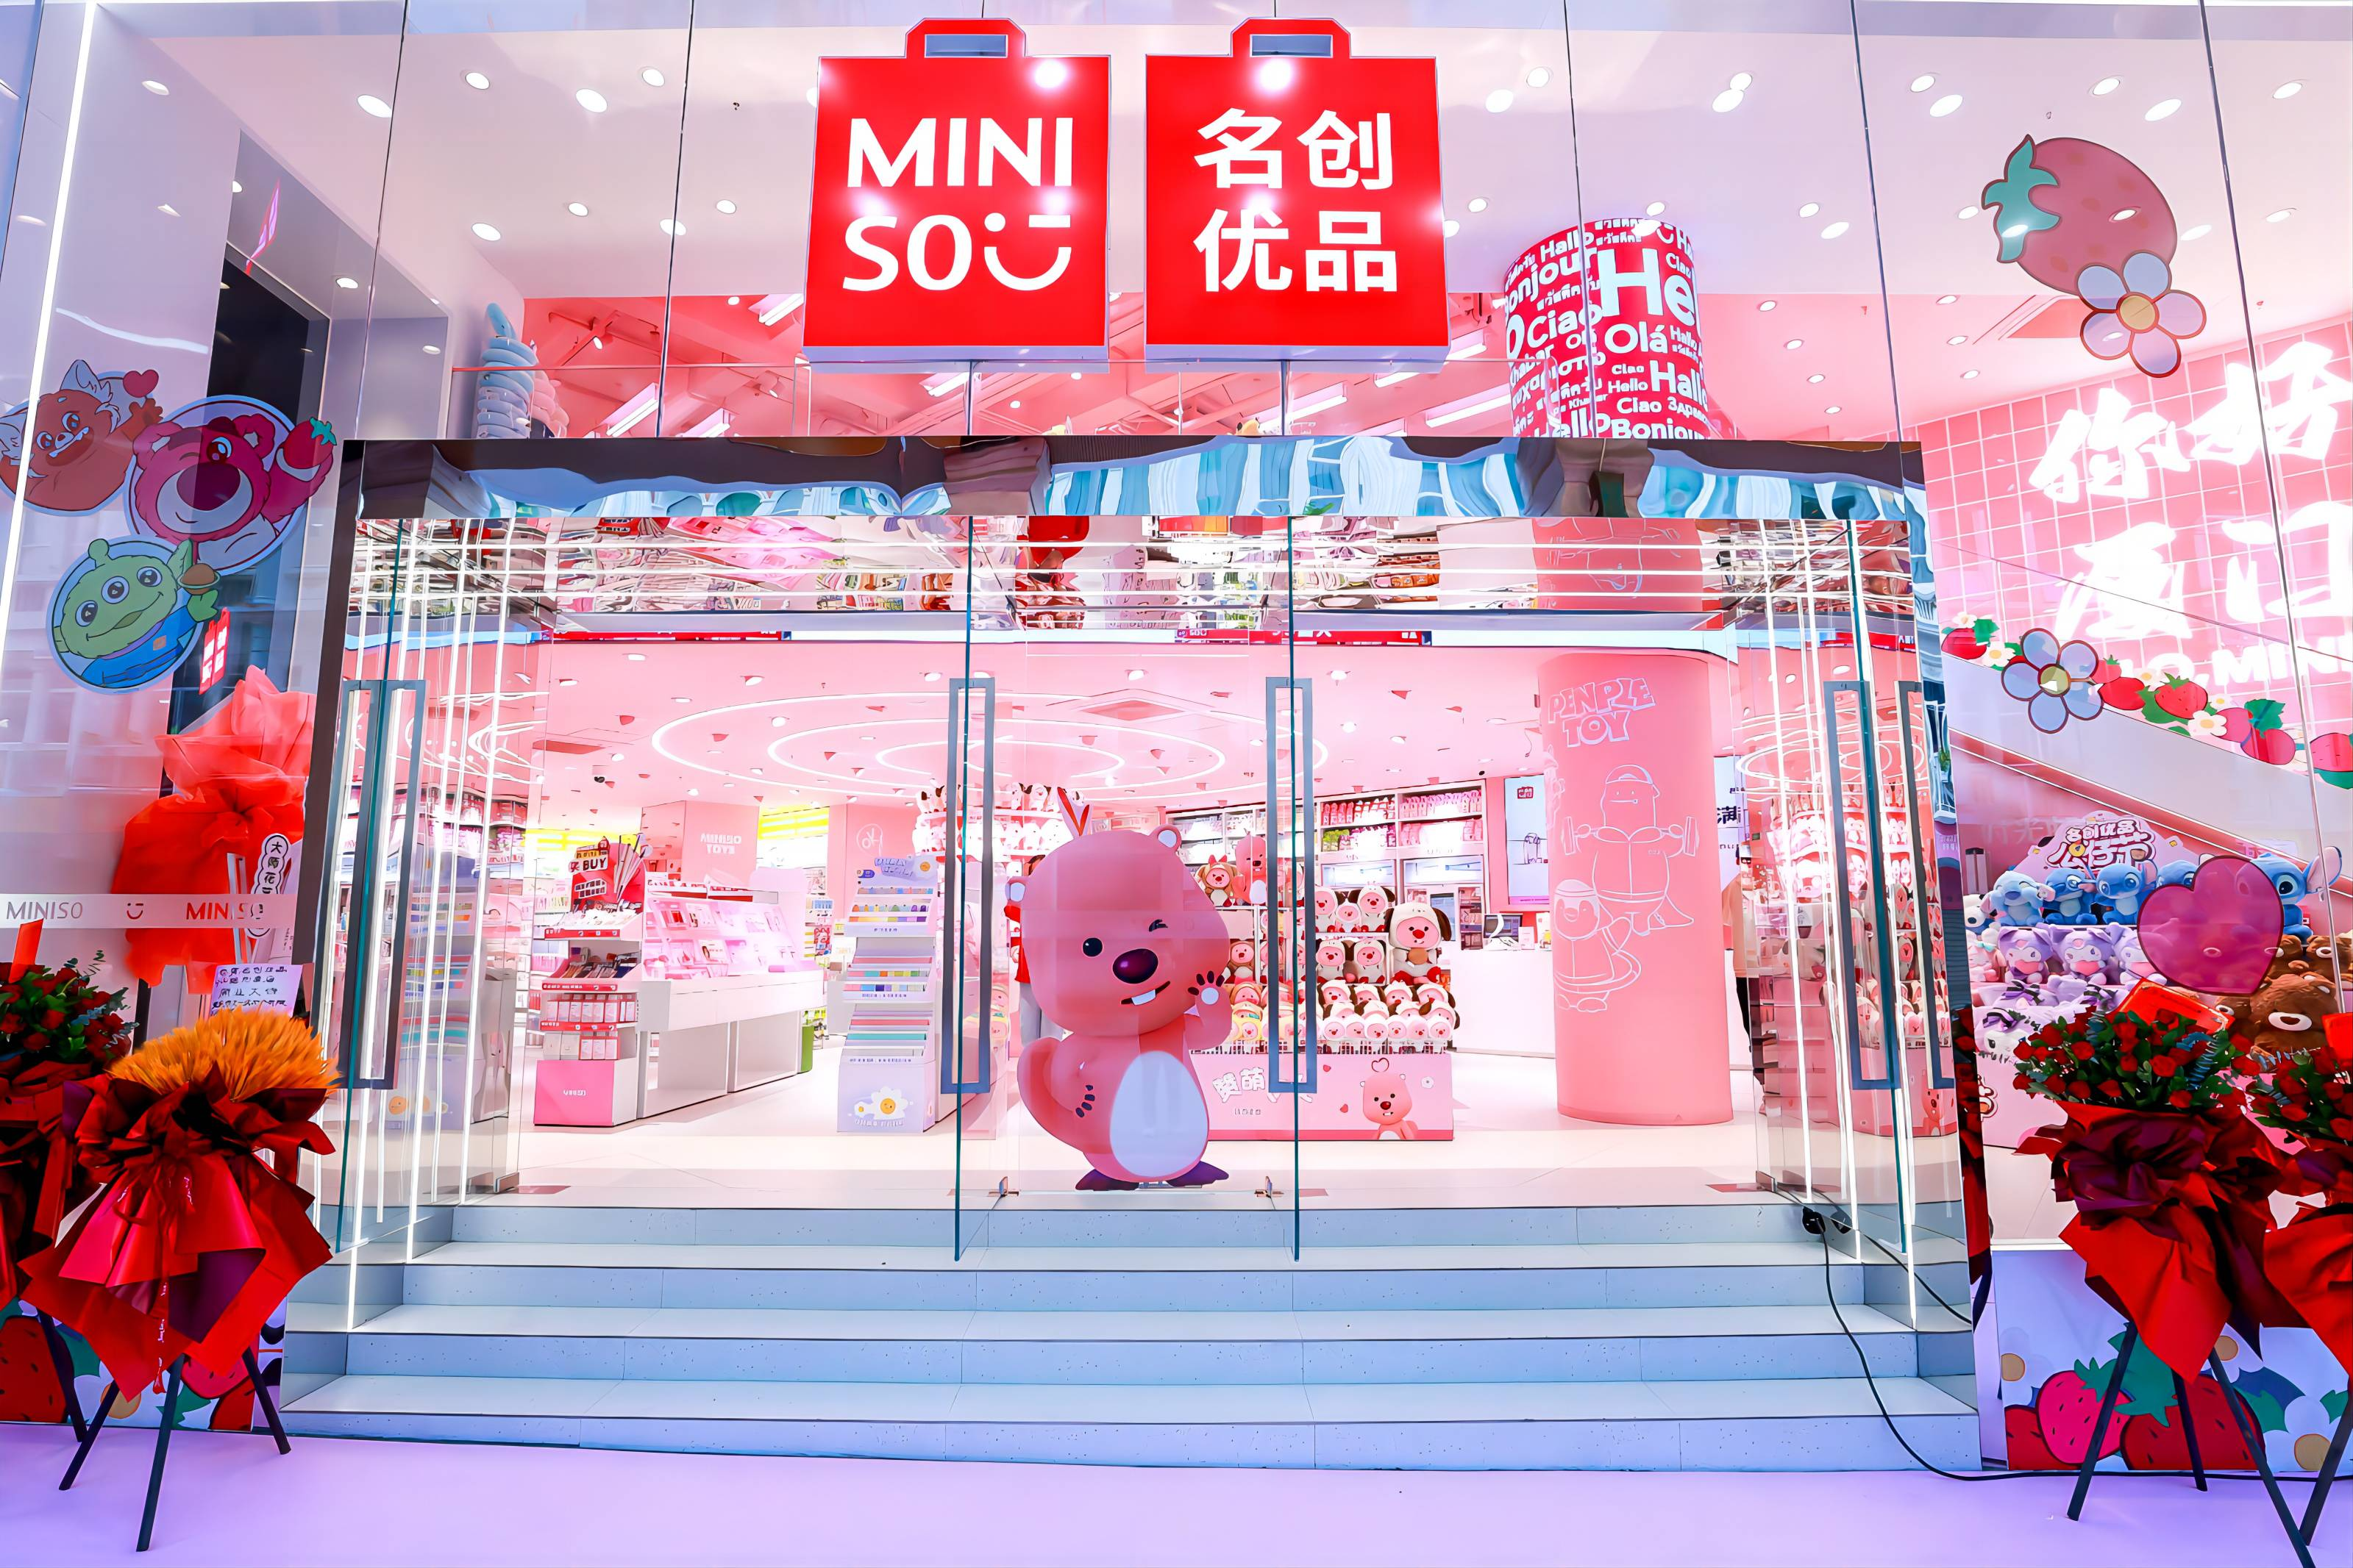
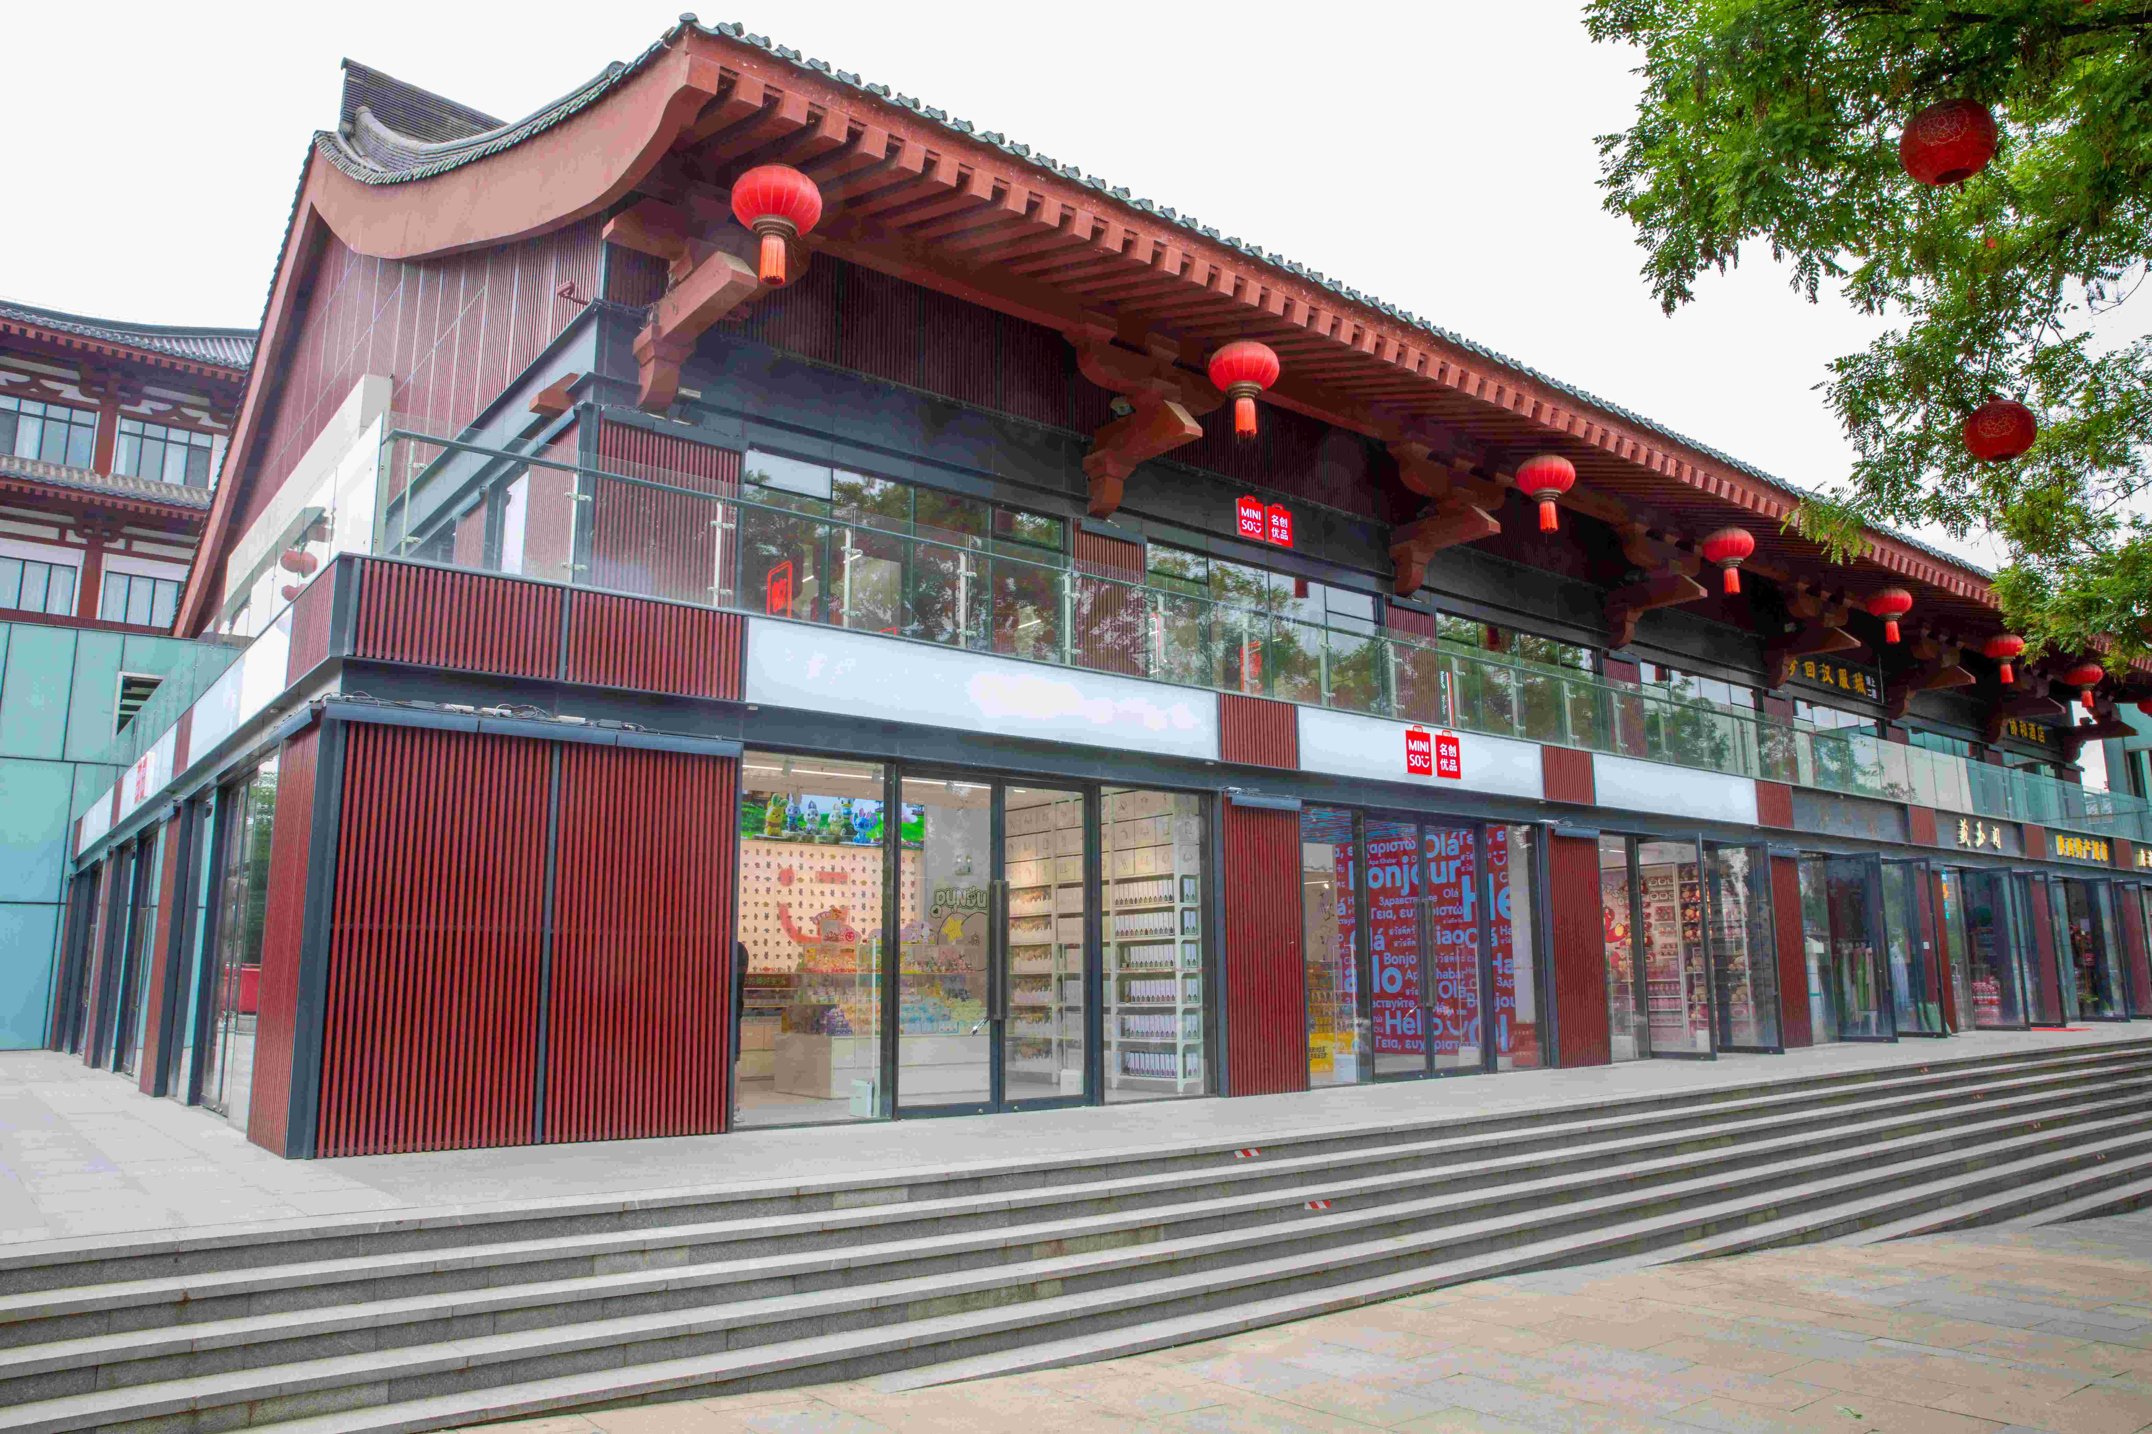
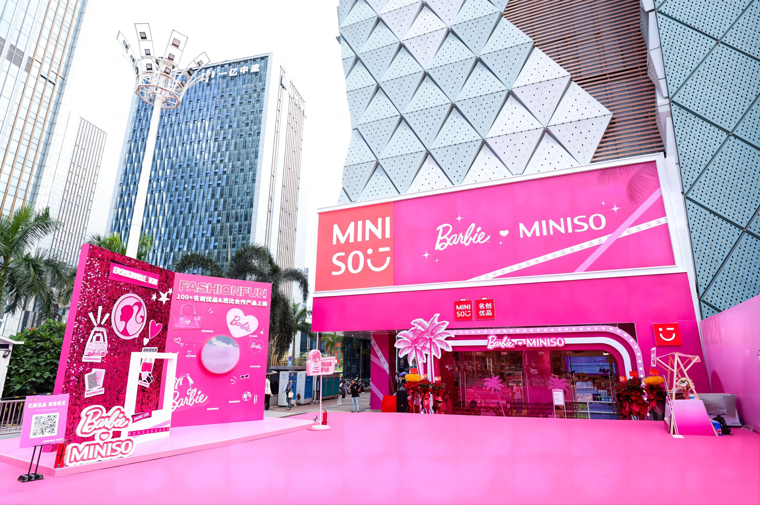
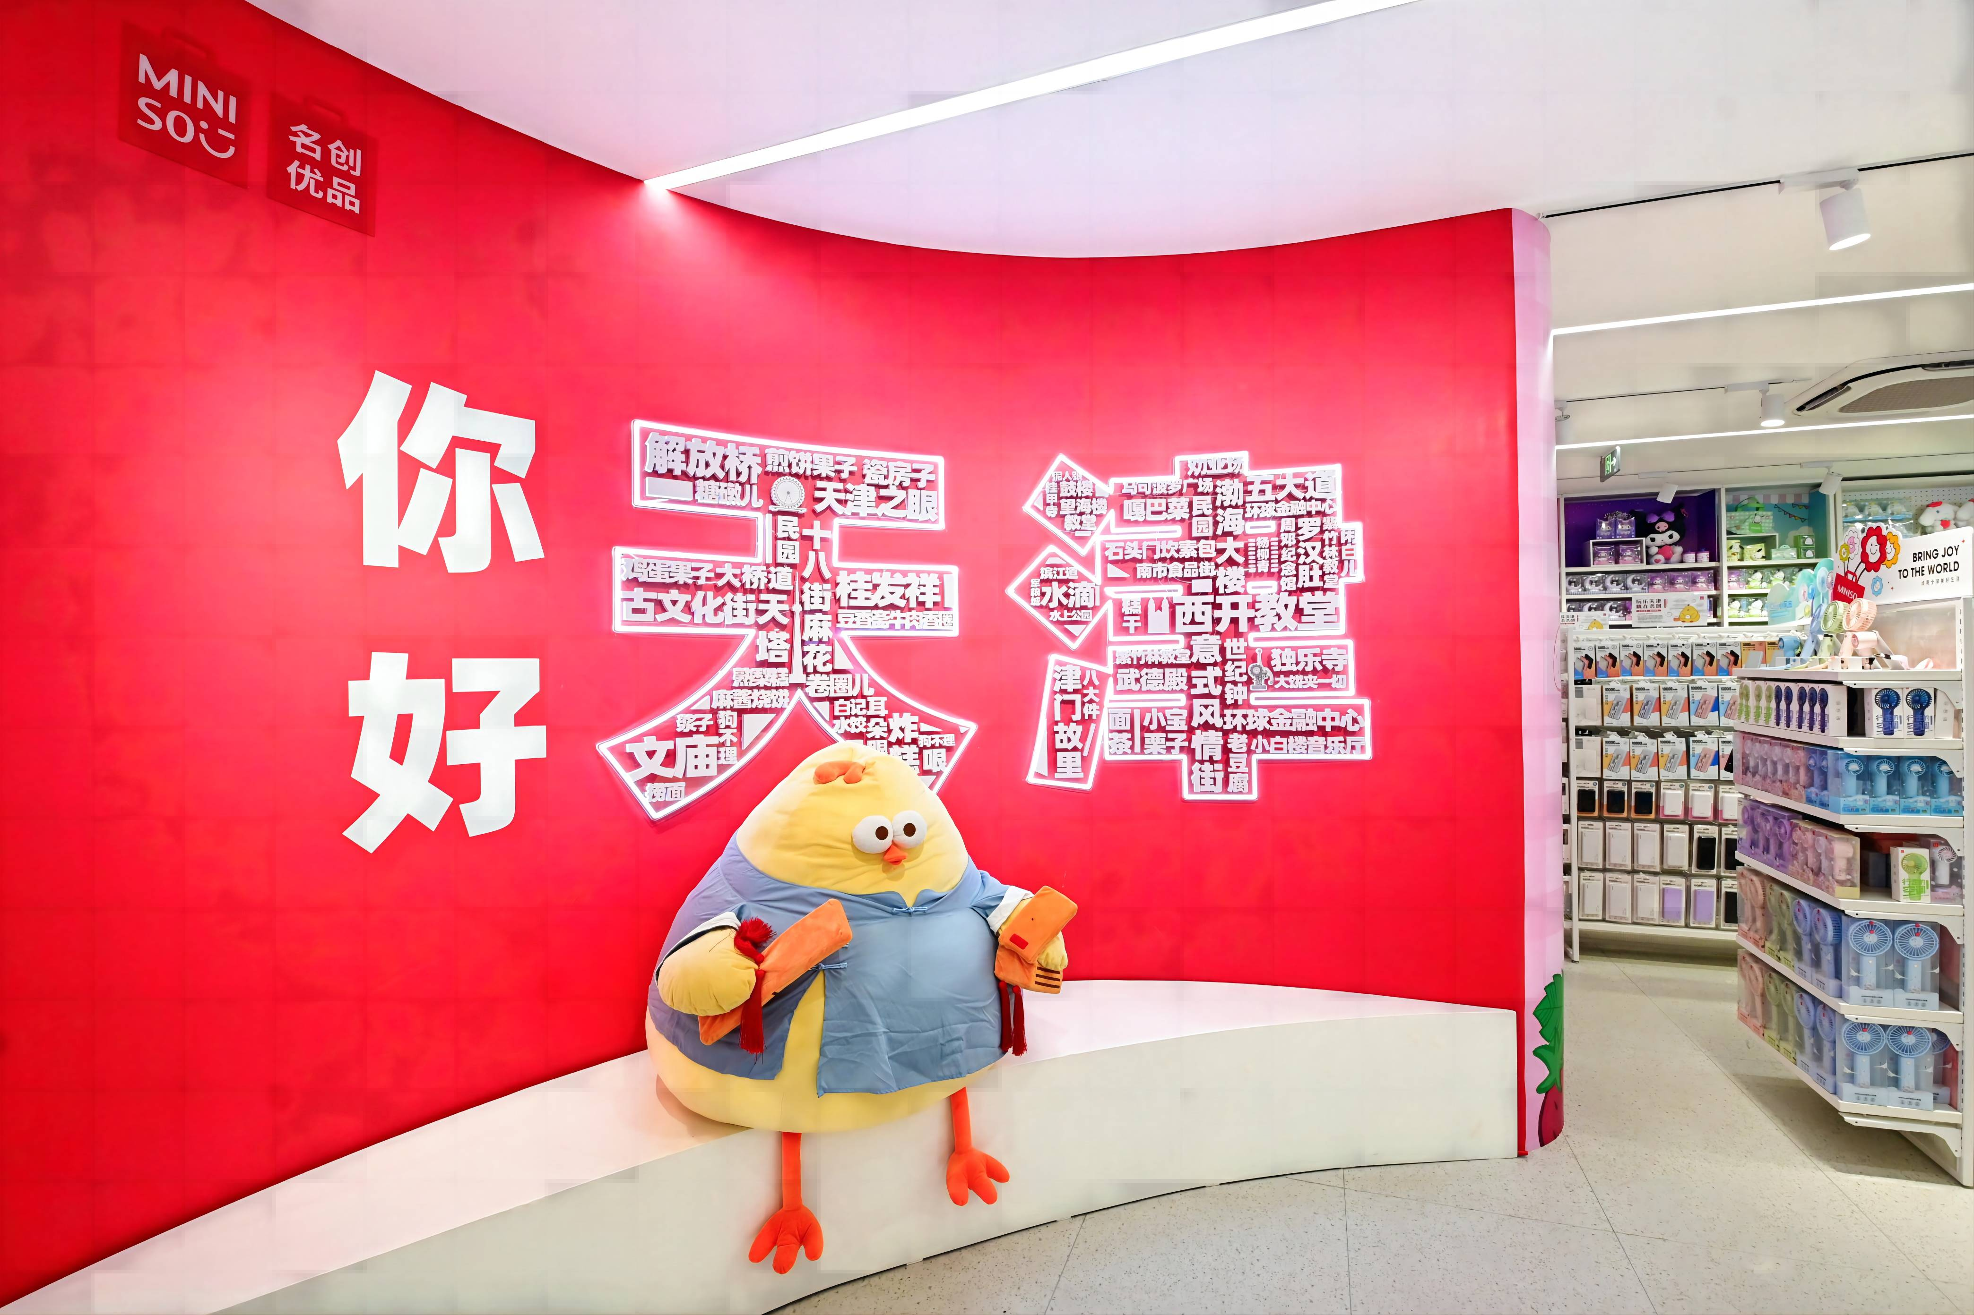





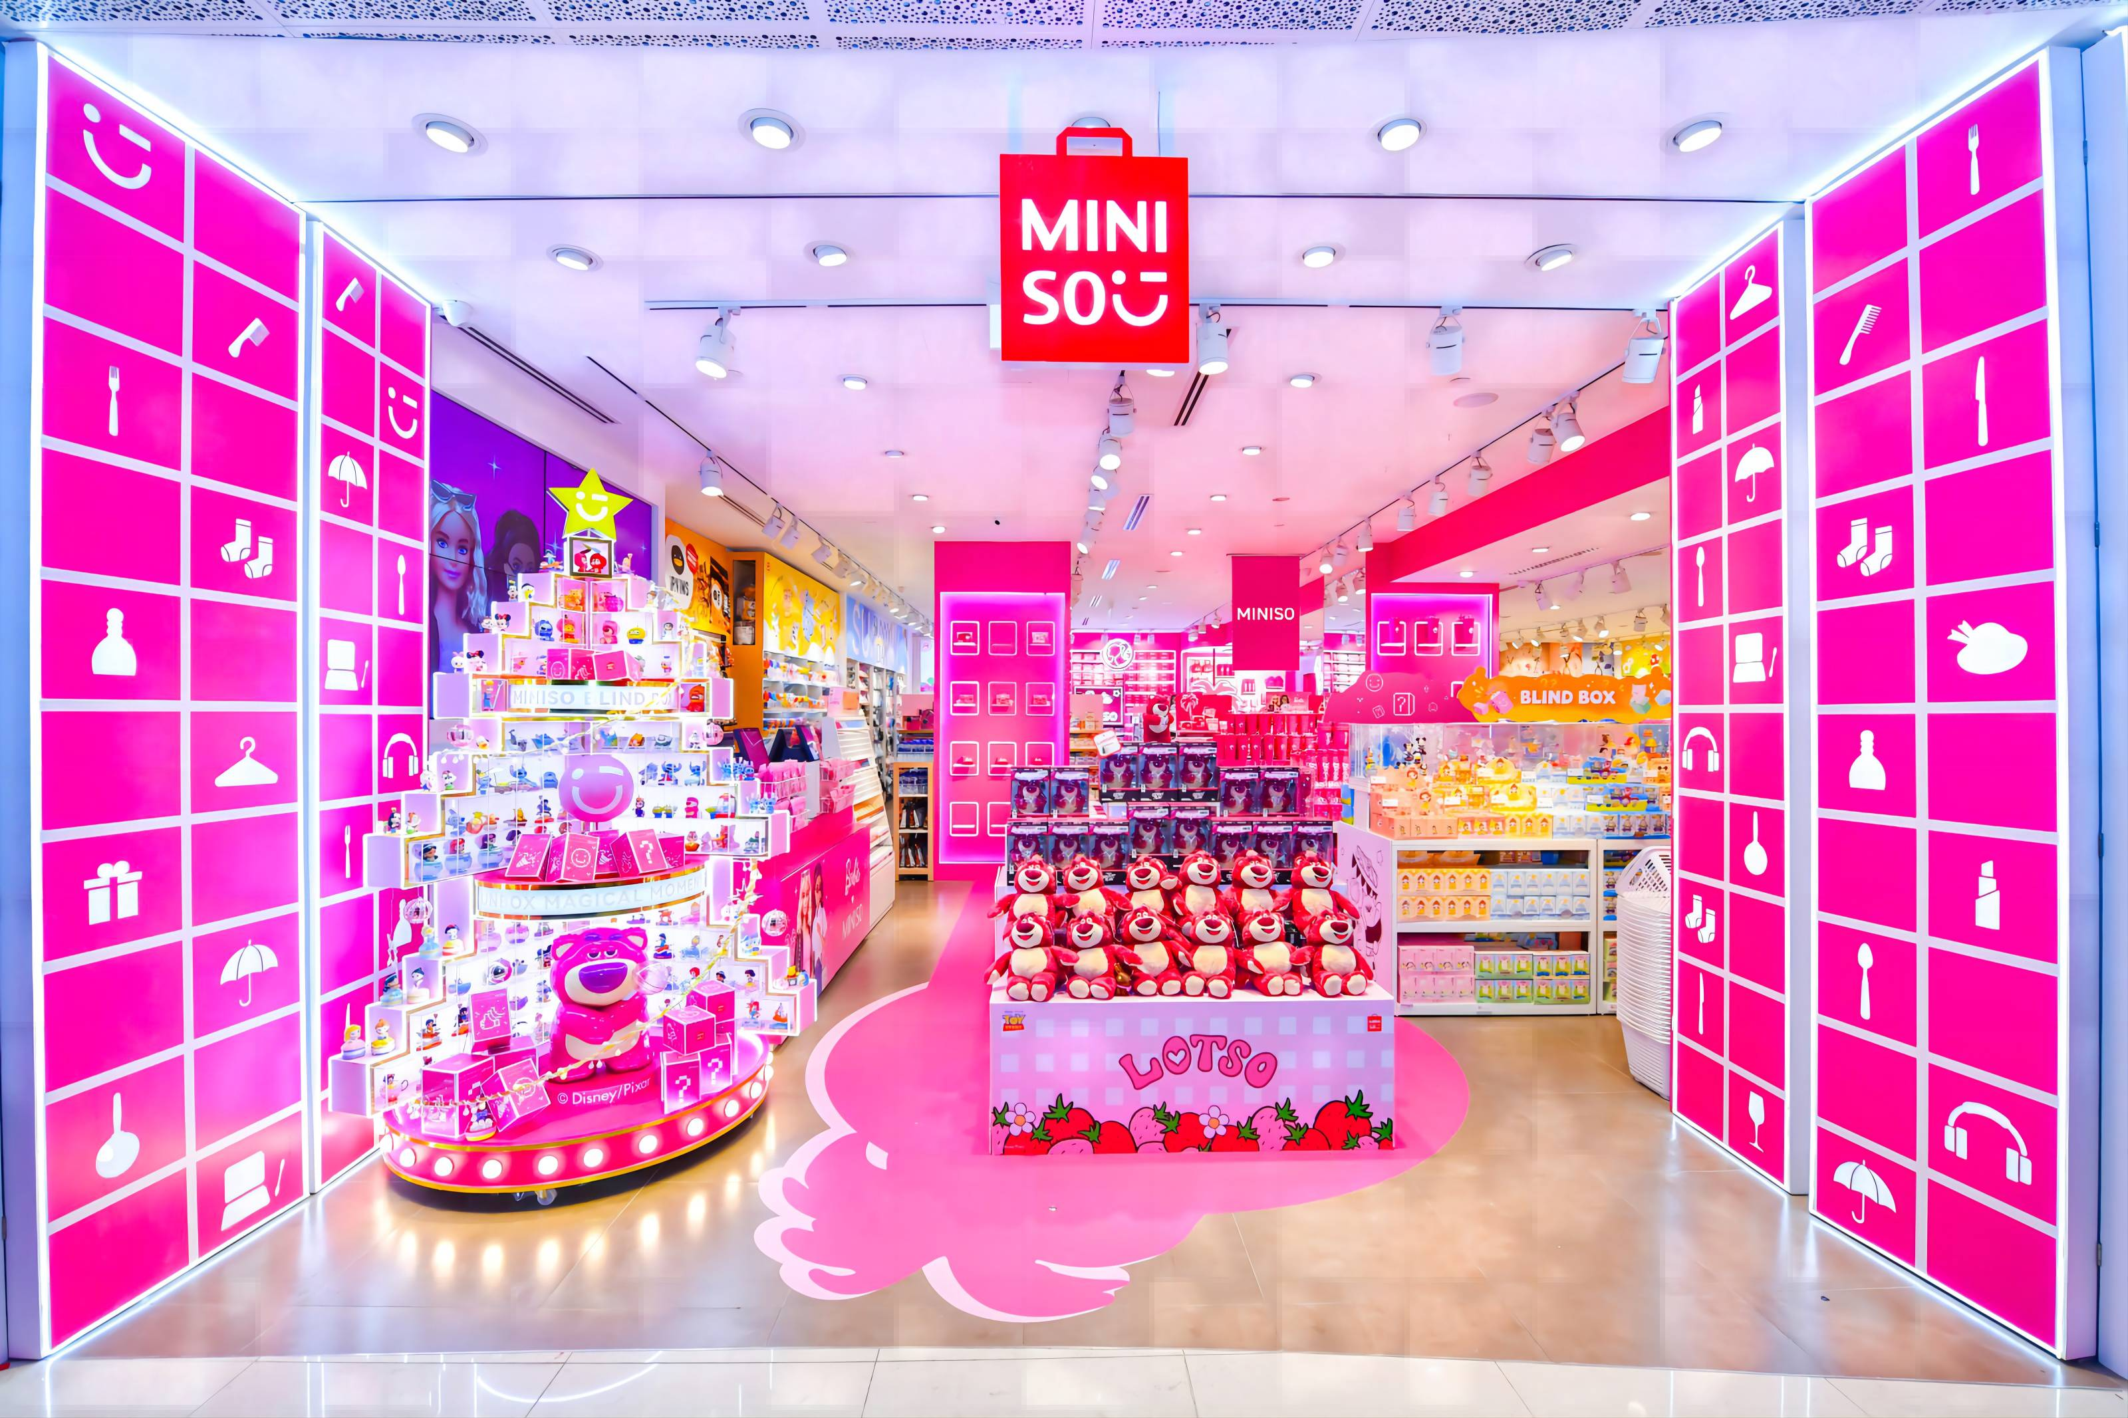
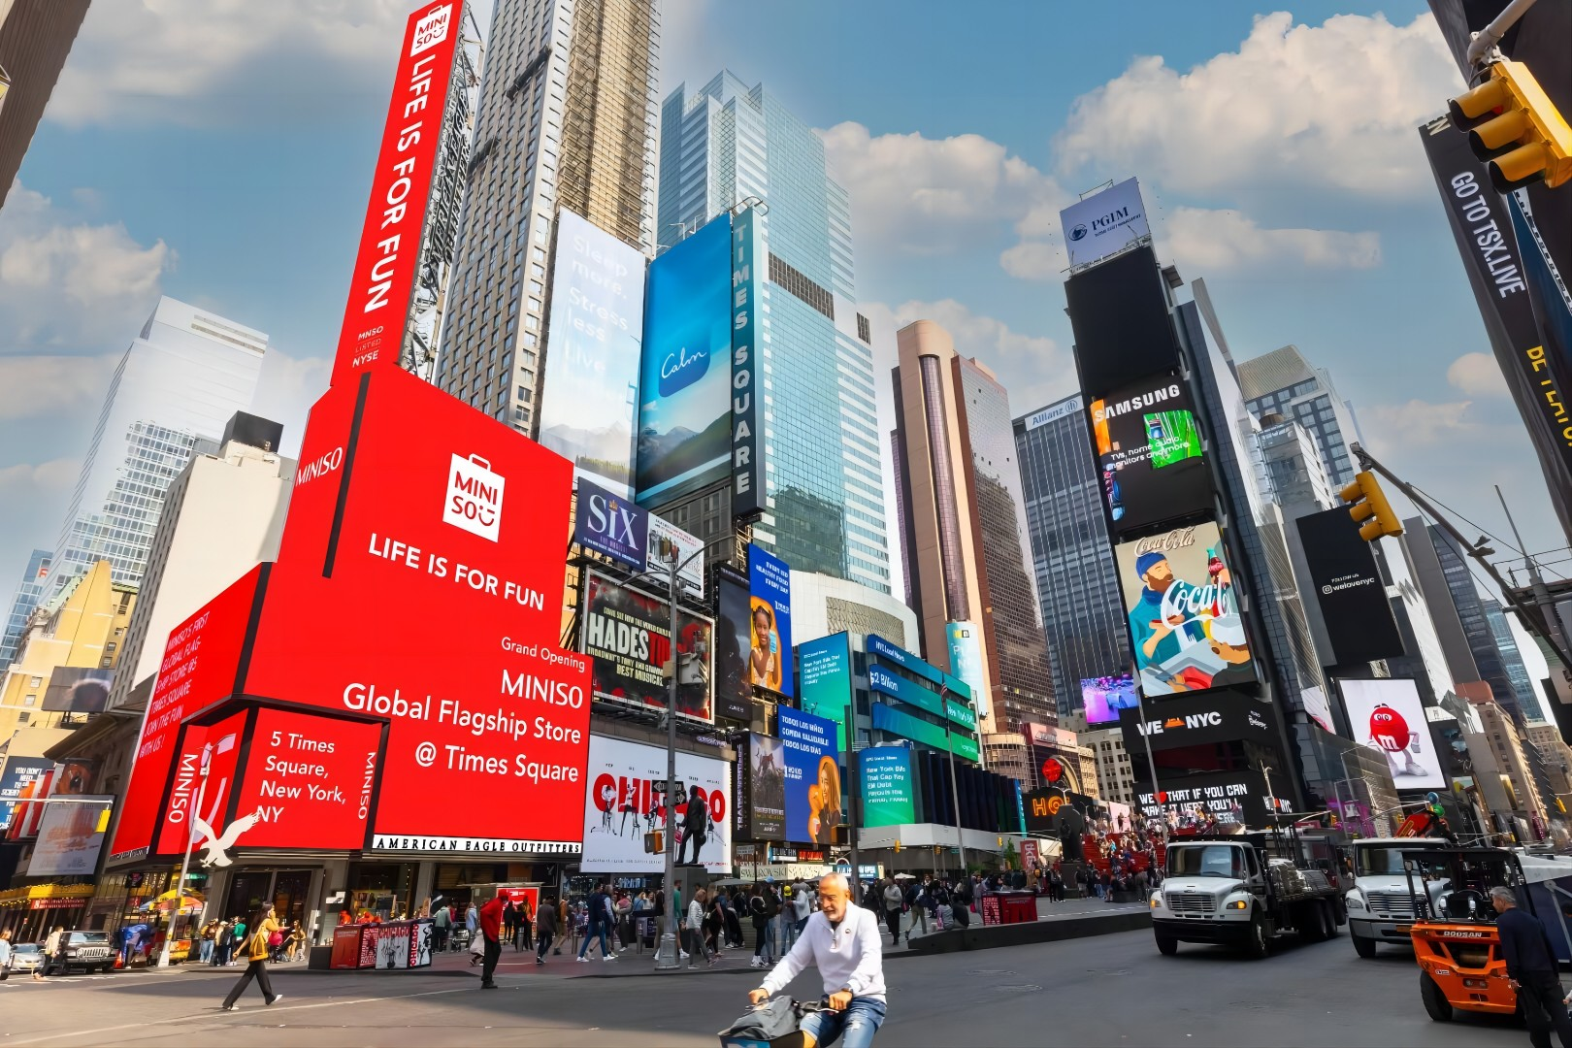
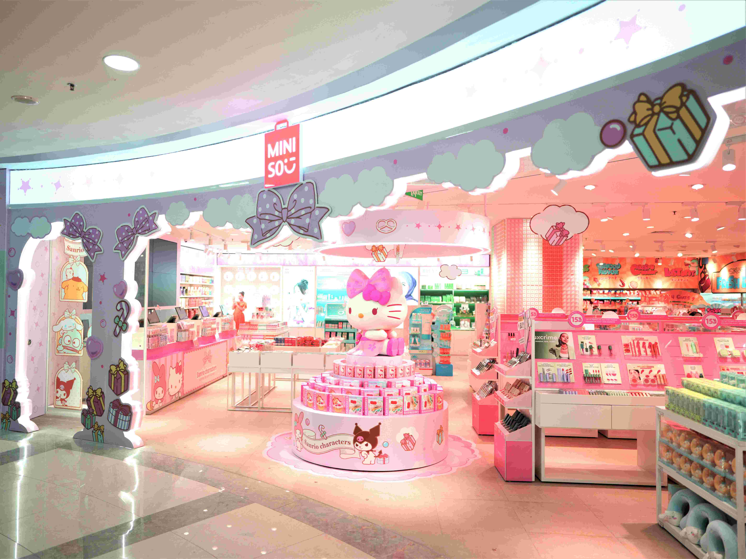
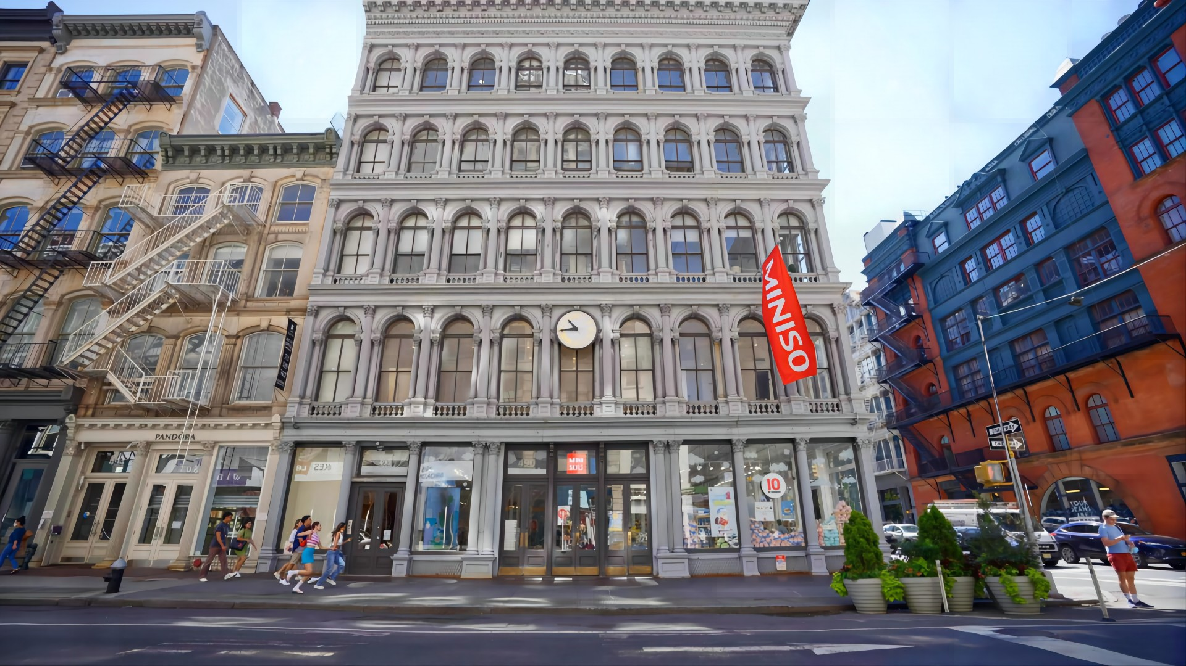
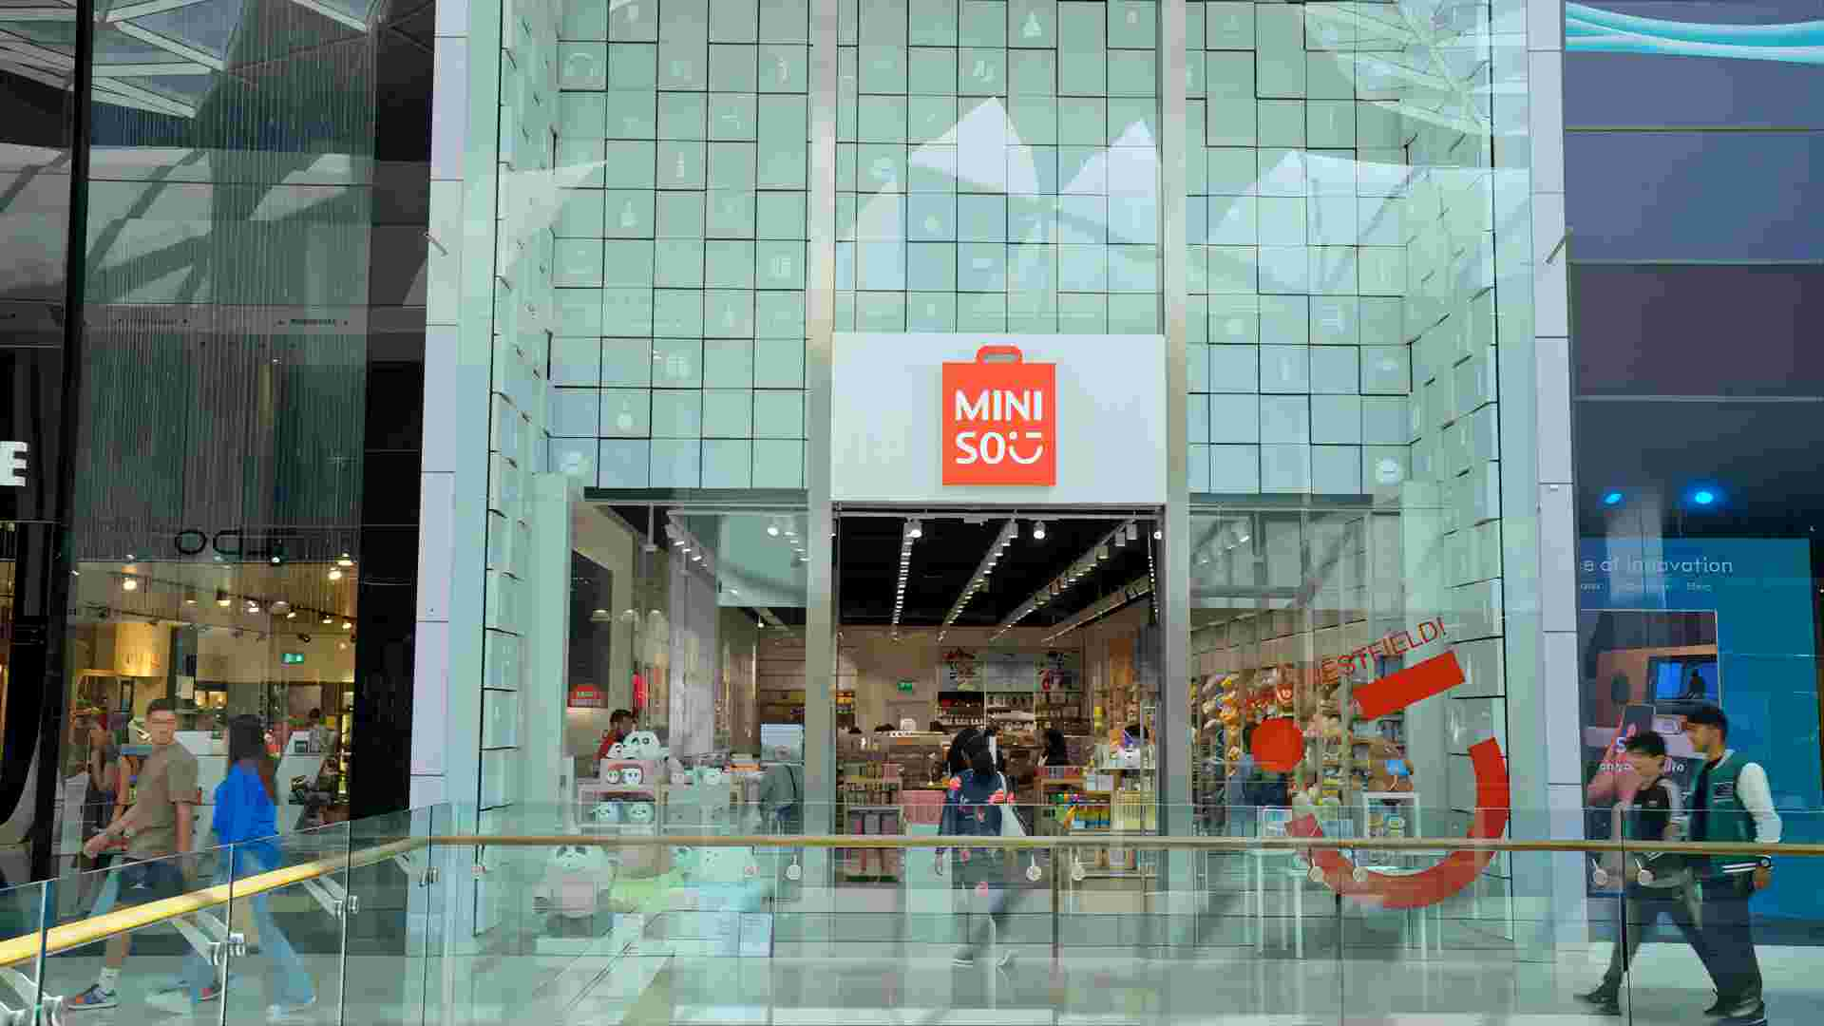
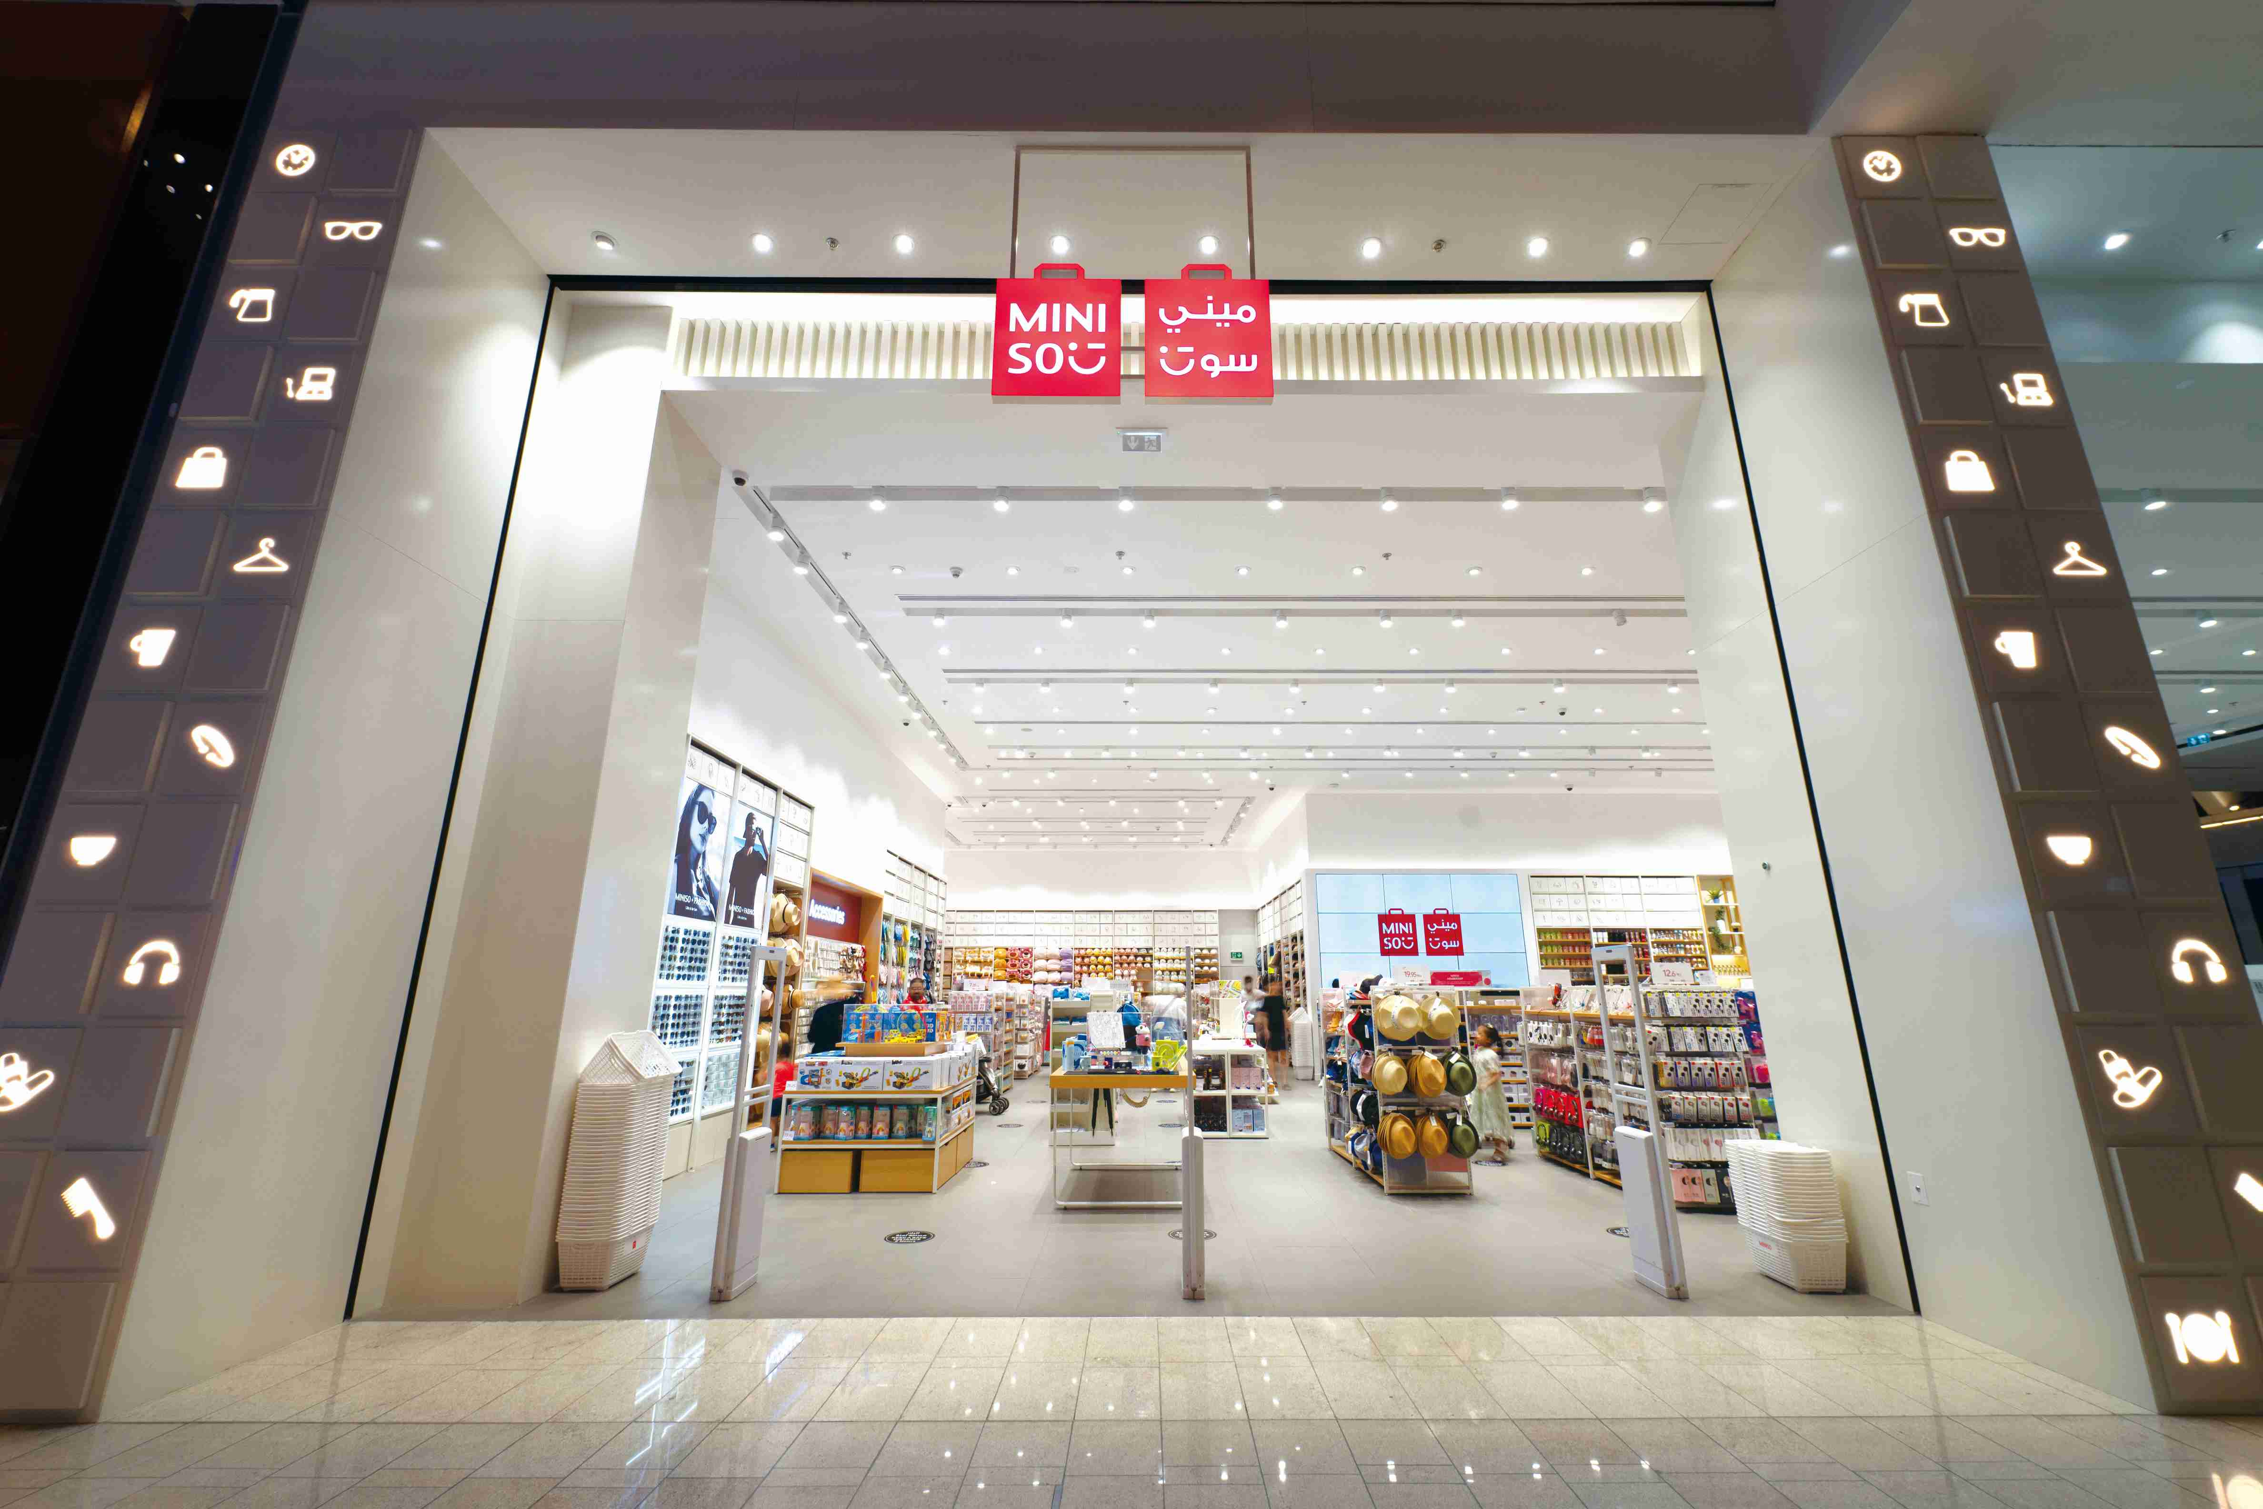
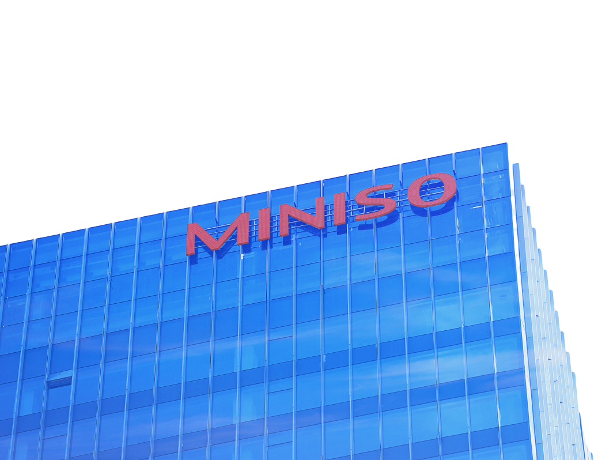

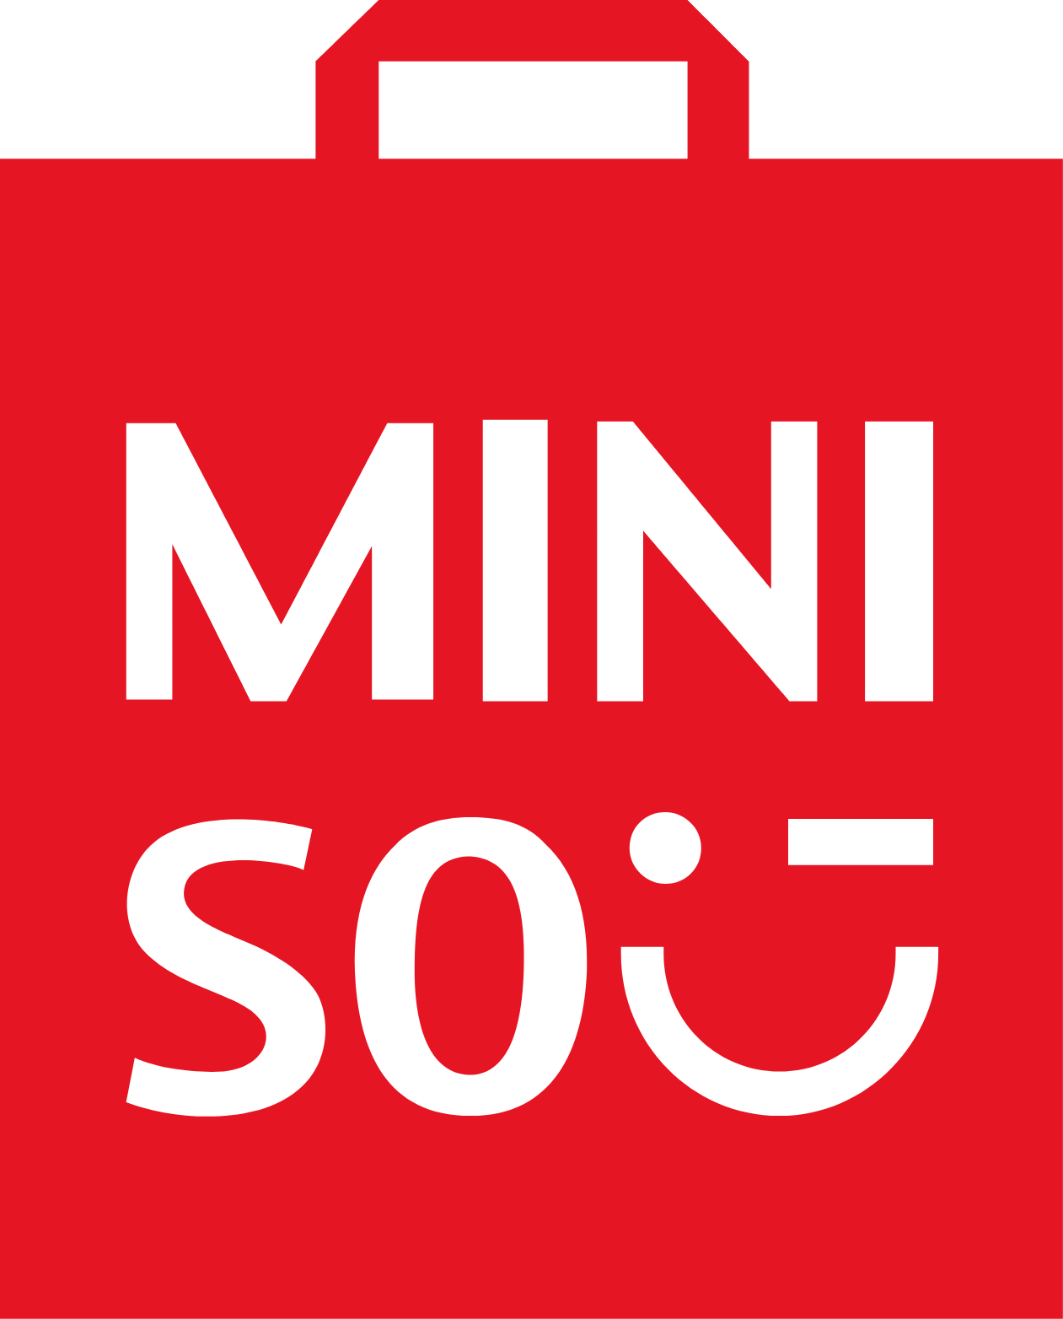
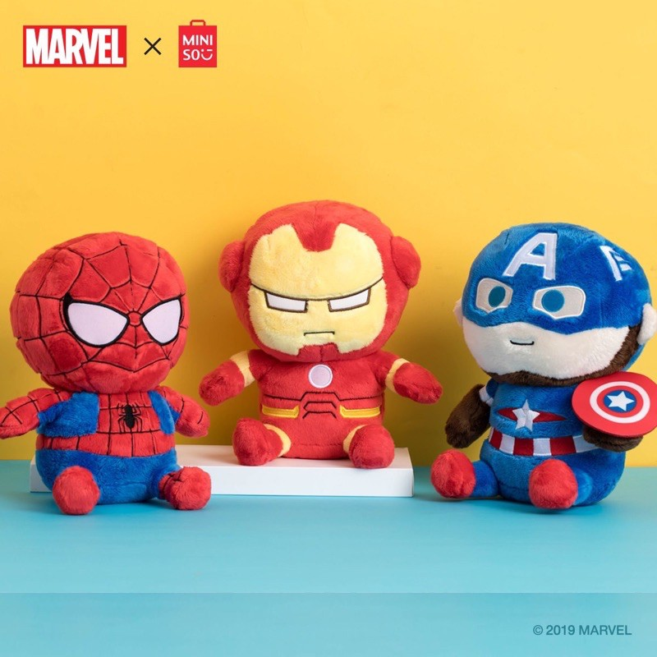
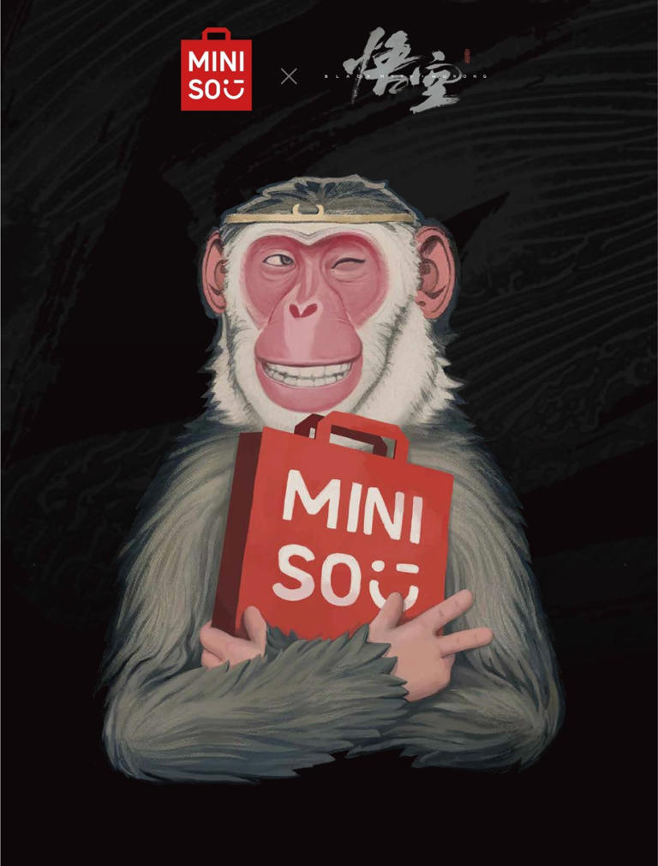
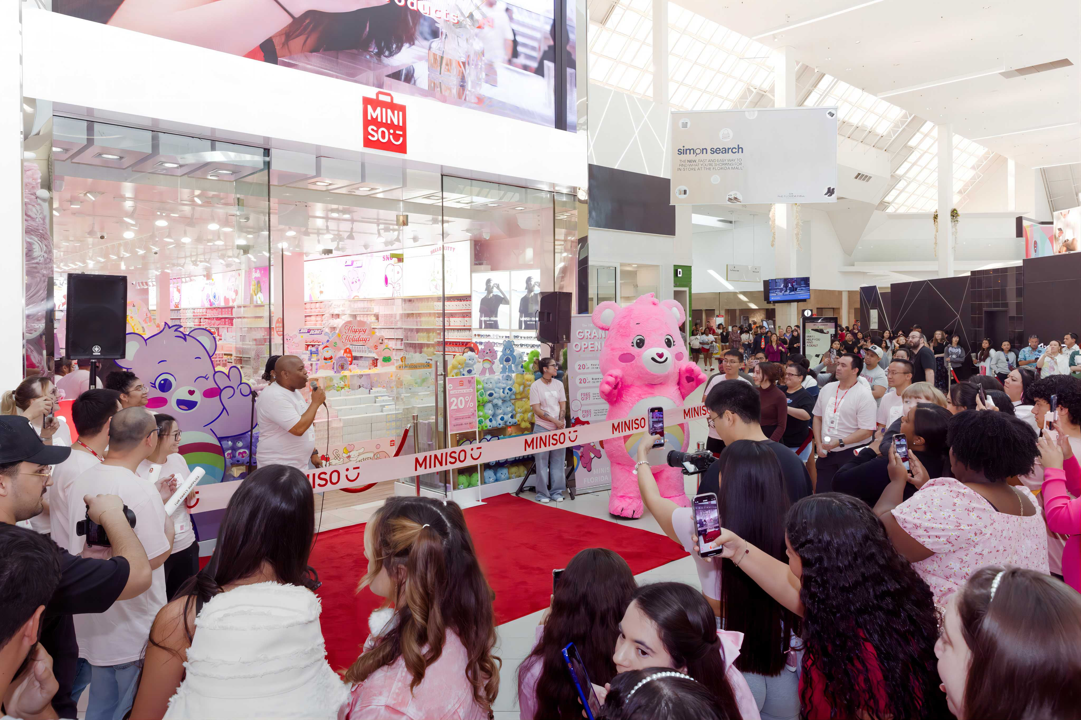
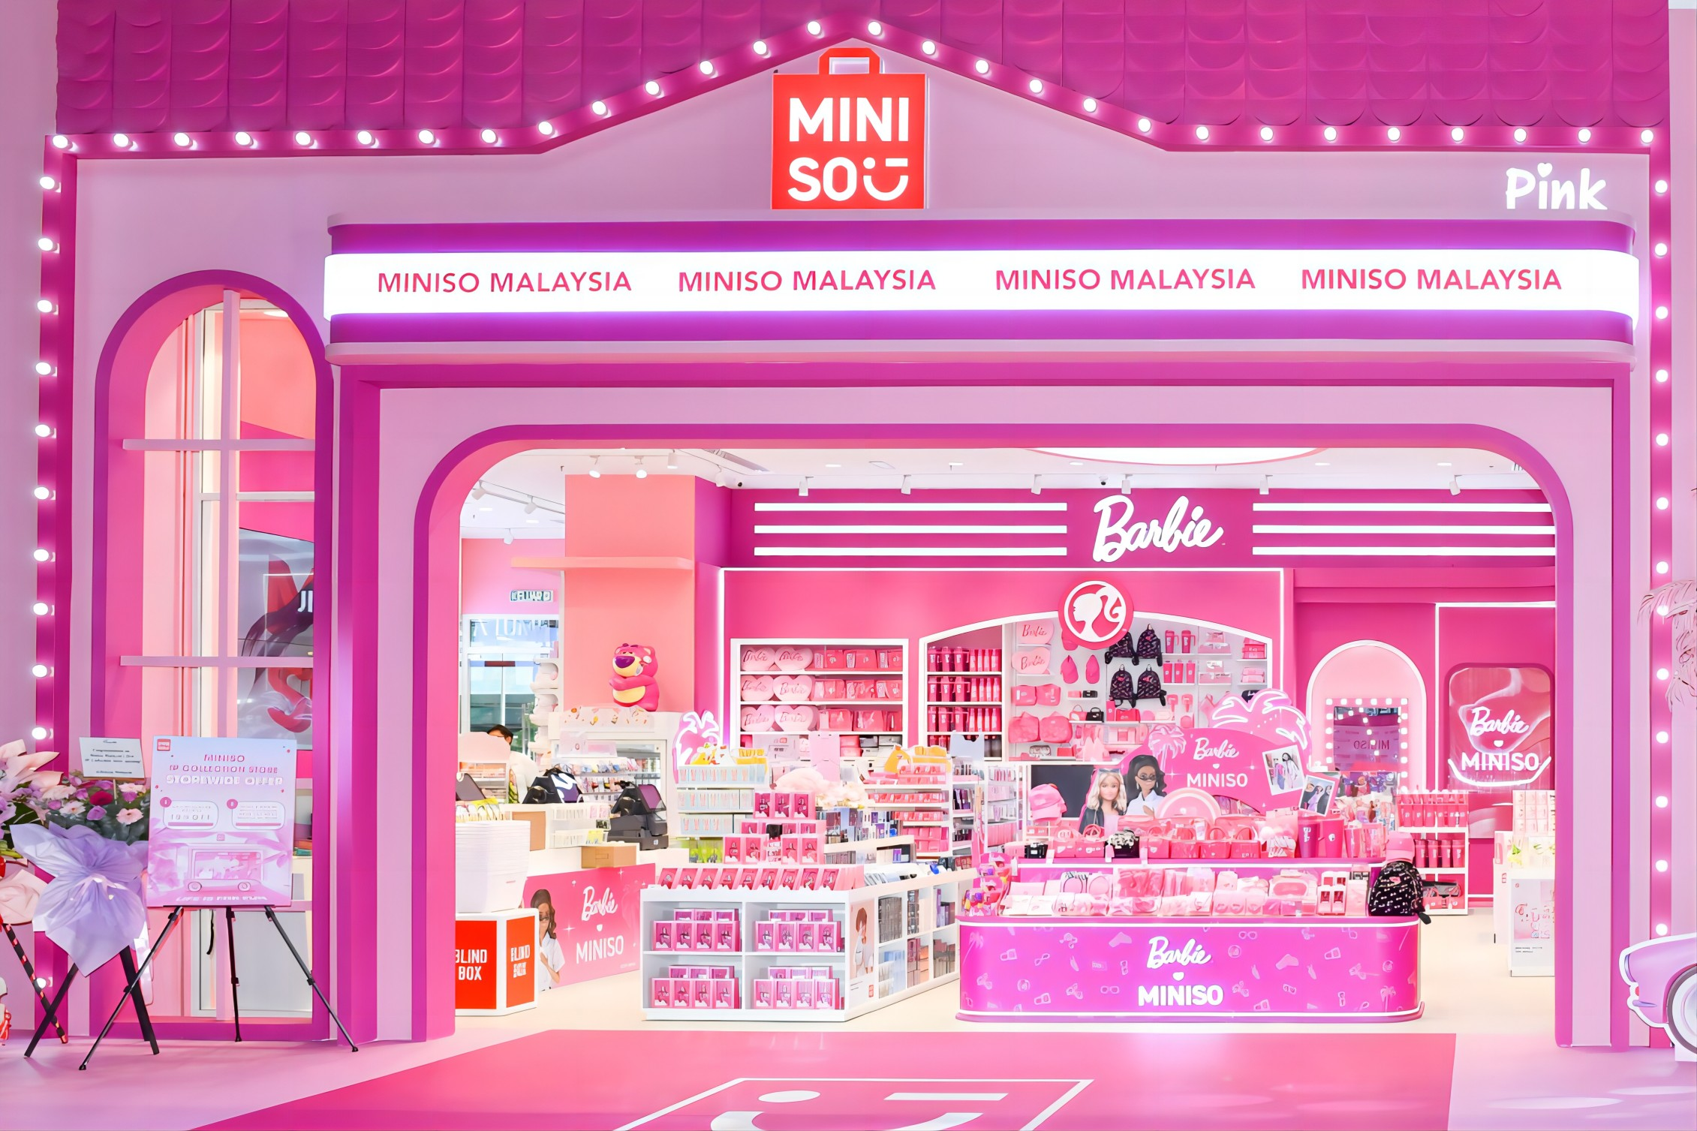
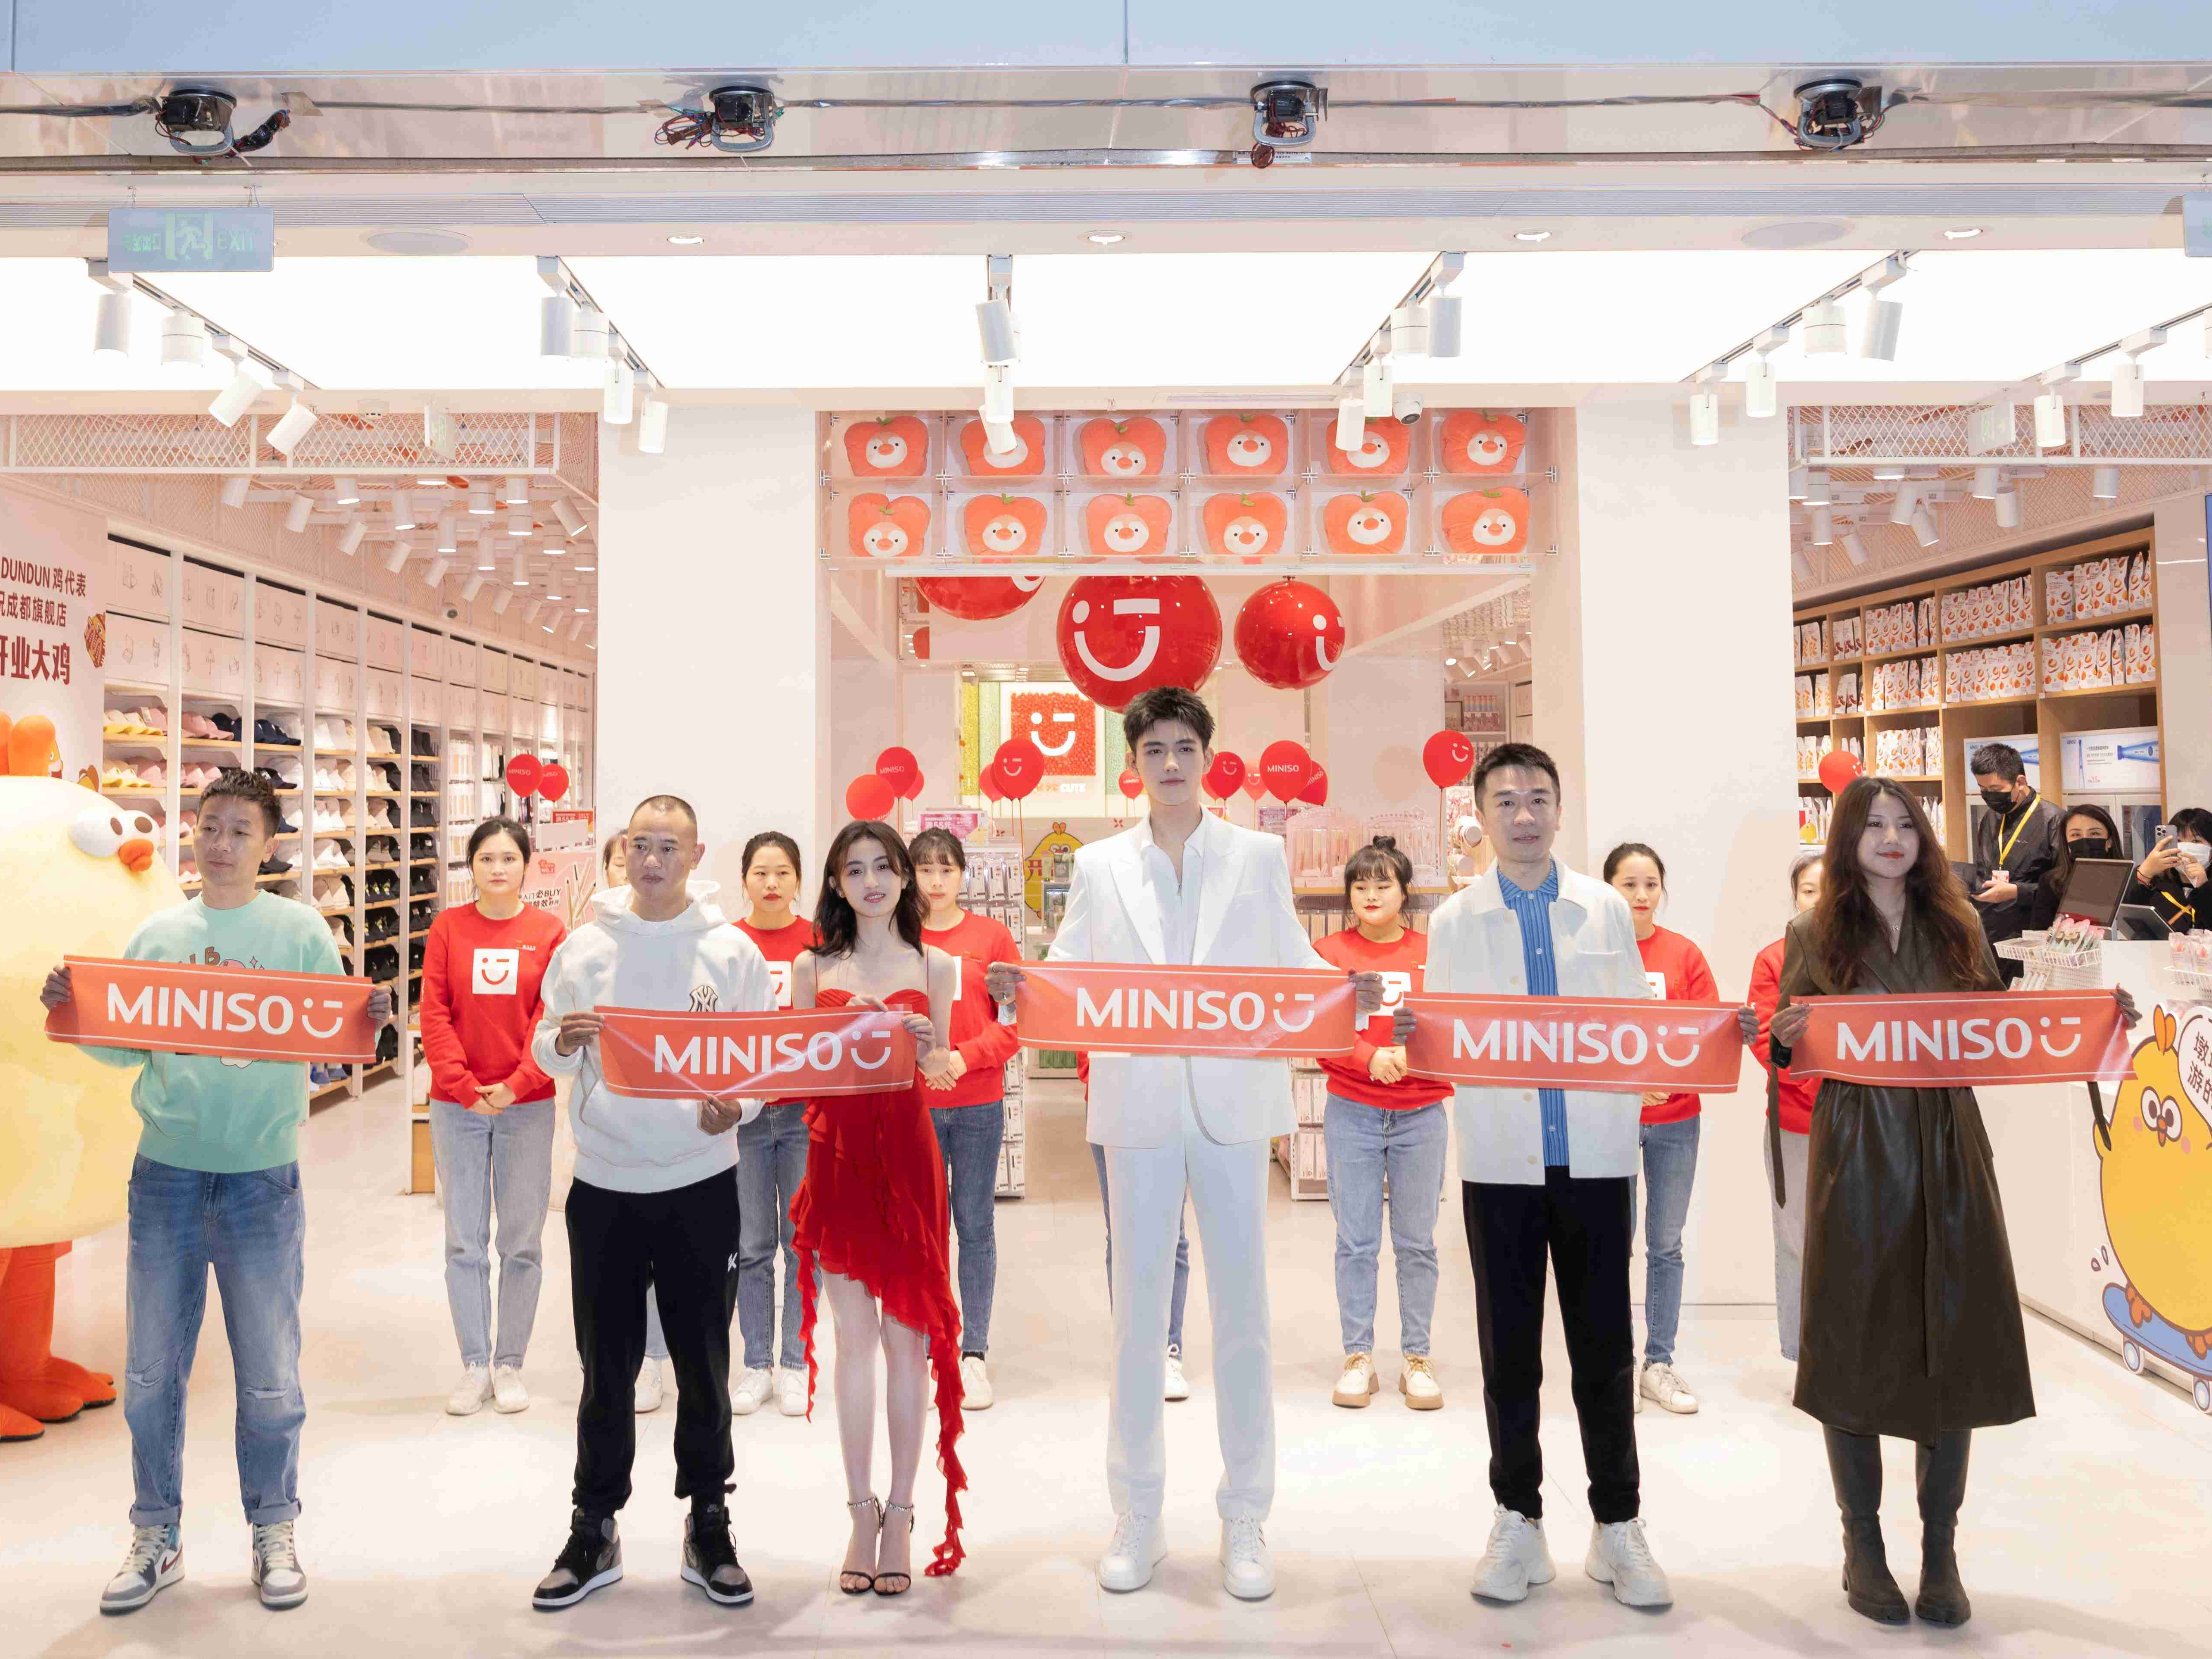
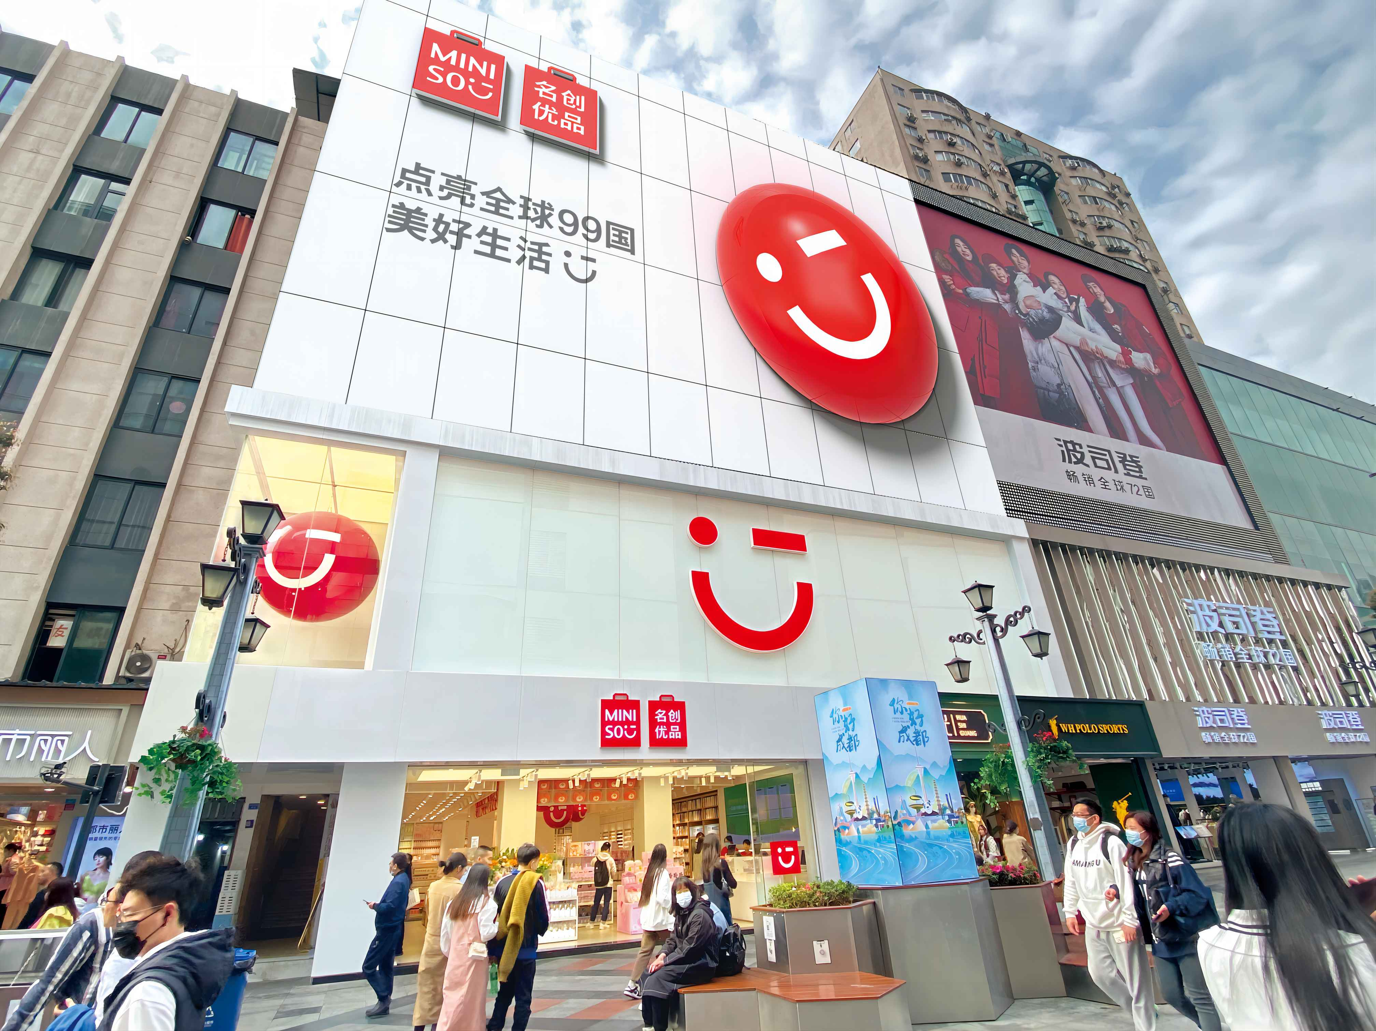
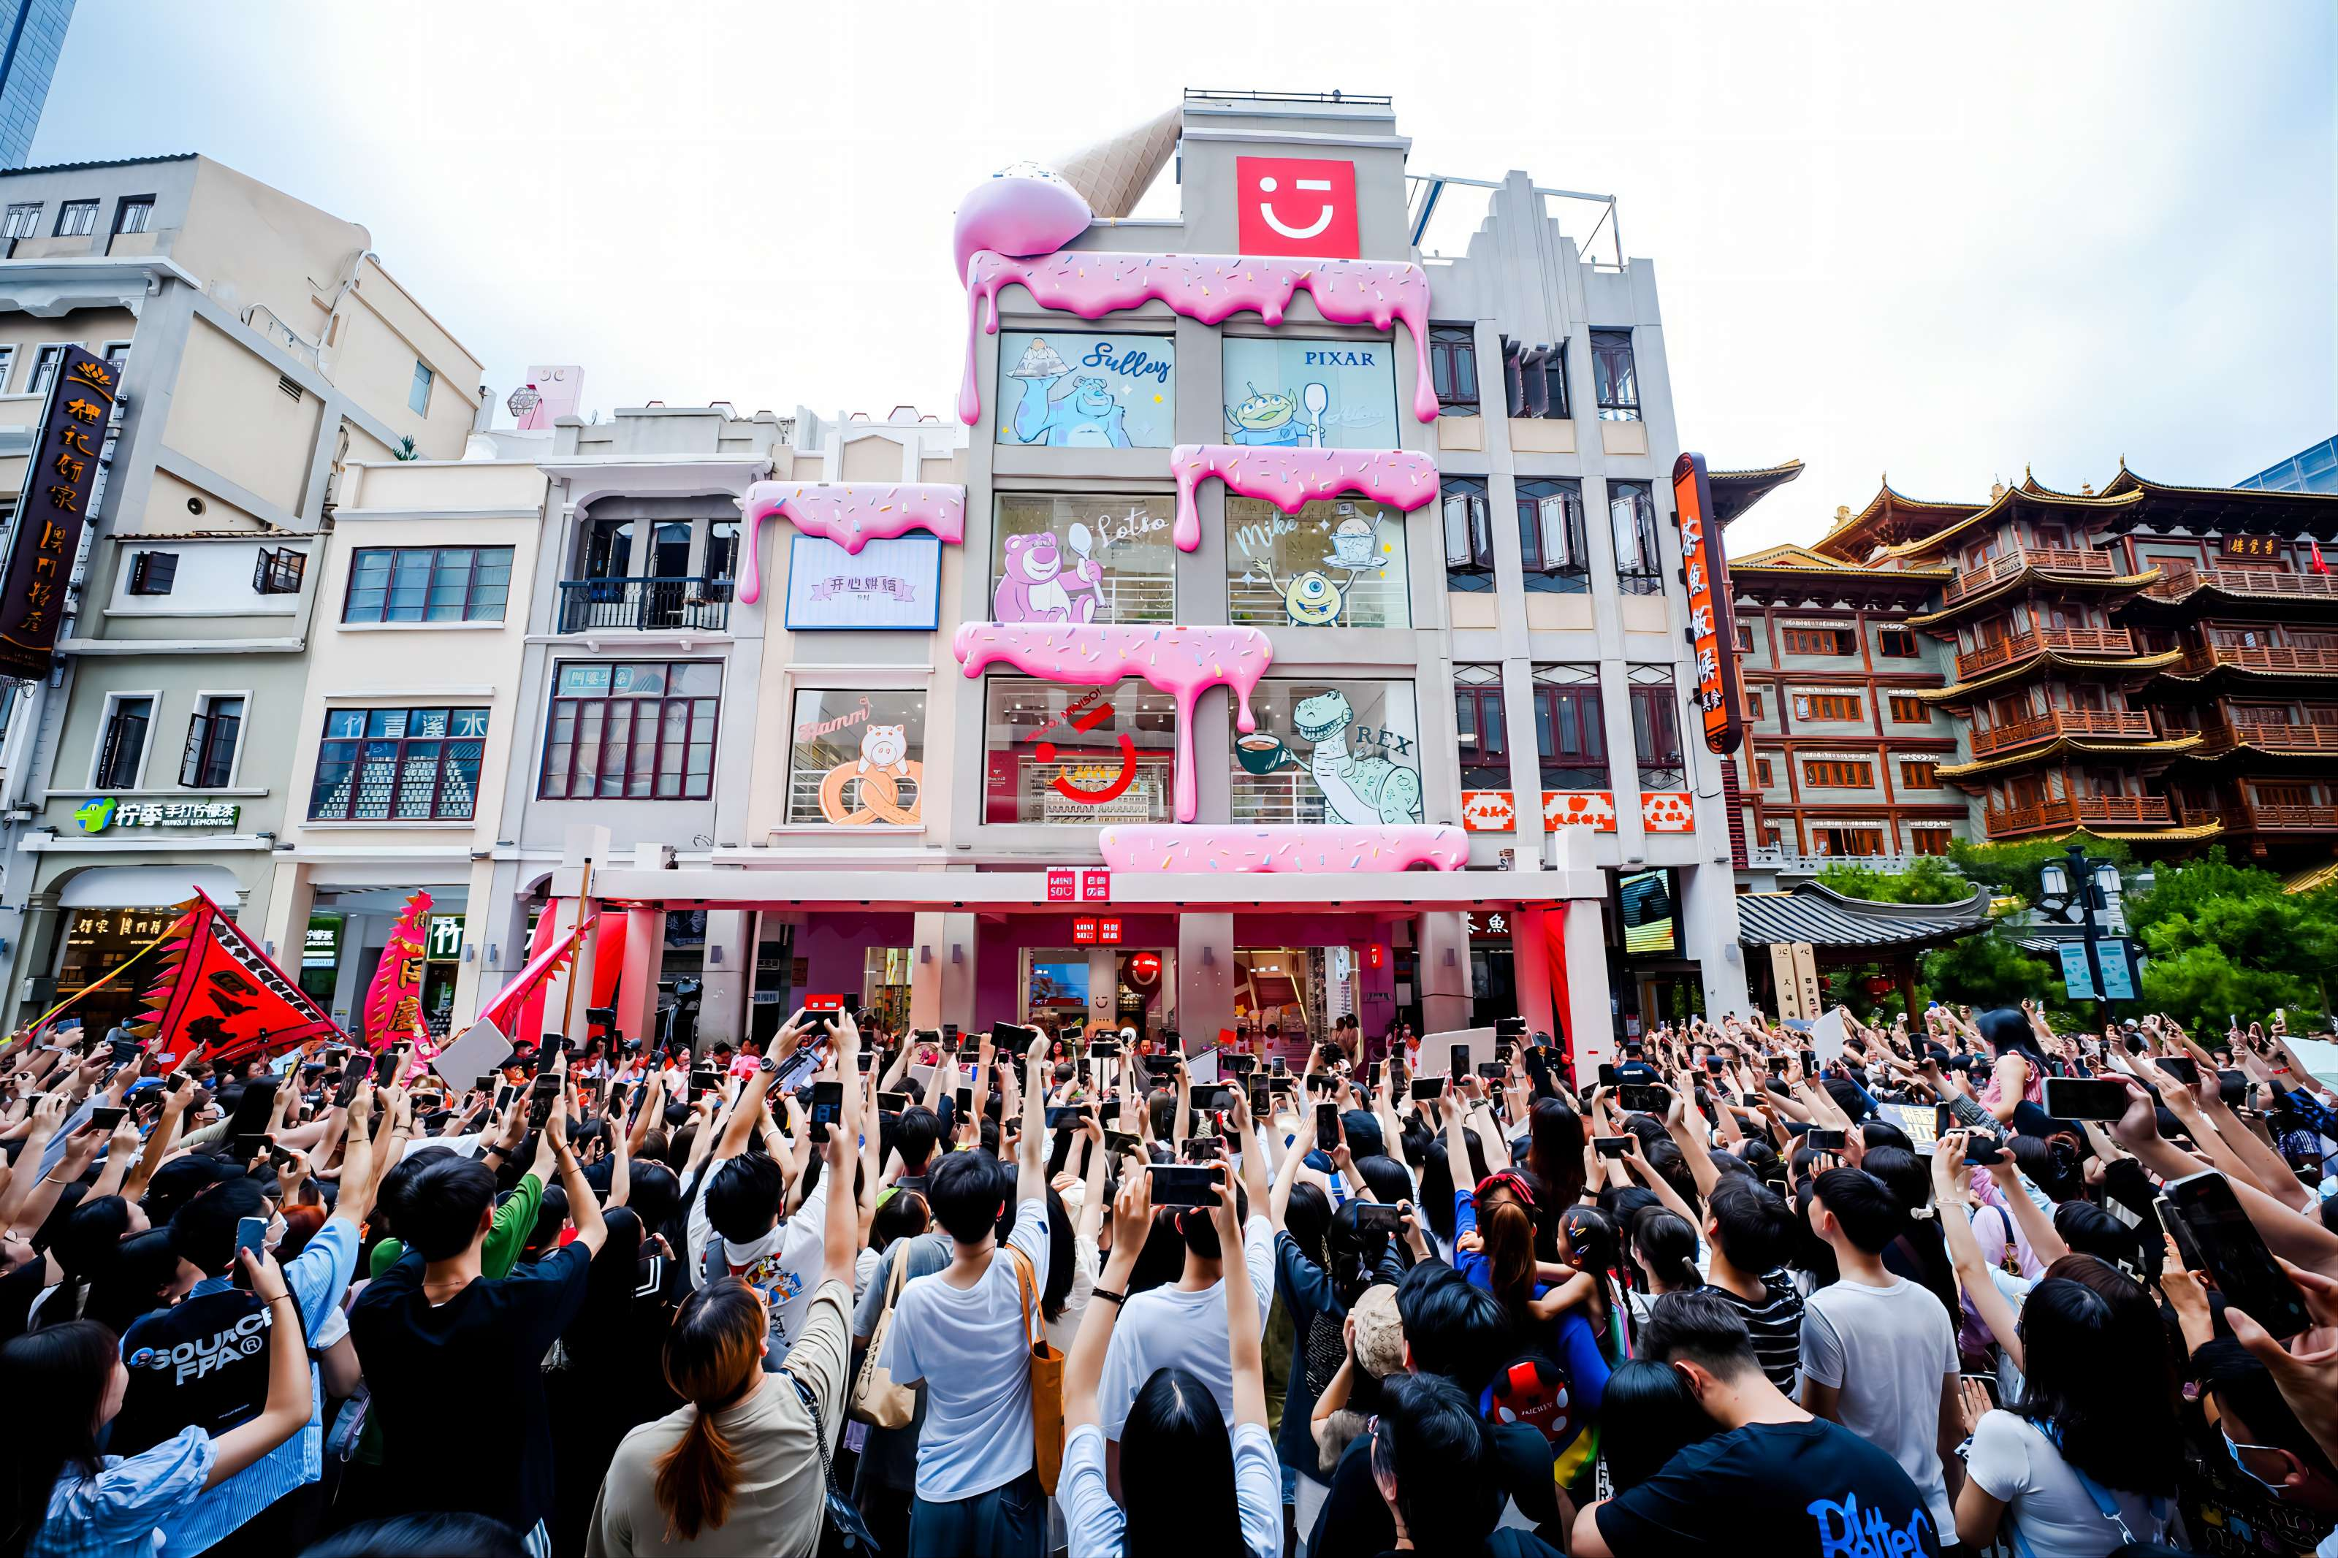
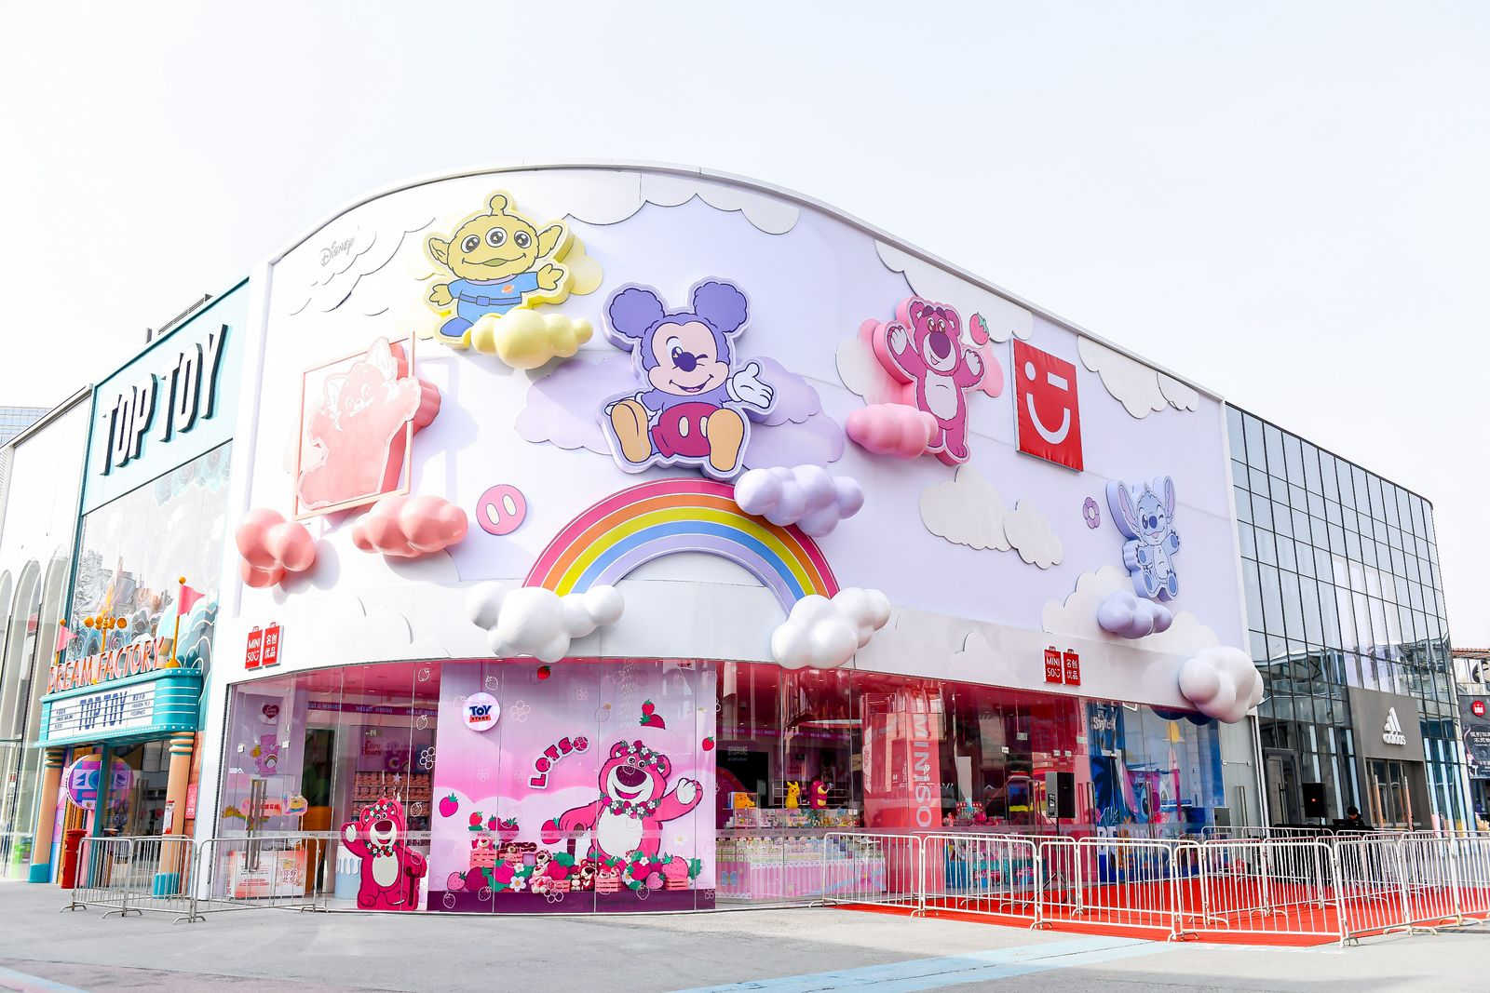

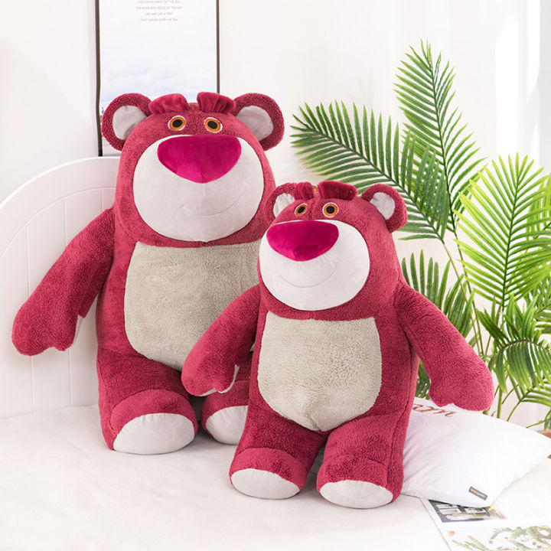
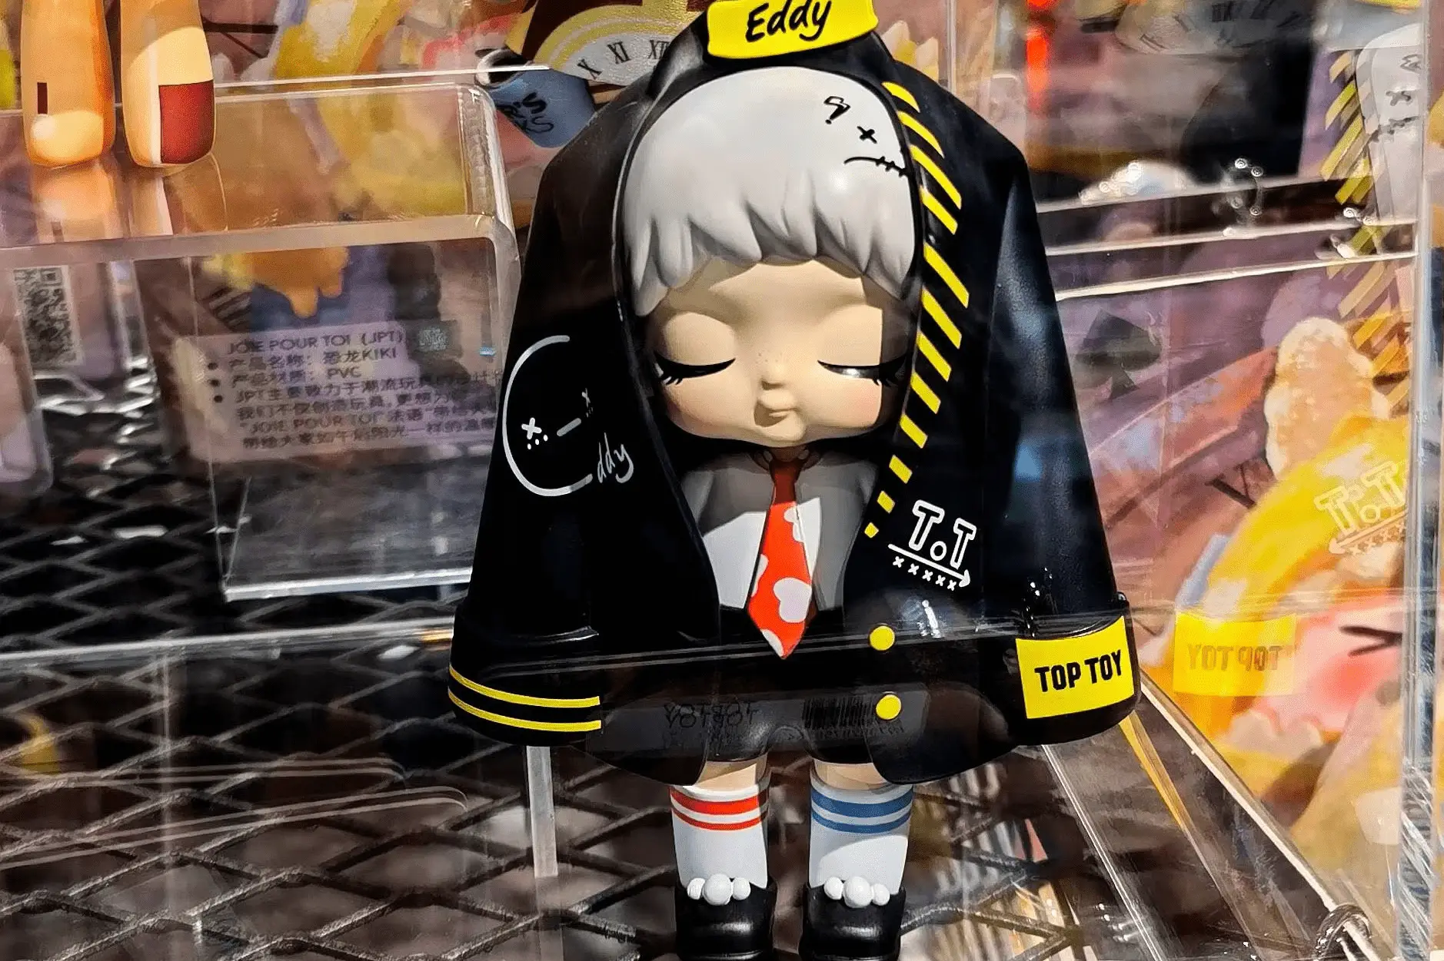
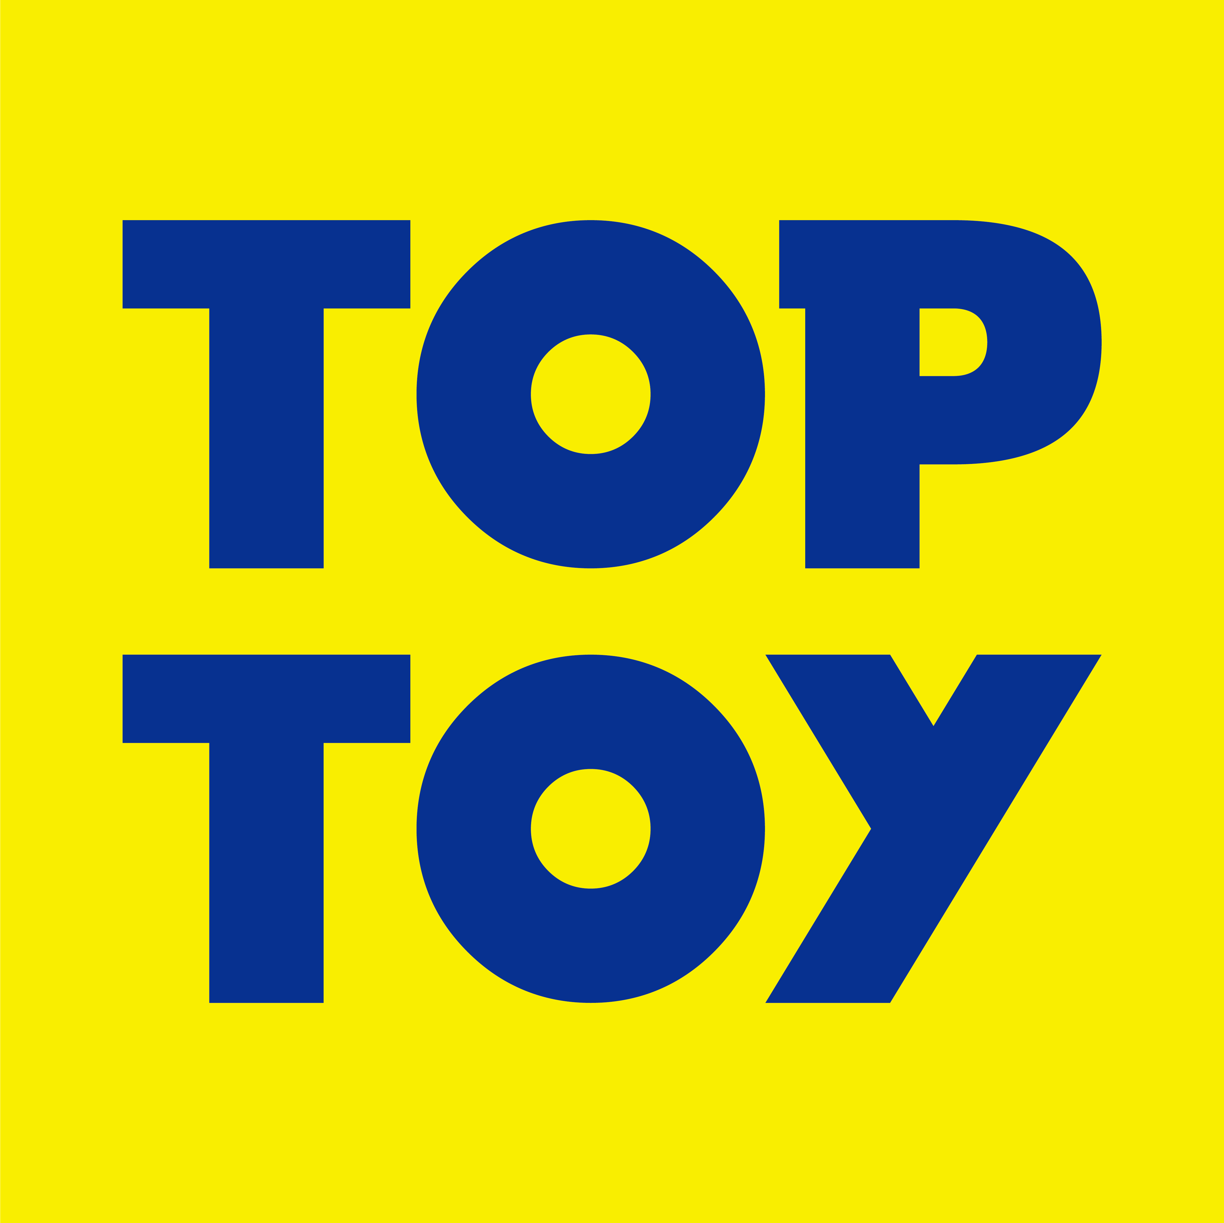
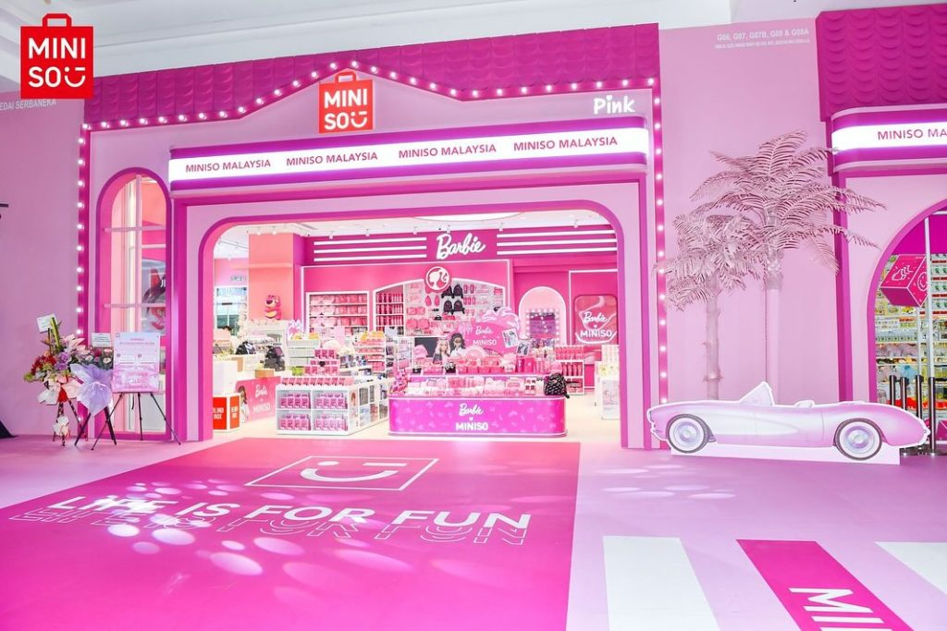

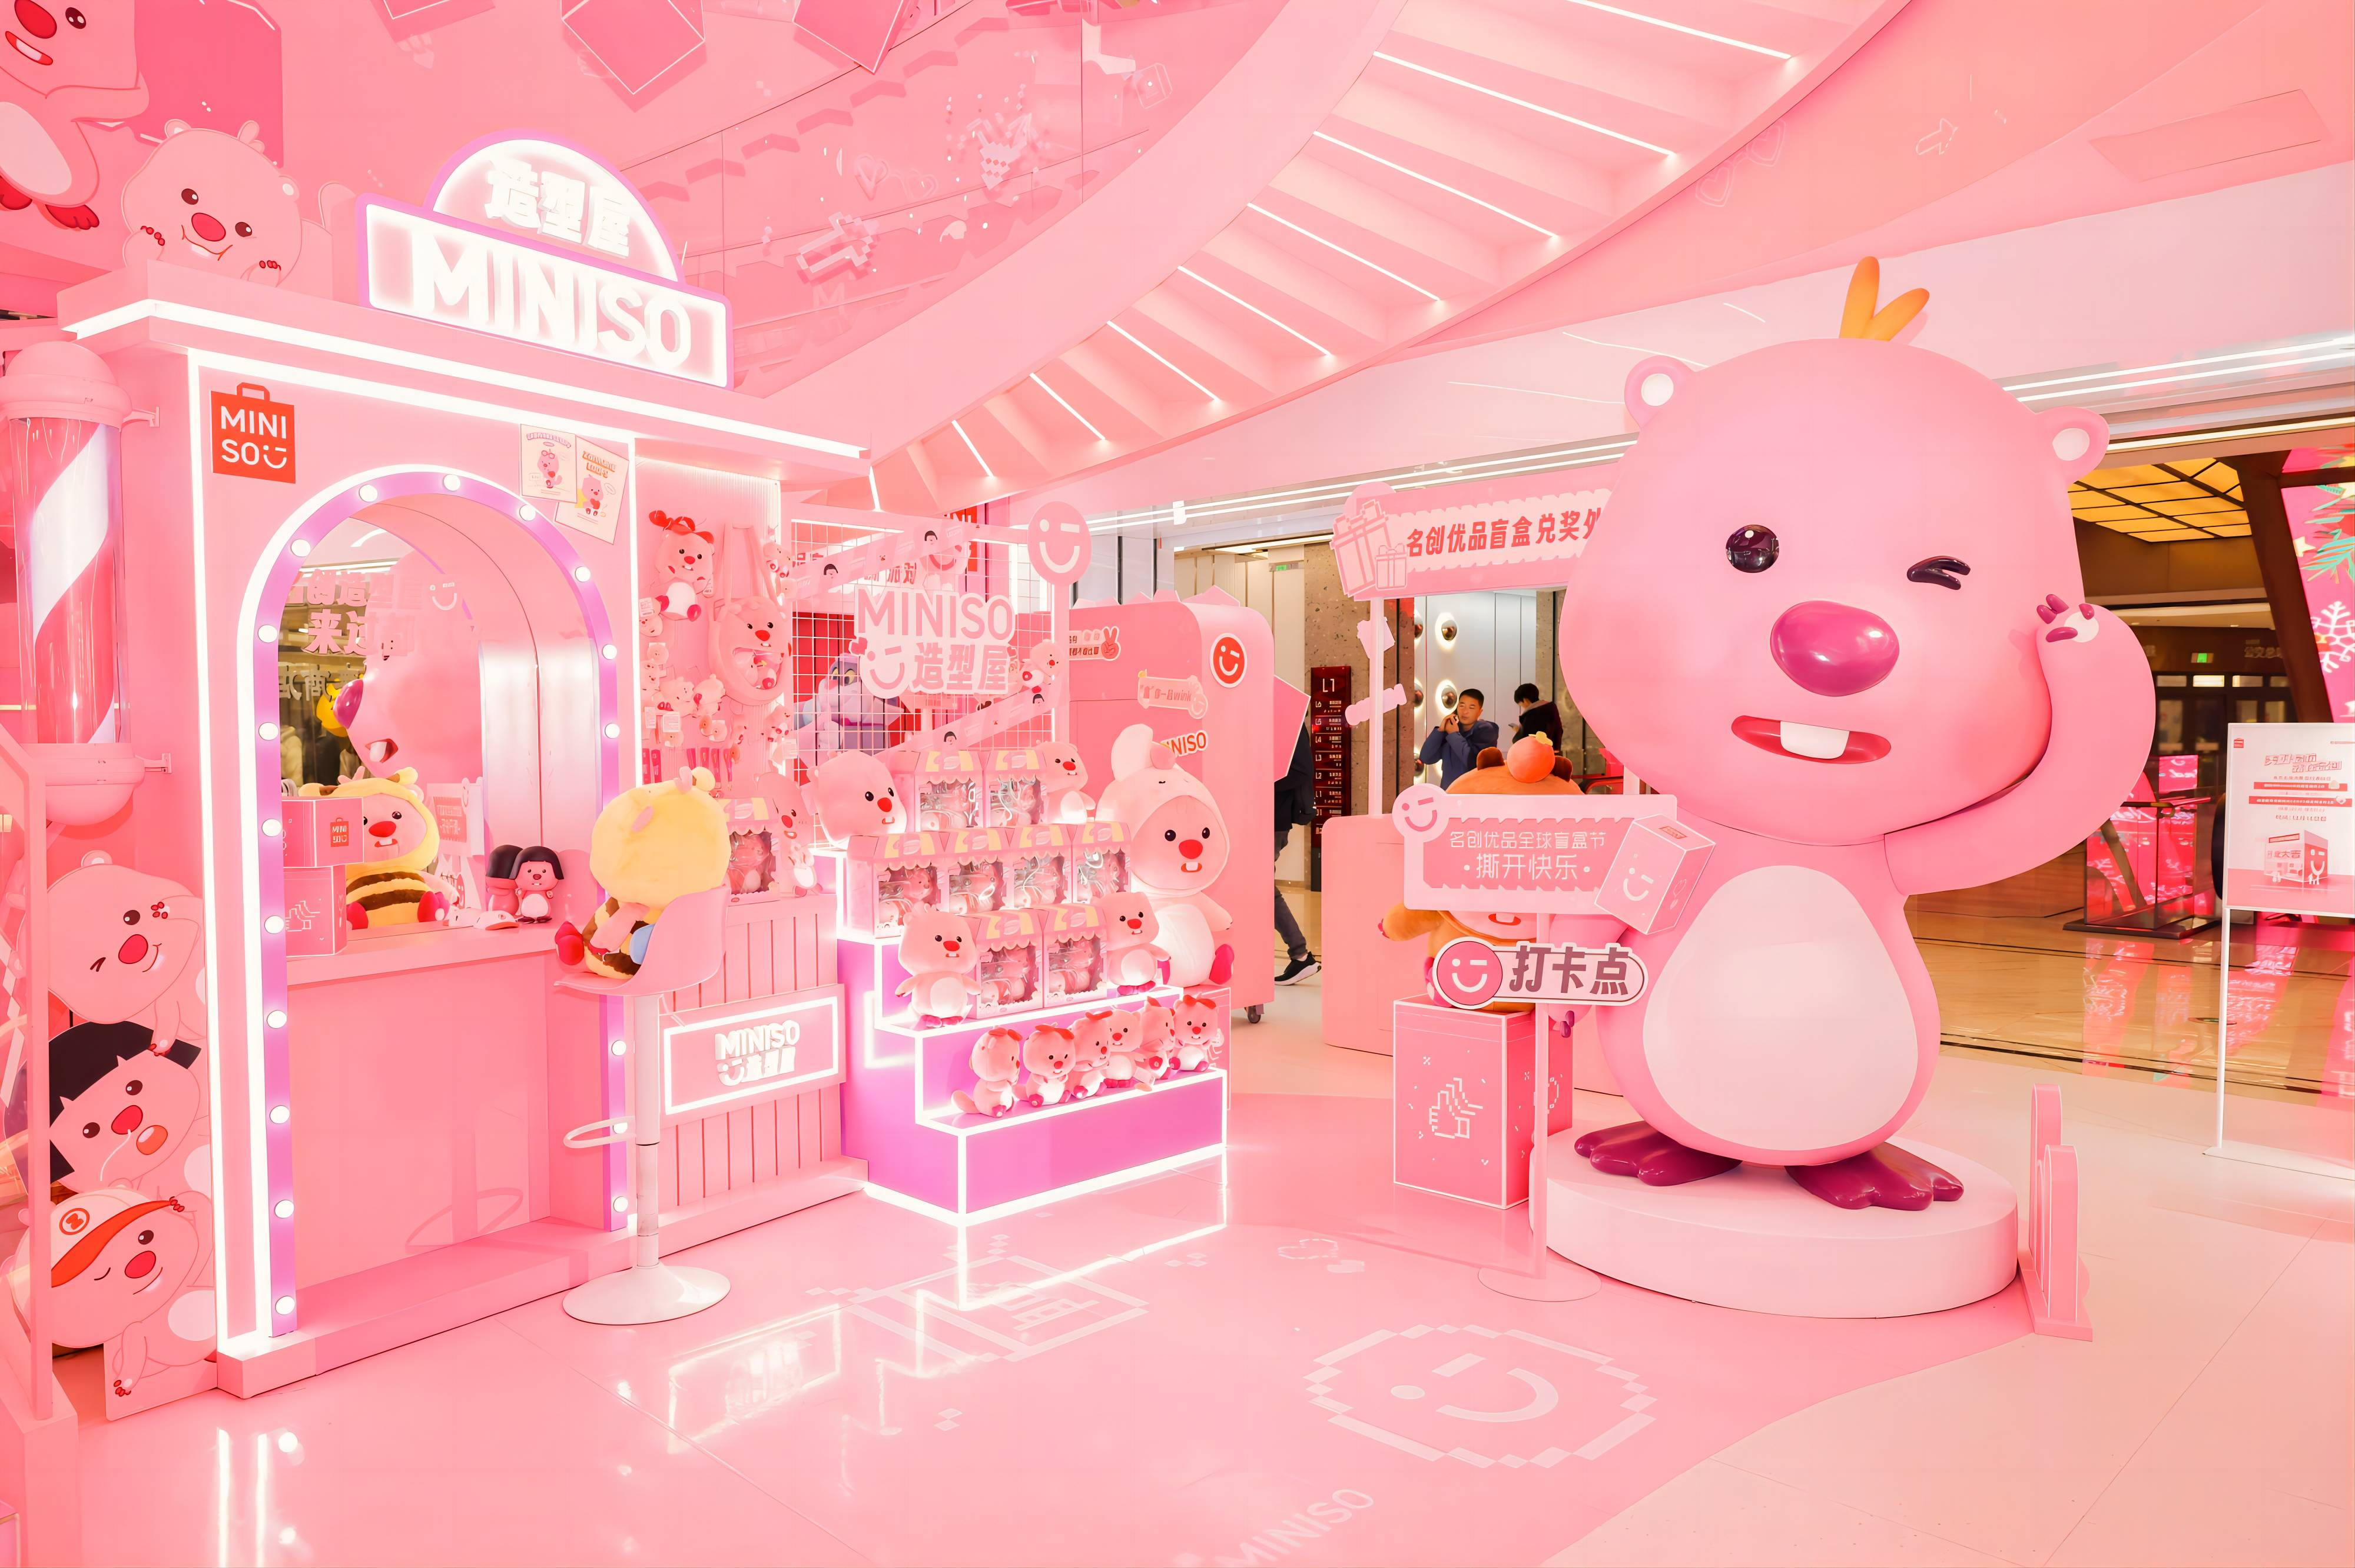
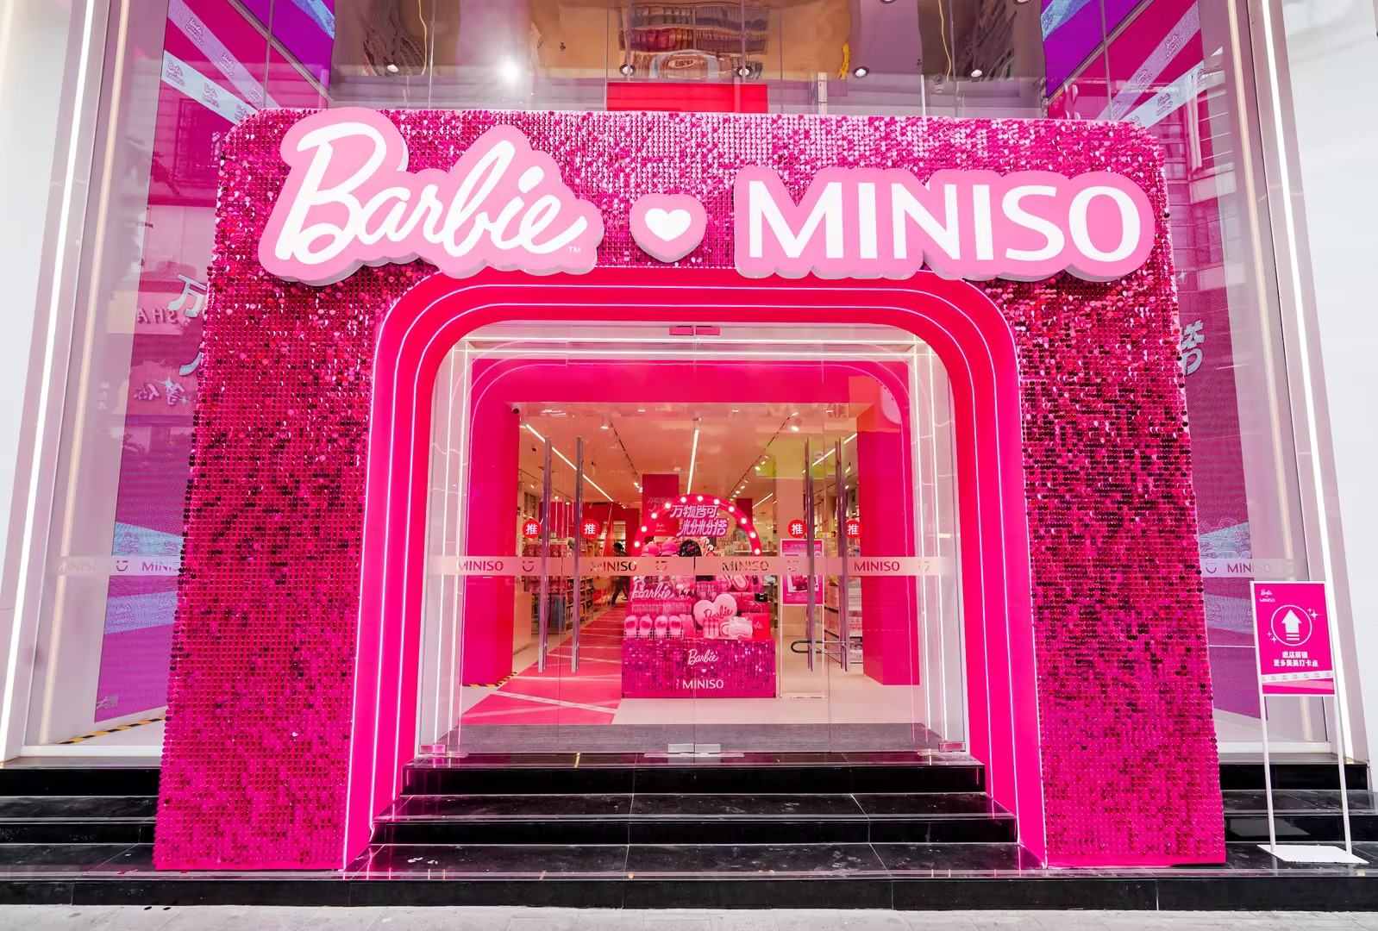
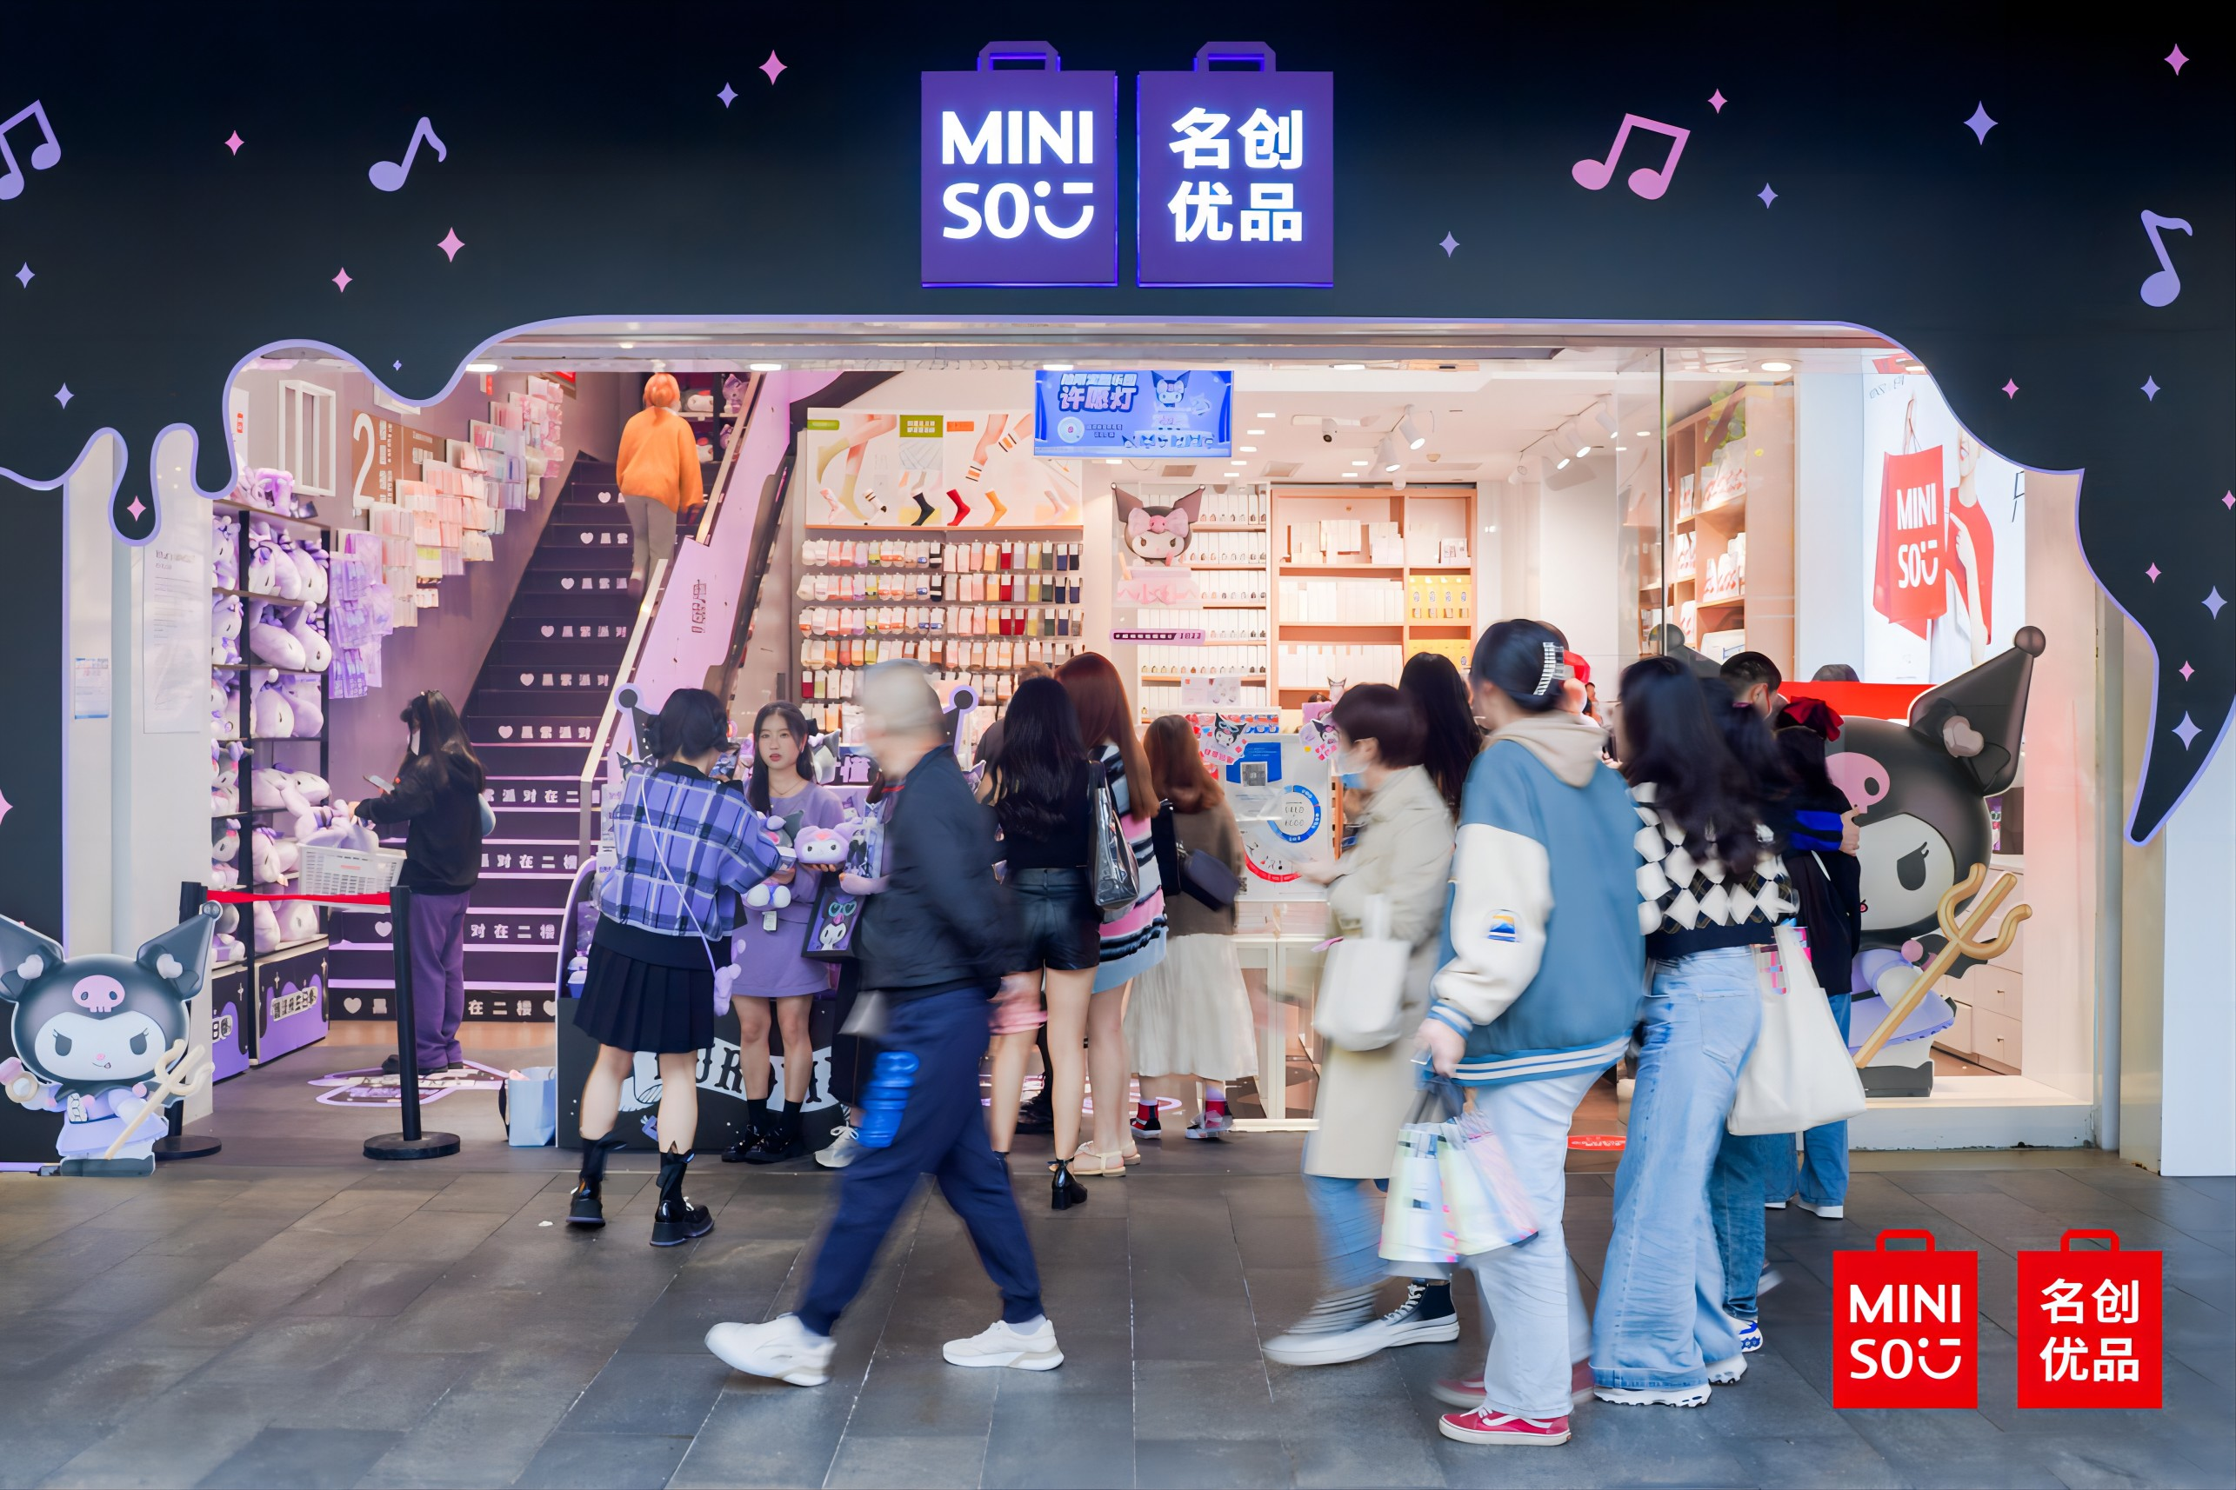
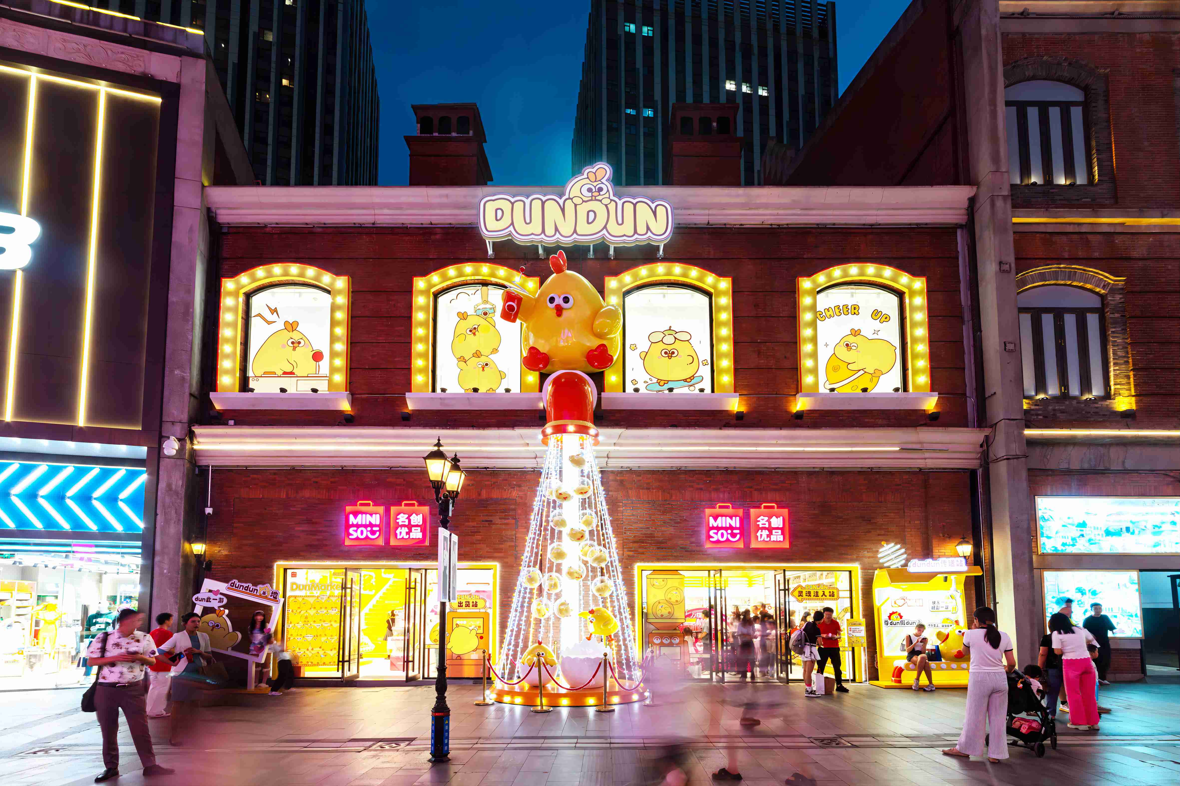
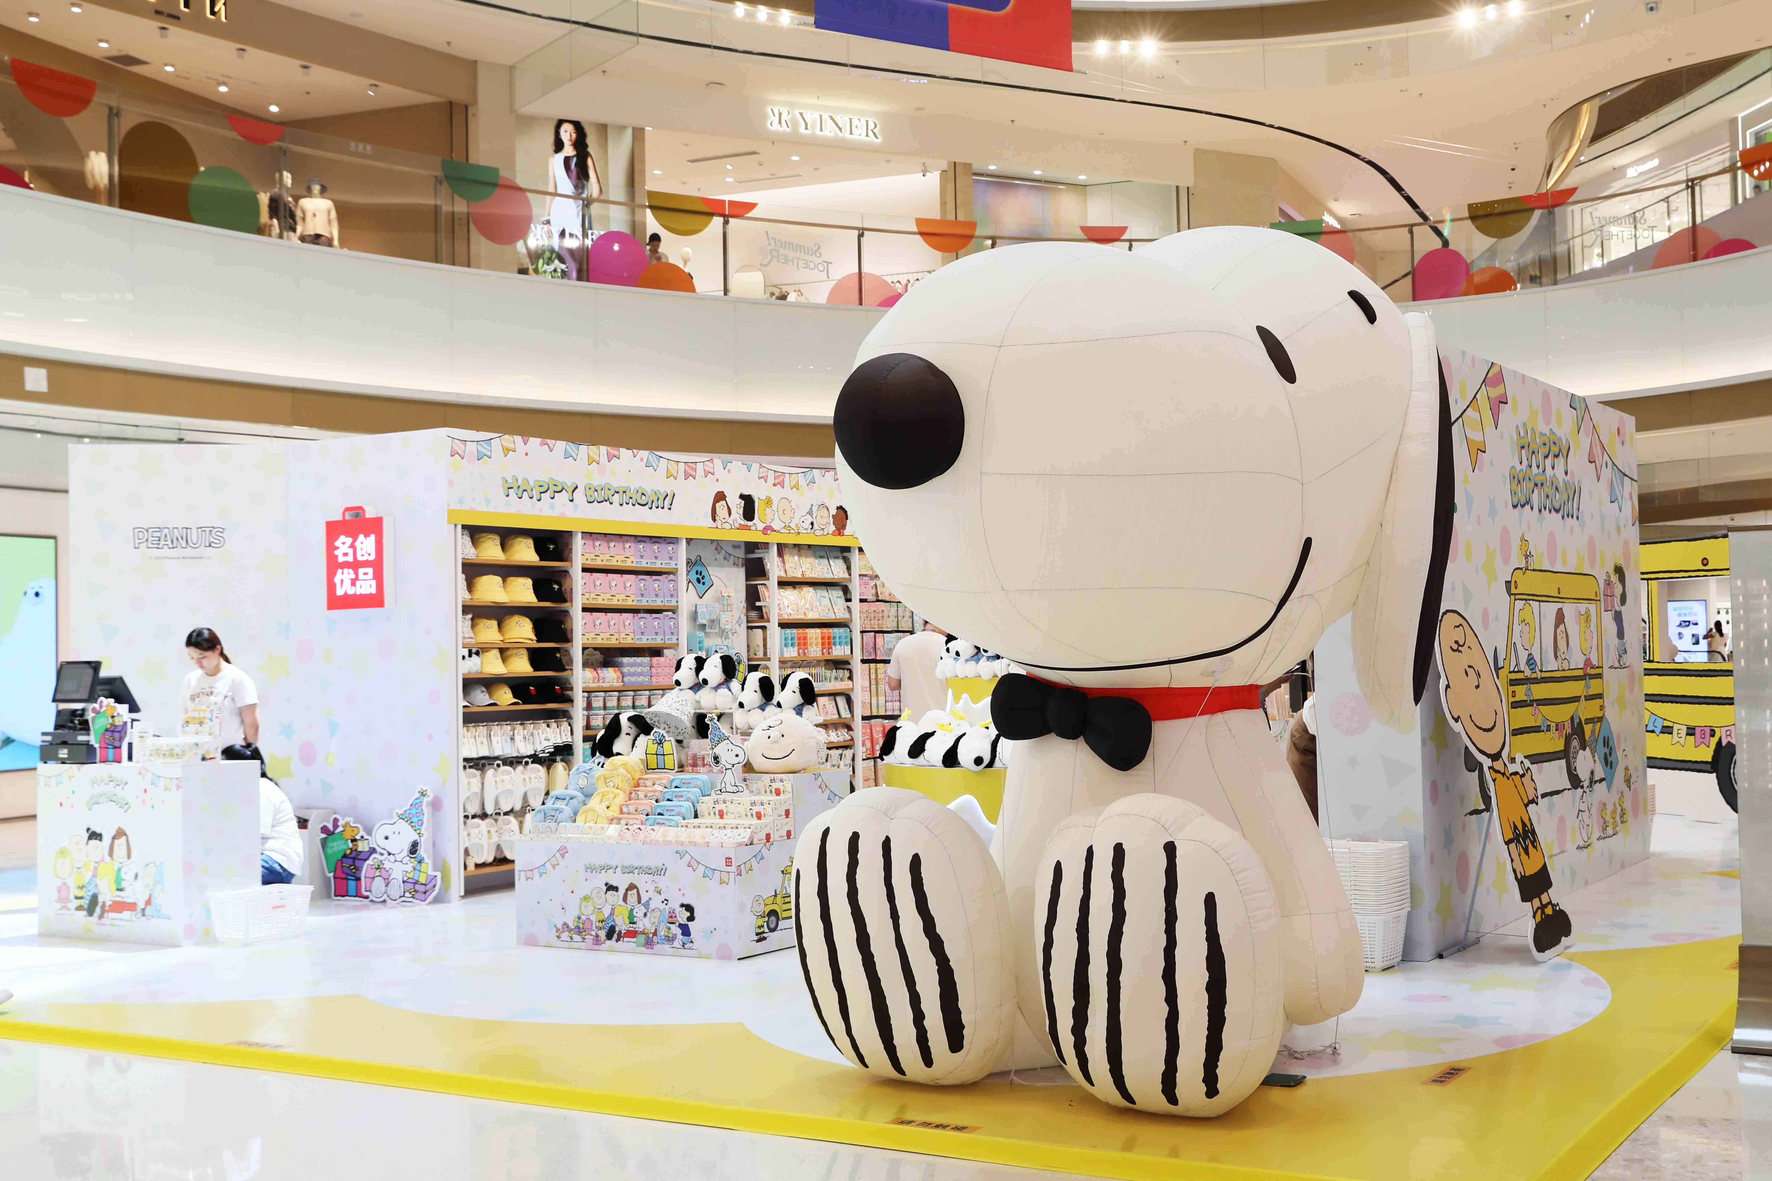
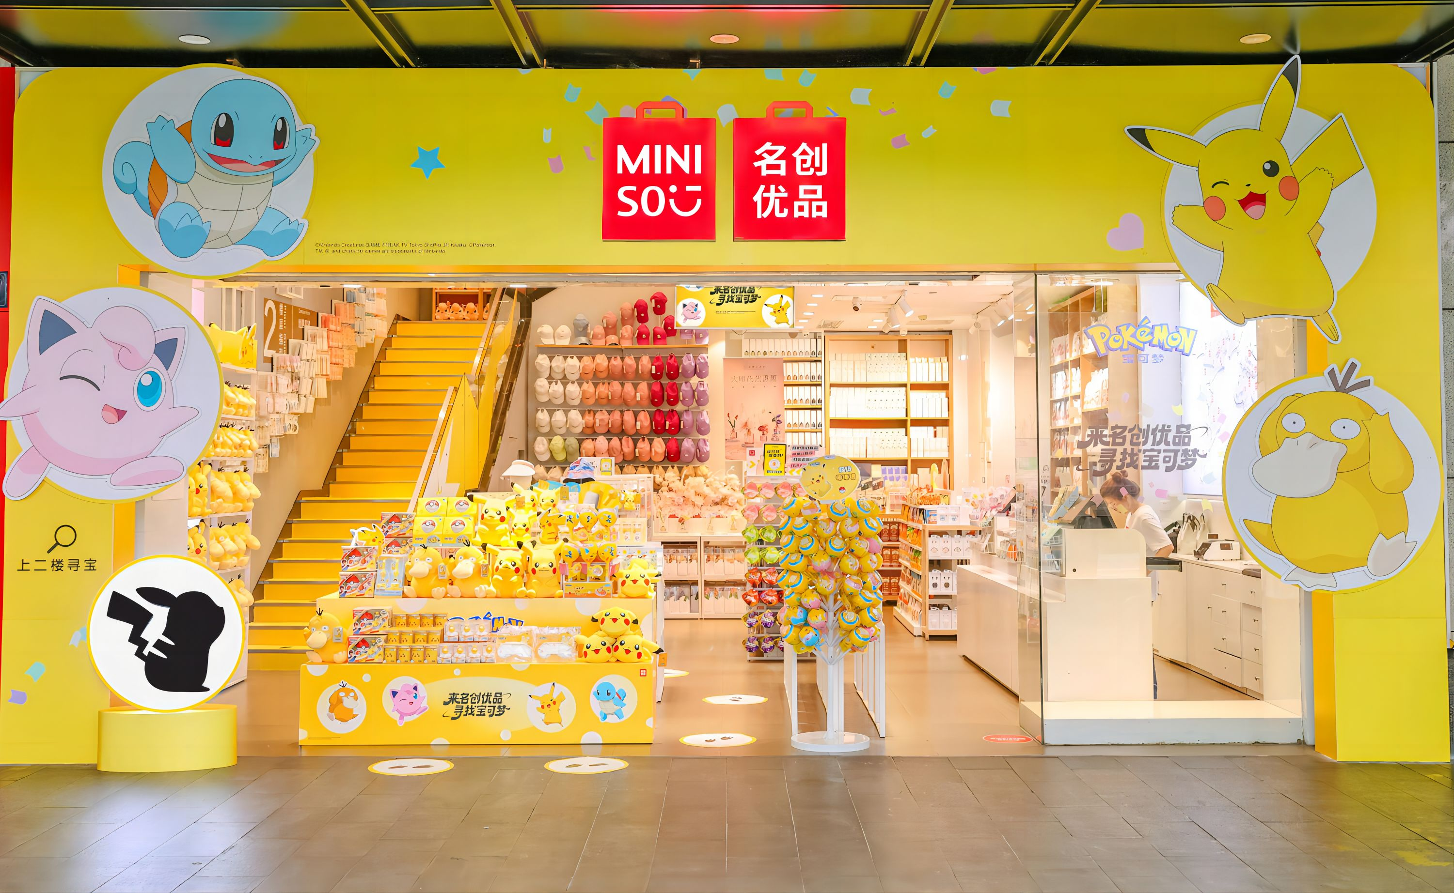
1.1 Company Description
Countries/Regions
Worldwide Stores
Member Users
Consumption
Cumulative Private Domain Users
7186 (MINISO)
234 (TOP TOY)
111
100 Million⁺
1 Billion⁺
4000 W⁺
Design
The world's LARGEST private label general retailer.
Founded in 2009, the company specializes in the fashion retail industry, focusing on the business philosophy of “interest consumption of young customer groups” and product posi-tioning of “high value, high quality, high cost-effective”.
At present, the company has successfully incubated TWO lifestyle brands: MINISO and TOPTOY (trend sub-brands).
Produce
Delivery
Sale
Renowned IPs
Associate
with IPs
Retail Model that improves
“cost-efficiency-experience”
Fig 2.1. MINISO Core Business Framework.
Data Source: Topsperity Securities (2025.01.24)
4

Slide 5
1.2 Development Path
2015 – 2018
Growth Period
2022
2019
2009 – 2014
Start-up Period
On July 13, it was listed on the Hong Kong Stock Exchange under a dual listing model.
The number of stores exceeded 4,000, more than 1,600 overseas, and the layout of more than 70 cities and regions.
2015
2009
Launch of the globalization strategy. By the end of the year, there were more than 1,000 MINISO stores.
Founder GuoFu Ye establishes MINISO.
2013
2023
Opened the first MINISO store in Guangzhou, China.
2020
Listed on the NYSE.
Launched TOPTOY.
With more than 6,600 stores. Upgraded its global brand strategy and positioned itself as a “lifestyle store featuring IP design”.
2017
On-line JingDong, Tmall.
2021
2014
2018
More than 5,000 stores and access to more than 100 geographic markets.
In August, the number of overseas stores exceeded 1,000.
In September, received a ¥1 billion investment.
At the end of the year, there were more than 300 MINISO stores.
2019 – Now
Strategic Upgrade period.
Data Source: Topsperity Securities (2025.01.24)
5

Slide 6
02
IPO
OVERVIEW

Slide 7

IPO Overview
Items | Information
Method of IPO | Dual Primary Listing
Date of IPO | 2022.07.13
Size of IPO | The issue of 41 million shares (3.4% of the total share capital before the issue) at an issue price of HK$13.8 raised approximately HK$412.8 million.
IPO First Day Return | -3.04%
After ten years of rapid development, MINISO has become a new consumer retailer driven by design and R&D, with online and offline co-development.
Top 100
China Franchise
Chain Companies
Top 500
Chinese Companies
Funds Raised Will be Used for
1. Expansion and upgrading of store network.
3. Iteration of technological competence.
2. Optimization of supply chain core competence and product development,
4. Replenishment of liquidity.
5. Brand cultivation
Data Source: MINISO Prospectus (2022.06.30) & Soochow Securities (2022.07.18) & Topsperity Securities (2025.01.24)
7

Slide 8
03
Company
Analysis

Slide 9

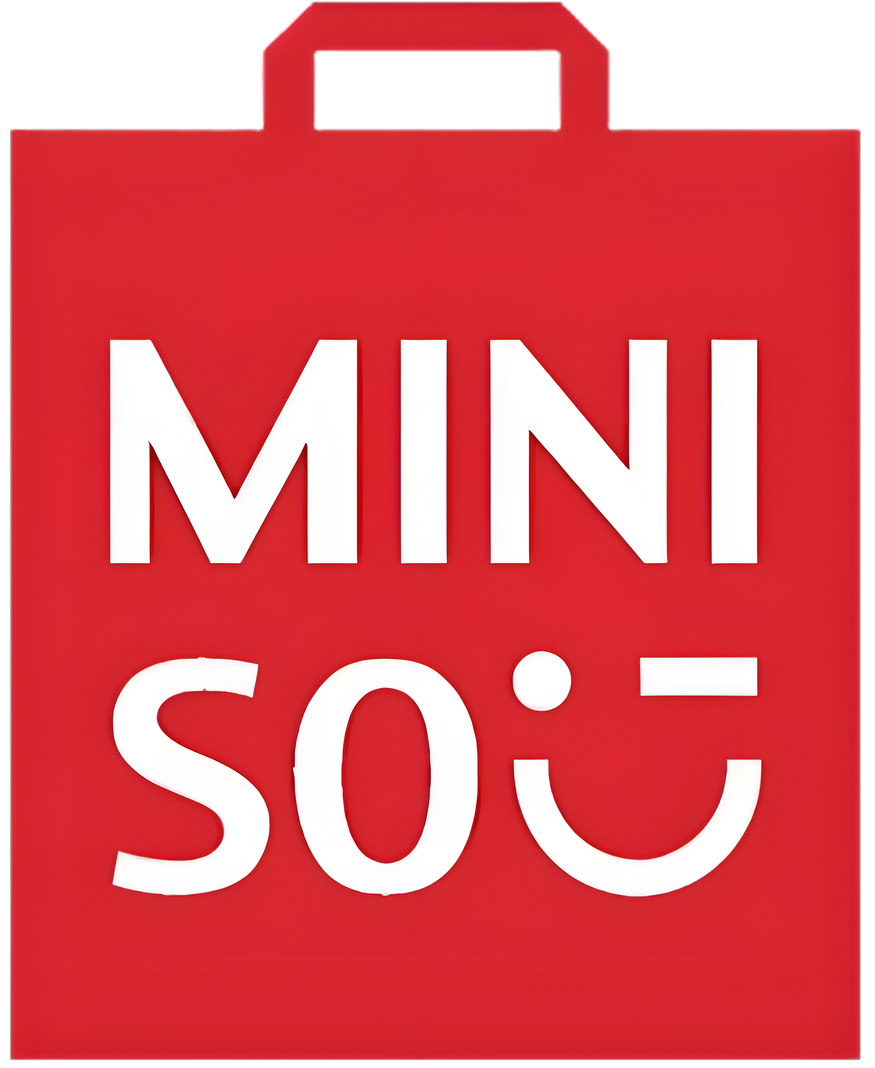

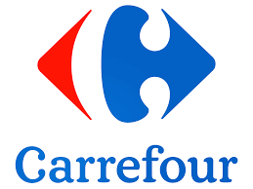

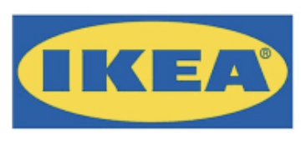
3.1 Industry Analysis: Home Lifestyle Retail
7.3% CAGR
Market of Home
Lifestyle Retail
Specialty Store
Private-brand
Supermarket
Fig 3.1 Market size of Home Lifestyle Retail in China(GMV)
Private-brand (MINISO): Refers to retailers that distribute various home lifestyle products, with > 50% of their total GMV derived from private label home and lifestyle products.
The Private-brand Retail Market Integrated Retail Space is Broad and Promising!
Fig 1.2 Market size of Private-brand in China(GMV)
Data Source: ???
9

Slide 10
Industry Analysis: Private-brand Retail
Global
Market Fragmentation: Global CR3 is 17.5% (2021), showing moderate consolidation.
Strategic Differentiation: Unlike competitors’ minimalist (MUJI) or ultra-low-cost (DAISO) positioning, focuses on "super IP" collaborations and lifestyle branding.
Domestic
Low Concentration: CR5 is just 18.6% (2021), reflecting intense competition.
MINISO’s Lead: Holds 11.4% share, doubling the next competitor. 1,000+ retailers generated ¥10.8B GMV (2021), with rapid growth potential.
Fig 1.3 Top 5 Global Private-brand Retail Companies by GMV (2021)
Fig 1.4 Top 5 Domestic Private-brand Retail Companies by GMV (2021)
10
This sector is competitive both domestically and globally, with MINISO leading in market share.

Slide 11
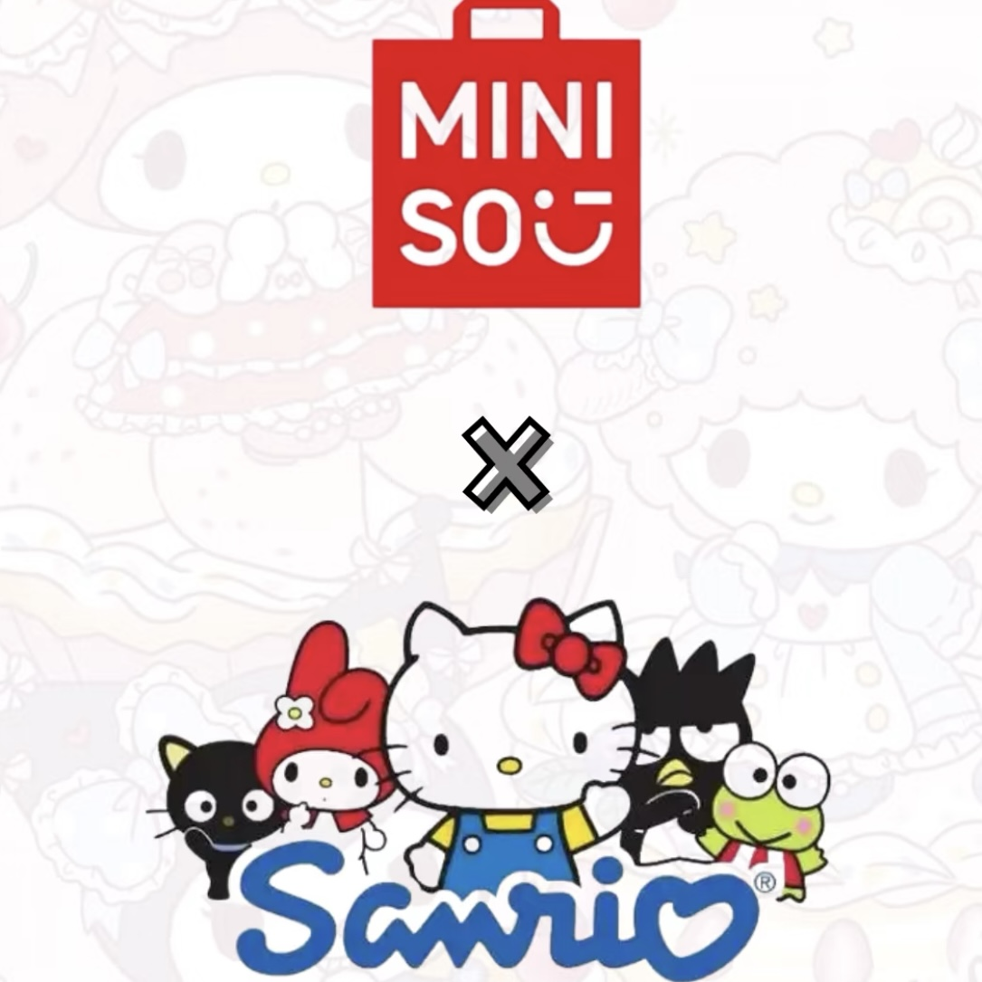
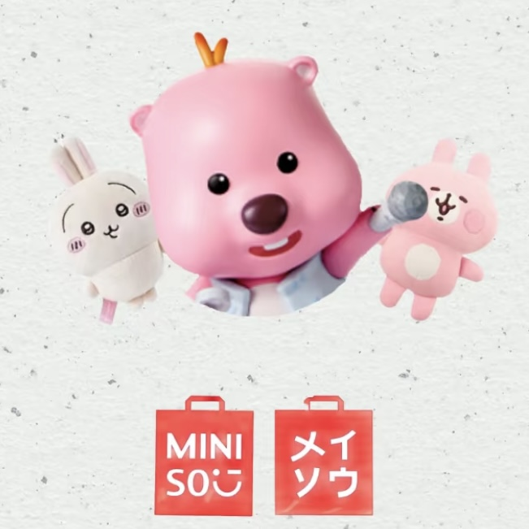
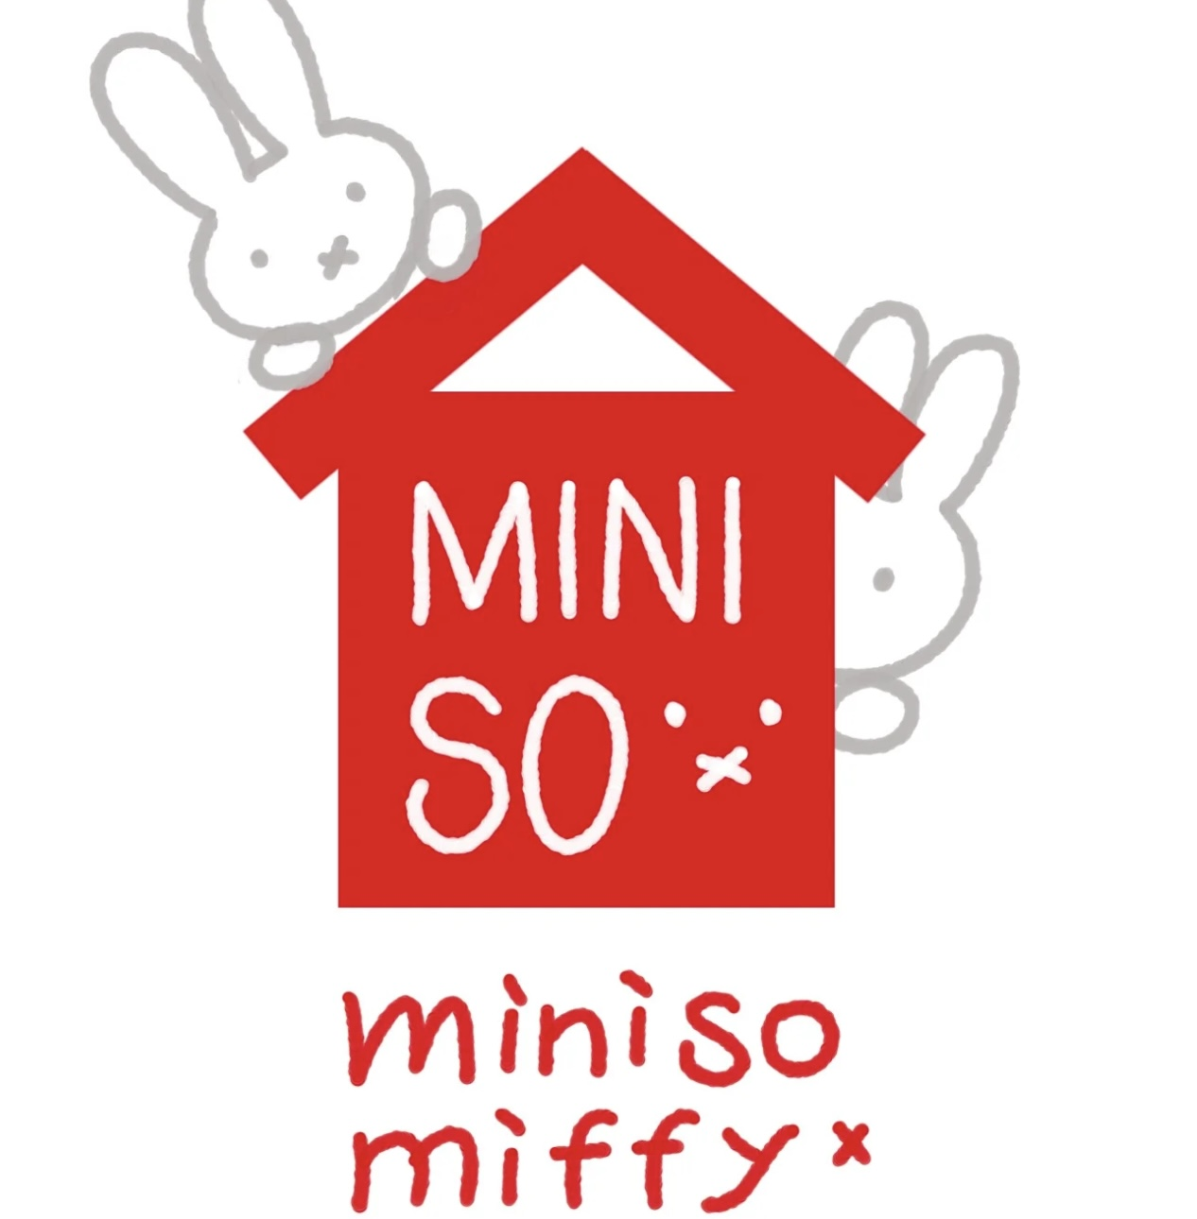



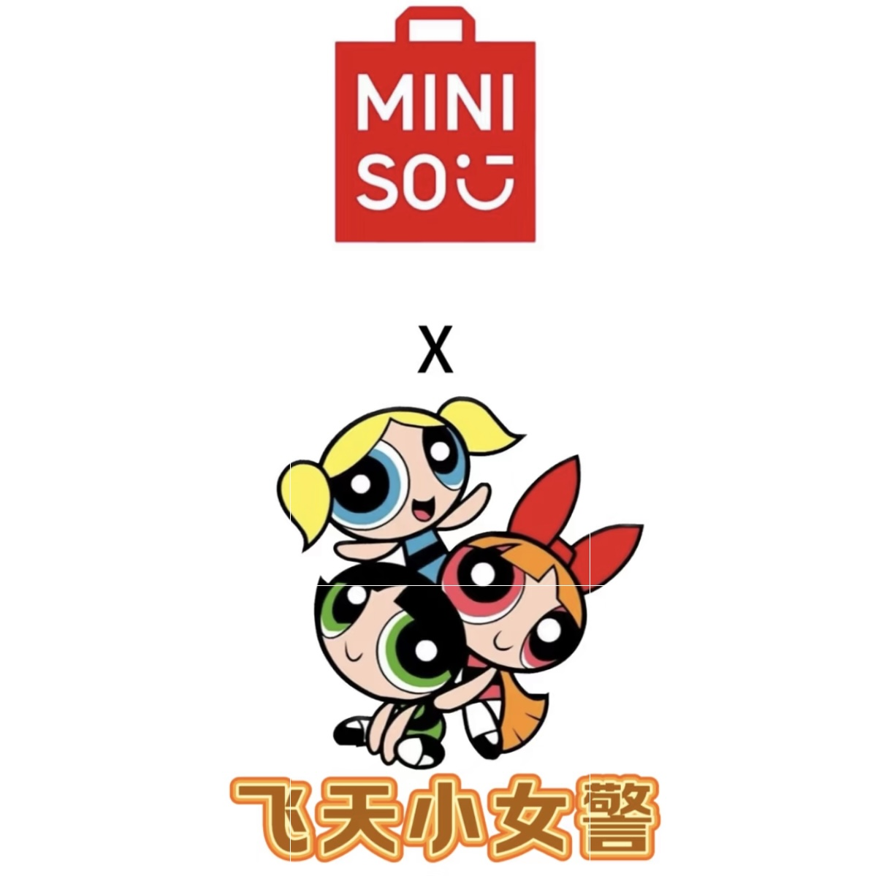
Industry Analysis: Trendy Toy
22.8% CAGR
Core Differences:
Global: Growth driven by premium IP ecosystem development and supply chain integration.
Domestic: Explosive growth in blind box, led by domestic innovation.
Fig 1.5 China’s Trendy Toy Market Size (GMV)
Fig 1.6 Global Trendy Toy Market Size by Retail Value
IPs collaborated with Trendy Toy
Data Source: ???
11

Slide 12
3.2 Business Analysis: Product-Driven
“711” Strategy
High Aesthetics
7
1
1
Launch approximately 100 new SKUs
A new cycle every 7 days
Three Highs
(Product Advantages)
High Frequency
High Quality
Selecting from 10,000 product ideas
Low Cost
Three Lows
(Operational Edge)
Low Price
Low Markup
Fig 1.8 MINISO SKU Number
Data Source: ???

Slide 13





Business Analysis: Product-Driven
Traditional Supply Chain
MINISO Supply Chain
Supplier
Direct supply from high-quality suppliers
Centralized negotiation with scale of over 5,300 stores, leveraging volume to reduce price
Supplier
Multi-level
Distribution
Smart stores achieve full digitalization.
High-frequency data communication with suppliers
Stores
Offline-to-private-domain traffic conversion
Promote O2O consumption loop
Private-domain users + platforms like Meituan and Ele.me
Consumer
Offline Consumers
Information asymmetry
High costs
Vertical Integration
Breaking Information Barriers
Reducing Costs and Improving Efficiency
Global Collaboration with High-Quality Suppliers(over 1,400 suppliers)
2. Bulk Procurement Enhances Bargaining Power(the procurement cost ratio from the top five suppliers decreased to 8.4%, while the largest supplier's share dropped to 1.9%.)
Fig 1.9 Procurement cost of Top 5 Suppliers

Slide 14


Business Analysis: Channel-Driven
Strategy: Light-Asset Franchise Expansion, Flexible Store Formats Adapting to Local Conditions with Flexible Layouts — Three Store Types Driving Growth Together
One-Stop, Strongly-Controlled Franchise System
Next-Day Revenue Sharing System
Next-Day Revenue Sharing System
Franchisee
Strongly-Controlled
Initial Investment & Daily Exp
Stores
Product Deposit System: one-time paid & no stock pressure
In FY2020, over 90% of MINISO's revenue came from franchisees and distributor channels.
Fig 1.10 Franchise/Distributor Channel Contributed of Total Revenue in FY2020
Fig 1.11 Stores Counted by Categories

Slide 15
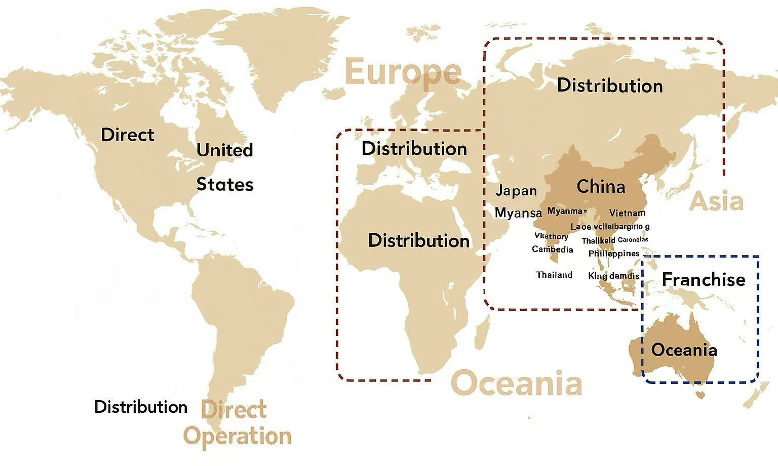
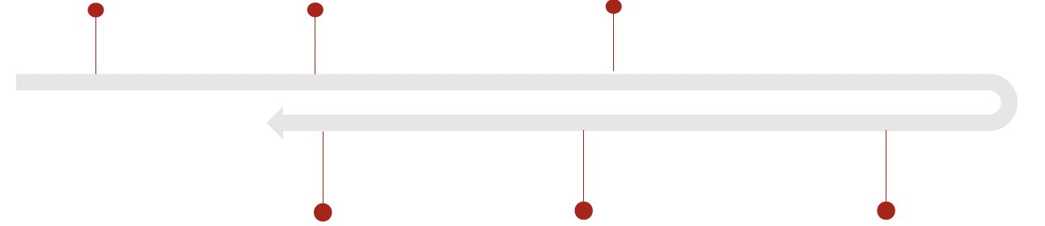
Business Analysis: Channel-Driven
Overseas Business Expansion
Localized Business Model
Conference
in Brazil
2018.4
Global forum
in Mexico
2019.6
M&O PARIS
Fall Exhibition
2019.6
2021.9
7 new stores in India
2021.9
'Flagship’
New York store
2020.8
MINISO first store
In European country
Fig 1.12 Numbers of Stores Counted by District
Fig 1.13 Revenue by Region (in millions yuan)

Slide 16
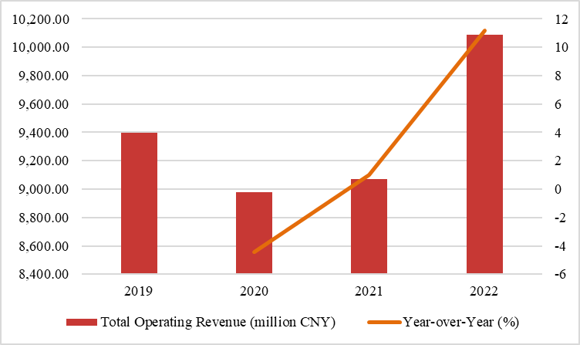
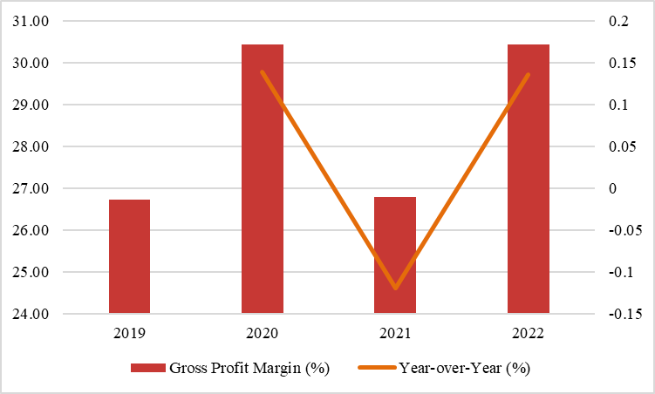
Financial Analysis
1. Due to the COVID-19 Pandemic, Revenue Remains Sluggish
MINISO's operating revenue experienced a significant decline during 2020–2021 as a result of the pandemic but saw a rebound in 2022.
The operating revenues from 2019 to 2022 were RMB 9.39 billion, 8.97 billion, 9.07 billion, and 10.08 billion, respectively.
2. Fluctuations in Gross Profit Margin Caused by Overseas Operations
The gross profit margins from 2019 to 2022 were 26.7%, 30.4%, 26.7%, and 30.4%, respectively, showing significant volatility overall.
The sharp fluctuations in gross profit margin are closely related to overseas market performance.
Gross margin in overseas markets > domestic market, changes in sales channels and the development of overseas operations have a considerable impact on overall gross profit margin.
Fig. Total Operating Revenue for Fiscal Years 2019–2022
 | 2019 | 2020 | 2021 | 2022
Gross Profit Margin in China (%) | 0.257 | 0.275 | 0.249 | 0.251
Overseas Gross Profit Margin (%) | 0.289 | 0.365 | 0.347 | 0.421
Fig. Gross Profit Margin for Fiscal Years 2019–2022
16
Data Source: MINISO Prospectus (2022.06.30) & Soochow Securities (2022.07.18) & Topsperity Securities (2025.01.24)

Slide 17
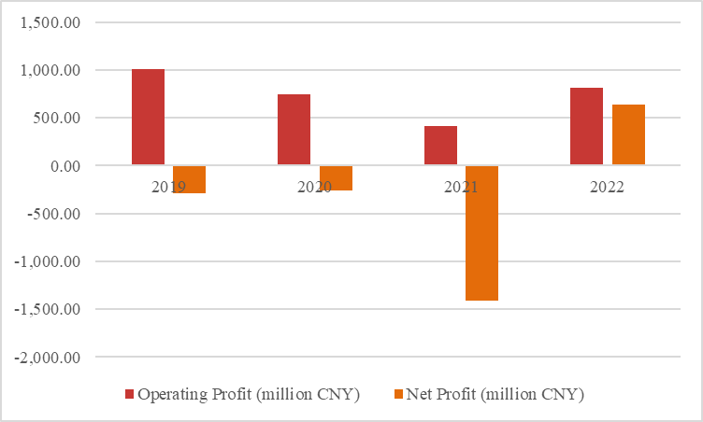
Financial Analysis
3. Operating Profit Declined Constantly, Net Loss Expanded Sharply
From 2019 to 2021, MINISO's operating profit declined for three consecutive years, amounting to RMB 10.09 billion, 7.45 billion, and 4.13 billion, respectively.
At the same time, net losses expanded significantly, reaching RMB -2.90 billion, -2.62 billion, and -14.15 billion, respectively.
Despite relatively stable revenue, rising costs and growing expenses placed significant pressure on profitability.
Fig. Operating Profit for Fiscal Years 2019–2022
4. Sufficient Cash Flow and Short Turnover Days
From 2019 to 2022, MINISO's cash and cash equivalents were 1.5, 2.8, 6.7, and 5.3 billion RMB, indicating ample liquidity.
The inventory turnover days from 2019 to 2022 were 63, 78, 78, and 69 days, respectively.
Due to the company's focus on fast-moving consumer goods and the supply chain advantage of placing most of its inventory on store shelves rather than in warehouses, the company has relatively short turnover days.
Tab. Main financial indicators for Fiscal Years 2019–2022
 | 2019 | 2020 | 2021 | 2022
Debt to Assets Ratio | 102.2 | 105.5 | 37.9 | 37.7
Current Assets / Total Assets | 86.3 | 85.4 | 85.9 | 71.6
Current Liabilities / Total Liabilities | 60.8 | 53.7 | 85.9 | 89.1
Current Ratio | 1.4 | 1.5 | 2.6 | 2.1
Operating Cycle | 104.2 | 92.8 | 92.4 | 82.3
Inventory Turnover Days | 62.7 | 77.9 | 78.4 | 68.9
Accounts Payable Turnover Days |  | 32.3 | 30.7 | 33.2
Total Asset Turnover Ratio | 2.1 | 1.6 | 1.1 | 0.9

Slide 18
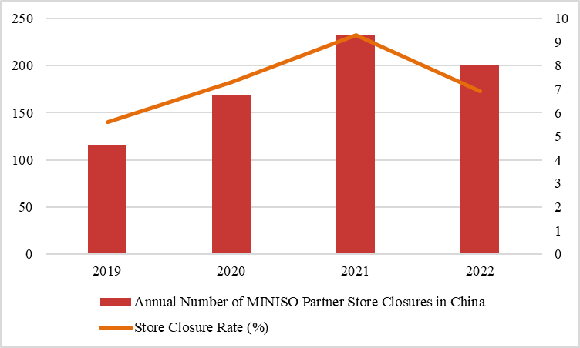
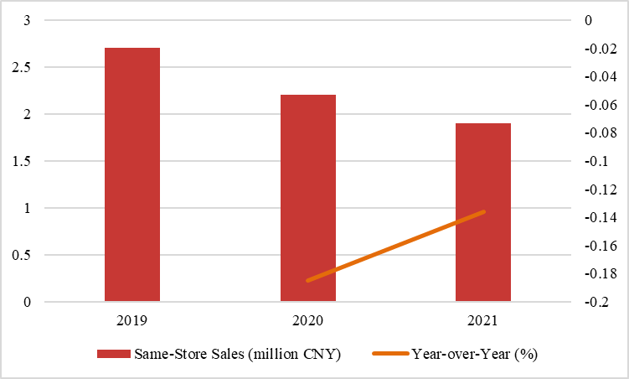
Financial Analysis
Analysis 1: As of June 30, 2022, the company's overall business performance has somewhat recovered, but the long-term impacts of the pandemic, including store closures, decreased passenger flow, and obstacles in overseas markets, continue to significantly limit MINISO's further expansion.
The number of store closures peaked at 233 in 2021, and although it decreased in 2022, it still remained higher than pre-pandemic levels.
Over 90% of MINISO's revenue comes from offline sales. From the 2019 to 2021, MINISO’s same-store sales were 2.7 million, 2.2 million, and 1.9 million RMB, respectively, showing a noticeable downward trend.
Fig. Annual Number of MINISO Partner Store Closure in China for Fiscal Years 2019–2022
Fig. Same-Store Sales for Fiscal Years 2019–2022
Data Source: ???

Slide 19
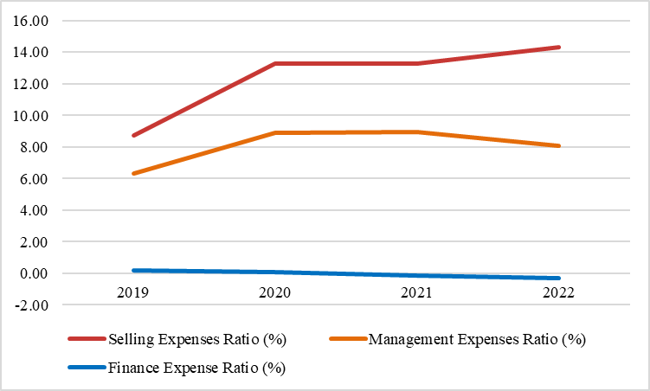
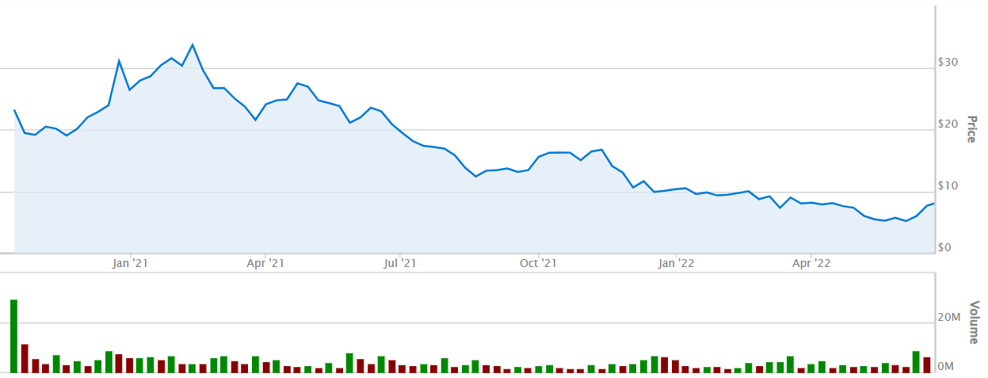
Financial Analysis
Analysis 2: Due to investments in fixed costs, brand collaborations, product licensing, and marketing promotions, both selling and administrative expenses have increased year by year.
It is strategically important for long-term brand enhancement and market expansion.
At the same time it adds short-term cost pressure, thereby squeezing operating profit and indirectly creating a need for the company to further scale up to dilute costs.
Fig. Expenses for Fiscal Years 2019–2022
Fig. Miniso's U.S. stock price (2020.10 – 2022.06)
Analysis 3: In May 2022, the U.S. Securities and Exchange Commission (SEC) identified several U.S.-listed Chinese companies as facing delisting risks. Although MINISO is not on the delisting list, the company has been actively pursuing a dual primary listing as a proactive measure to mitigate potential delisting risks in the U.S., while also aiming to improve stock liquidity and address related issues.
Data Source: ???

Slide 20


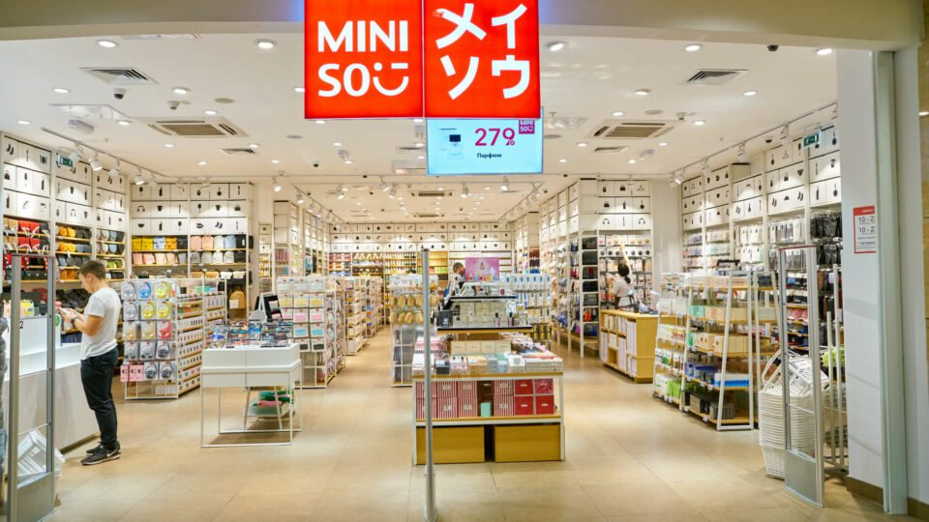



Financial Analysis
Due to the impact of the pandemic, sluggish revenue growth, rising costs and expenses, and consecutive losses have become major challenges for MINISO.
Externally, the company’s underperformance in the U.S. stock market, coupled with the looming threat from the SEC, has undoubtedly increased risks and uncertainties.
With declining revenue per store, MINISO will have to rely on store expansion to "grow the pie.“
To support its strategic goals of "expanding and upgrading its domestic and international store network," "enhancing product development and supply chain capabilities," and "strengthening technological capabilities," MINISO needs additional capital to cope with rising costs and better support its expansion plans.
Therefore, pursuing a listing in Hong Kong has become not only a reasonable but also a necessary step.
Declining
Performance
Rising
Costs
Customer
Attrition
External
Risks
COVID-19

Slide 21
04
Valuation

Slide 22
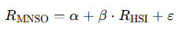


CAPM: Cost of Equity
Regression
CAPM
📌 Definition: Beta (β) represents how much a stock's return tends to move relative to the return of the overall market.
We used linear regression to estimate Miniso’s beta relative to the Hang Seng Index, by using daily returns over the period of Miniso’s initial IPO in the US.
Variable
Risk Free Rate $r_{f}$ | US 10 Year Yield (2022): 2.95%
Expected Return$E(r_{m})$ | Hang Seng Index
Beta β | 0.924
Time Span | 2020.10.15 (IPO in U.S.) - 2022.06.30
After finding the Beta (β), we can use the CAPM formula to find the Cost of Equity
Using CAPM: $E(r_{e})=r_{f}+β_{e} × (E(r_{m}) − r_{f} )$
We arrive at Cost of Capital, $E(r_{e})=$ 9.91%.
α = -0.0012 , β = 0.924

Slide 23






Cost of capital: Cost of debt $r_{d}$ & WACC
Variable
Short-term Debt | 258.4
Long-term Debt | 399.6
Debt (with interest) | 658.013
Equity | 7027.4
Preferred equity | 0
Effective tax rate | 29.5%
Mid-term Bond Rate | 1.5%
Bond Rate | 1.7%
Debt Ratio Adjustment Factor | 1.38
Assumption: After 2022, the company is no longer affected by the pandemic, and its capital structure (debt/equity ratio) and risk profile remain stable.
Recall: Cost of equity $r_{e}$
Based on regression:$β_{e}=9.24\%$
→$r_{e}=9.91\%$
$$WACC=r_{d}×\left(1−τ\right)×\frac{D_{i}}{D_{i}+E}+r_{e}×\frac{E}{D_{i}+E}$$
Note: Millions of CNY per share/unit
Calculate the cost of debt $r_{d}$
using the method provided by Bloomberg:
WACC = 9.21%
$$r_{d}=\left(r_{m}×\frac{S}{S+L}+r_{L}×\frac{L}{S+L}\right)×f=2.23\%$$
Based on the assumptions, the WACC in 2022 is used as the valuation parameter for subsequent periods.
WACC in 2021 = 9.0%.
Source: Bloomberg

Slide 24






Conclusion: 风险评估
Question：Why?
Comprehensive Assessment：Low Bankruptcy Risk:
Unlikely in the near term if strategies are executed and inventory well managed.
With a deliberate reduction in inventory proportion, the company maintains resilience even if the pandemic persists long-term or consumer recovery falls short of expectations.
Current ratio = 2.56
I.A.R = 15%
Financial and Operational Risks
Short-term risks are manageable, but vigilance is required against liquidity risks.
Current ratio >1.5, well above the bankruptcy warning threshold (typically <1.0 signals danger).
2022
Current ratio 2.1
This reflects the company's shift from a "conservative defense" stance to "proactive expansion", while still maintaining a safety margin.
2021
I.A.R means Inventory to Current Assets Ratio
2020
Current ratio 2.6
The company demonstrates extremely strong short-term solvency
FUTHER
2019
Current ratio 1.5
During the pandemic, the retail industry generally encountered liquidity pressures, but a 1.5% demonstrates preliminary risk resilience.
Aggressive Expansion
Current ratio 1.4
Brand positioning controversy declining single store revenue, and adaptability issues in sinking markets
Facing Challenges
Conservative Defense
If it continues to be affected by the epidemic
Current Ratio = 1.67
I.A.R = 21.4%
Even amid persistent declines, with current assets plummeting and liabilities rising, the company maintains a robust defensive position with a ratio still above 1.5.
Impact of the Pandemic
Declining Revenue
TOP TOY
Intensifying competition
Frequent incidents Strategic adjustment
1. Domestic MINISO continues to expand into lower-tier markets;
2. Brand globalization with a high-quality supply chain;
3. TOP TOY is in a rapid expansion phase
Measures for shocks

Slide 25




Revenue forecast：FCF forecast
Method 1: Estimate EBIT margin by using Revenue CAGR
Based on post-pandemic recovery assump-tions, historical data, and multi-source analysis, the following conclusions are drawn:
Domestic market is projected to show gradual recovery starting from 2023, with moderate growth momentum.
International markets & TOP TOY will demonstrate accelerated revenue growth, driven by:
Post-crisis rebound
Store network expansion
Brand premiumization
Emerging market penetration
Growth rates are expected to peak in 2024 before stabilizing at sustainable levels.
year | 2023 | 2024 | 2025 | 2026 | 2027
Domestic Revenue Growth Rate | 10% | 12% | 12% | 12% | 12%
International Revenue Growth Rate | 35% | 40% | 38% | 35% | 35%
TOP TOY Revenue Growth Rate | 35% | 45% | 40% | 35% | 35%
$$FCF=EBIT×\left(1−TaxRate\right)+Depreciation$$
$$−CapEx−∆Working Capital$$
 | 2022A | 2023E | 2024E | 2025E | 2026E | 2027E
CFO | 1514.40 | 1441.55 | 2330.38 | 2897.84 | 3461.18 | 4118.78
Net Profit | 704.51 | 1111.34 | 1559.03 | 2157.89 | 2632.83 | 3240.36
D&A | 389.87 | 365.14 | 344.87 | 331.19 | 320.51 | 308.96
Changes in Non-Cash Working Capital | -420.03 | 34.93 | -426.48 | -408.76 | -507.83 | -569.46
CapEx | -1234.21 | -175.79 | -215.39 | -227.10 | -206.09 | -216.19
FCF | 280.19 | 1265.76 | 2114.98 | 2670.74 | 3255.09 | 3902.58
Method 2: Estimate FCF by FCF’s CAGR
Alternative Methodology: Estimate FCF's CAGR from 2022 to 2027 under defined assumptions to derive future FCF projections.
year | 2023 | 2024 | 2025 | 2026 | 2027
Estimated FCF | 1280.48 | 1462.31 | 1669.96 | 1907.09 | 2177.90

Slide 26
DCF Valuation
📌 Key Assumptions
Miniso will recover from Covid-19 shocks, and grow at forecasted rates.
Covid-19 supply chain and lockdown policies reflected heavily in 2022 FCF data.
We will create a normalized FCF for the base year by using 2021 CAGR.
Two valuations for estimated range.
Conservative Valuation: Prospectus Est. CAGR
Optimistic Approach: Forecasted FCF
Year | Estimated FCF
2023 | 1280.48
2024 | 1462.309
2025 | 1669.956
2026 | 1907.09
2027 | 2177.897
2028 (n+1) | 2487.158
Year | Estimated FCF
2023 | 1265.764
2024 | 2114.984
2025 | 2670.744
2026 | 3255.089
2027 | 3902.583
2028 (n+1) | 4456.749
NPV of FCF | 6425.062
Terminal value | 40115.46
Perpetual growth rate | 3.00%
PV of terminal value | 25834.41
Enterprise value | 32658.3
Net Debt | -4901
Equity value | 27757.3
Shares Outstanding | 1266.67
Per Share Value | 21.91
NPV of FCF | 6425.062
Terminal value | 71883.1
Perpetual growth rate | 3.00%
PV of terminal value | 42392.7
Enterprise value | 52577.6
Net Debt | -4901
Equity value | 47676.6
Shares Outstanding | 1266.67
Per Share Value | 37.63
Baseline FCF Calculation
Year | Miniso FCF | CAGR
2020 | 901.58 | --
2021 | 981.84 | 8.9%
2022 | 398.83 | -59.3%
CAGR was -59.3% in 2022, this data cannot be used to estimate base year FCF.
Prospectus CAGR: 14.2%
981.84*(1+14.2%) = 1121.26 (2022 FCF)

Slide 27
Relative Valuation
Compared with discount retailers in America and Japan.
Main Comparison Ratios: EV/EBITDA, P/E Ratio, P/S Ratio (Price to Sales)
Observed mean of ratios and compared to Miniso multiples.
Company | EV (USD) | EBITDA (USD) | EV/EBITDA | Revenue (USD) | P/S | Net Income | P/E
Muji (TSE: 7453) | 2.62B | 442.8M | 5.92 | 3.91B | 0.69 | 194M | 13.98
Dollar Tree (DLTR) | 43.18B | 3.04B | 11.99 | 28.33B | 1.19 | 1.62B | 20.86
Dollar General (DR) | 68.9B | 4.06B | 14.36 | 37.84B | 1.36 | 2.42B | 21.36
Five Under (FIVE) | 11.98B | 461.36M | 22.72 | 3.08B | 3.54 | 261.53M | 41.61
Miniso (MNSO) | 1.65B | 182.07M | 8.52 | 1.56B | 1.55 | 98.86M | 24.5
 | Mean | Miniso
P/E | 24.462 | 24.5
EV/EBITDA | 12.702 | 8.52
P/SALES | 1.666 | 1.55
Miniso’s valuations are average, with EV/EBITDA being undervalued.
What is the investment thesis?
High growth potential in TOPTOY and overseas expansion.
Our estimates, and Prospectus CAGR for TOPTOY are both 35-40% YoY.
Assuming Covid-19 restrictions for overseas stores are less restrictive in the future, overseas operations CAGR is estimated at ~35%
High growth rates in these parts of Miniso’s operations can justify a higher premium: P/E Ratio

Slide 28
Valuation Conclusion
Valuation Method
Predicted Price
Assumptions
DCF
Lower Bound
Upper Bound
21.9
37.6
P/S
7.16
36.4
P/E
12.2
36.7
EV/EBITDA
7.37
30.5
IPO Price
Comparing valuation methods to find reasonable price range.
IPO price of $13.20, stock downside is low, while upside is large.
Predicted Stock Range 12.17 – 35.23

Slide 29

Predicted Price Range vs. Actual Price
Actual stock performance from IPO (July 13, 2022) to current price.
First ~10 weeks, price is at the lower bounds.
After, price rises and converges to the upper bound for 20 weeks.
Miniso (9896HK) converges to the upper bound 5 times from the IPO date to the present.
More than 60% of the time, price is within our estimated bounds. Very accurate!
Ticker 9896 (HKEX)
20 weeks
20 weeks

Slide 30
05
Extension

Slide 31
Quantitive profit method extension
Construct factors based on History data form NYSE
The NYSE is the world’s largest trading market and offers valuable insights for HKEX.
Feasibility: The same company, the same set of financial reports and business logic
Technical Index
Bollinger Bands
EMA
ATR
Volatility
MACD
Model
Random Forest
Transformer
Recurrent Neural Network
History data from NYSE
Expected Result
Short-term return: 5%-10%
Medium to long-term return: 10%-20%
Influencing factors: The effectiveness of technical indicators, data noise

Slide 32
Quantitive profit method extension
Use data from related stocks for prediction.
Feasibility: Data is accessible, and the prices of highly correlated stocks exhibit strong correlation.
Select highly correlated stock
consumer goods
retail
trendy toy
Features
Momentum
Valuation
Alpha101
Alpha191
Model
Random Forest
Transformer
Recurrent Neural Network
History data from NYSE&other EX
Expected Result
Short-term return: 5%-10%
Medium to long-term return: 10%-20%
Influencing factors: Stability of stock correlations, effectiveness of factor selection, and quality of model training.

Slide 33
9896.HK
MINISO
LIFE IS FOR FUN
April 17th, 2025
Group 3: Kai Ren, Gary Li, Rui Hu, Yang Lan, YiMing Jiang, WeiJie Zhang

